Slide 1
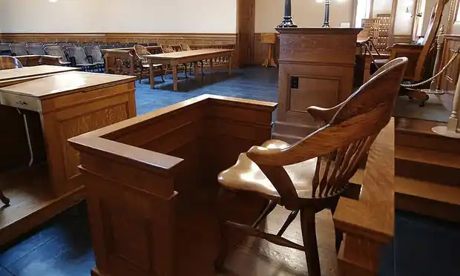
The Untrue History of Unsworn Statements
MAJ DanIEL F. Rendleman

Slide 2
“[The right to make an unsworn statement] has long been recognized by military custom. . . Moreover, it has generally been considered unrestricted.”
U.S. v. Rosato, 32 M.J. 93 (C.A.A.F. 1991)
“We shall not speculate as to why for decades military law has granted accused servicemembers the right to make an unsworn statement.”
U.S. v. Partyka, 30 M.J. 242 (C.A.A.F. 1990)

Slide 3
Criminal Trial Procedure in the 19th Century
Witness Testimony Generally
Congress Declares All Federal Criminal Defendants Competent to Testify
No Sworn Testimony by Interested Parties
1846
Michigan First Allows Interested Witnesses to Testify in Civil Trials
1878
Defense Counsel in Court-Martial
Defense Counsel Not Required, Cannot Speak
Rules Against Addressing Witnesses, Court Still Strictly Enforced
1895
1875
“Suitable Officers” Required to be Appointed, Counsel Can be Heard
Notes:
John Appleton is the Michigan Supreme Court Chief Justice, disciple of Bentham

Slide 4
So How Was the Defendant Putting Forth a Case At All?
The Unsworn Statement
-Occurred during the findings portion of the trial
-Universal in the common law world
-Almost universally abolished now
-Strictly Limited
-A closing argument
-1917: Unsworn statement AND closing argument
Accused: I came home . . . the last day of August.
Judge: Have you any witness to prove that?
Accused: I cannot say I have a witness.
Judge: Then you say nothing.
Notes:
Georgia didn’t allow sworn testimony until 1962
-LA Court: “The rule ceases when the reason on which it is founded ceases, which is the case in those jurisdictions wherein the competency of an accused is expressly declared by statute.”
-The government’s closing argument was ALSO called a “statement”
-Talk about practice from 1917-UCMJ (not argument, basically evidence) (intent arguments)

Slide 5
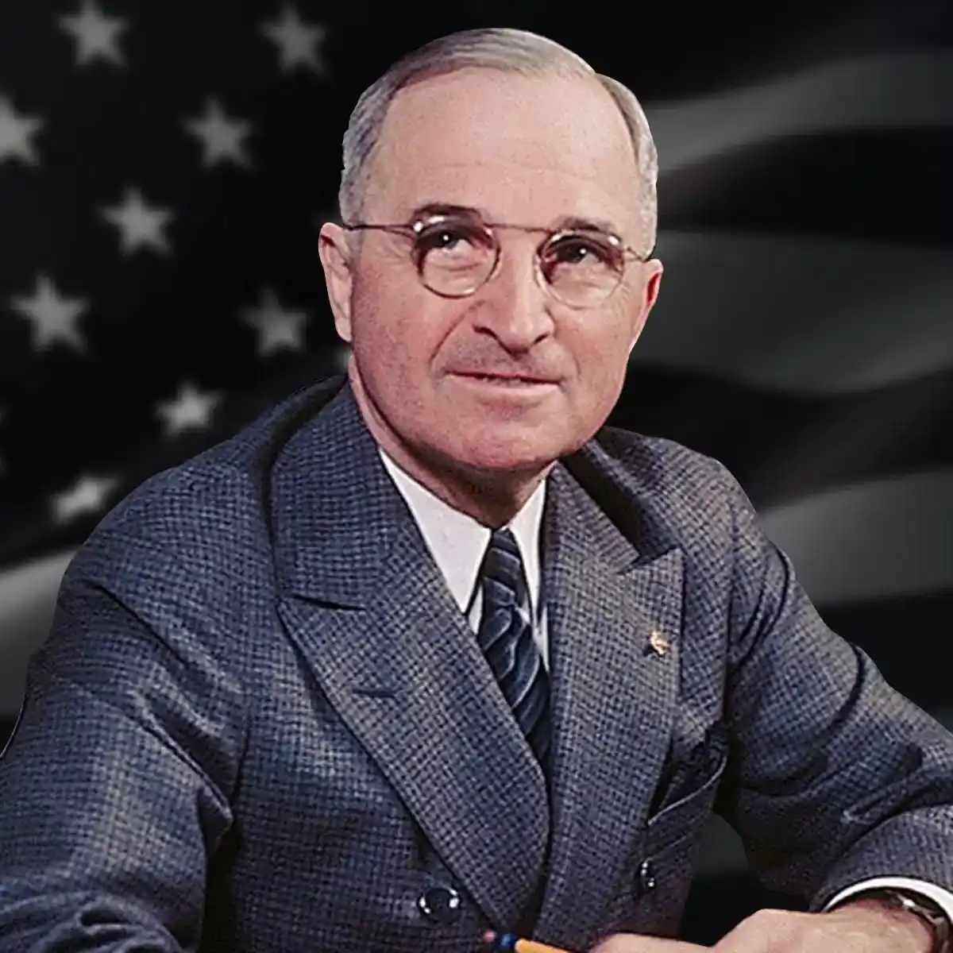
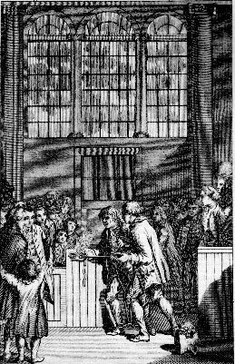
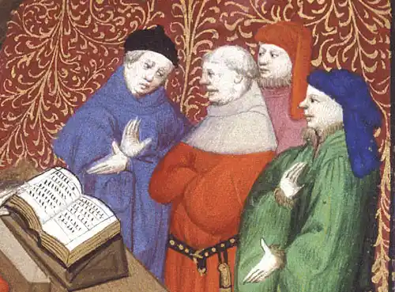
So What Does This Have To Do With Allocution?
“to give the defendant the opportunity to [make] statements which, by the strict rules of the law, could not have been admitted . . . In the due course of legal procedure, but which, when thus informally offered man to man, may be used to extenuate guilt and to mitigate punishment.”
Notes:
Quote is from Francis Wharton, 1899

Slide 6
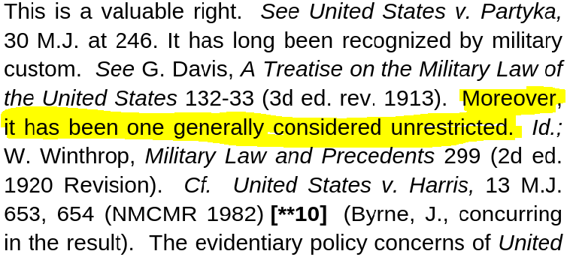
So Why Do We Say The Unsworn Is Unrestricted?
No person whatsoever shall use any menacing words, signs, or gestures, in the presence of a court-martial, or shall cause any disorder or riot or disturb their proceedings . . .
Any person subject to military law who behaves himself with disrespect toward his superior officer shall be punished as a court-martial may direct.
Three Points of Confusion:
Relying on sources that are not addressing the modern unsworn statement at all
“Wide Freedom”
“Not Evidence”
Notes:
RCM 1001 doesn’t include any language about unrestricted.
Prohibition against receiving chastisement and not “properly resenting it.”
“generally unrestricted” “largely unfettered” “virtually unrestricted”

Slide 7
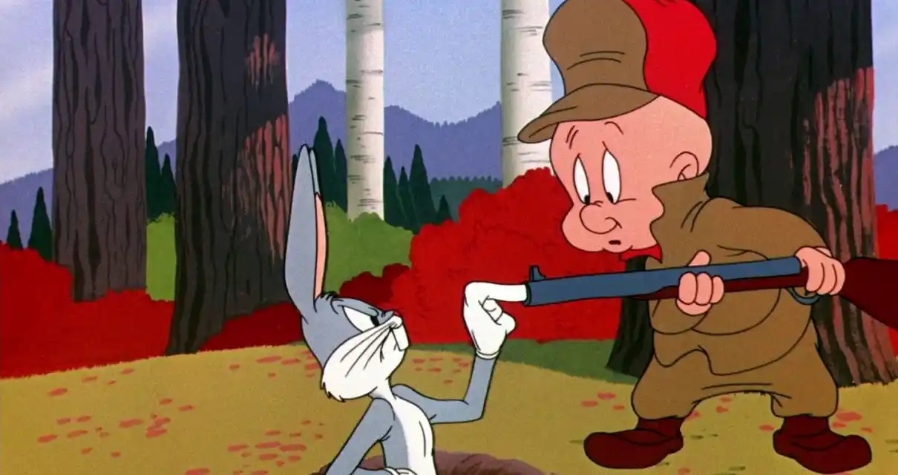
So What Is “Not Evidence?”
From the historical sources:
Something less than testimony; A prohibition on introducing facts; Argument
“Not subject to the Military Rules of Evidence.” US v. Tyler, 81 M.J. 108 (C.A.A.F. 2021)
-Co-accused’s acquittal, effects on drug rehabilitation programs, sex offender registration
Not subject to 403 balancing: “However, those rules do not apply to victim unsworn statements, which are not evidence.” United States v. Hamilton, 77 M.J. 579, 586 (A.F. Ct. Crim. App. 2017)
Result: Language that is intended to denigrate or diminish has become a windfall.
Notes:
Talkington opens the door to collateral consequences coming in through an unsworn but the judge can tell the members to disregard it through instructions. Talkington follows Rosato in that. Talkington was sex offender registration. Rosato is about rehab programs. Sowell is about co-accused and has to do with government opening the door first.

Slide 8
But What Do We Do About It?
∙What the unsworn gets right
∙New tools
∙Victim unsworn
∙What do we want the unsworn statement to do
Solutions:
Reconsideration of historical context in new cases
Limit accused unsworn to crime impact
Proposed RCM 1001(d)(2)(C): The accused may make an unsworn statement and may not be cross-examined by trial counsel upon it or examined upon it by the court-martial. The prosecution may, however, rebut any statement of fact therein. The unsworn statement may be oral, written, or both, and may be made by the accused, by counsel, or both. The content of such a statement may only include the impact of the crime on the victim, if applicable, and on the accused. The statement may not include a recommendation of a specific sentence.
Notes:
Goals of unsworn: correct mistakes in the historical understanding of the law, preserve important rights, and

Slide 9
Questions?
daniel.f.rendleman.mil@army.mil
Notes:
Talkington opens the door to collateral consequences coming in through an unsworn but the judge can tell the members to disregard it through instructions. Talkington follows Rosato in that. Talkington was sex offender registration. Rosato is about rehab programs. Sowell is about co-accused and has to do with government opening the door first.

