Slide 1
The Seven Military Clauses
Robert Leider
Assistant Professor of Law

Slide 2
Five Congressional Powers
Congress shall have Power . . .
To raise and support Armies, but no Appropriation of Money to that Use shall be for a Term longer than two years;
To provide and maintain a Navy;
To make Rules for the Government and Regulation of the land and naval Forces
To provide for calling forth the Militia to execute the Laws of the Union, suppress Insurrections and repel Invasions
To provide for organizing, arming, and disciplining, the Militia, and for governing such Part of them as may be employed in the Service of the United States, reserving to the States, respectively, the Appointment of the Officers, and the Authority of training the Militia according to the discipline prescribed by Congress.
U.S. Const. art. I, § 8, cl. 12-16

Slide 3
Two Restrictive Clauses
No State shall, without the Consent of Congress, . . . Keep Troops, or Ships of War in time of peace . . . .
U.S. Const. art. I, § 10, cl. 3
No person shall be held to answer for a capital, or otherwise infamous crime, unless on a presentment or indictment of a Grand Jury, except in cases arising in the land or naval forces, or in the Militia, when in actual service in time of War or public danger;
U.S. Const. amend. V
Notes:
In addition, will talk briefly about the engage in war provision in Section 10.

Slide 4
Armies/Navies versus Militia
Armies/Navies
  Professional (full-time)
  Voluntary enlistment
  Subject to military law at all times
  Defensive or offensive conflicts
Militia
  Nonprofessional service
  Conscripted (in theory)
  Subject to military law when on duty
  Defensive conflicts only

Slide 5
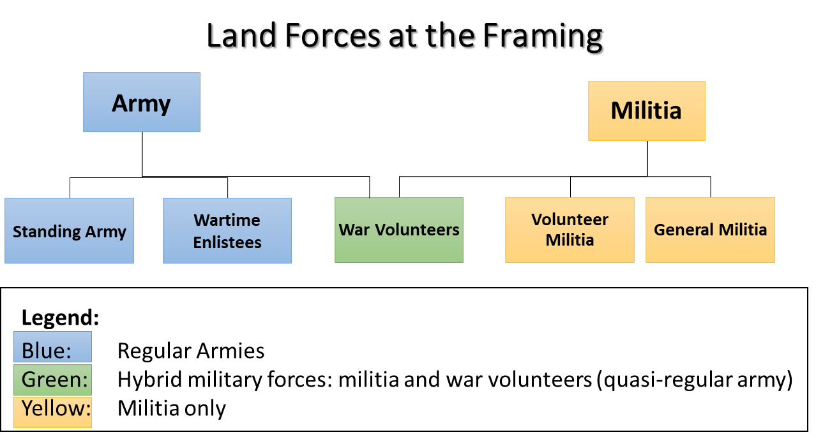
Land Forces at the Framing

Slide 6
Congressional Powers
Congress shall have Power . . .
To raise and support Armies, but no Appropriation of Money to that Use shall be for a Term longer than two years;
U.S. Const. art. I, § 8, cl. 12

Slide 7
Congressional Powers
Congress shall have Power . . .
To provide and maintain a Navy;
U.S. Const. art. I, § 8, cl. 13

Slide 8
Congressional Powers
Congress shall have Power . . .
To make Rules for the Government and Regulation of the land and naval Forces
U.S. Const. art. I, § 8, cl. 14

Slide 9
Congressional Powers
Congress shall have Power . . .
To provide for calling forth the Militia to execute the Laws of the Union, suppress Insurrections and repel Invasions
U.S. Const. art. I, § 8, cl. 15

Slide 10
Congressional Powers
Congress shall have Power . . .
To provide for organizing, arming, and disciplining, the Militia, and for governing such Part of them as may be employed in the Service of the United States, reserving to the States, respectively, the Appointment of the Officers, and the Authority of training the Militia according to the discipline prescribed by Congress.
U.S. Const. art. I, § 8, cl. 16

Slide 11
State Prohibitions
No State shall, without the Consent of Congress, . . . Keep Troops, or Ships of War in time of peace . . .
U.S. Const. art. I, § 10, cl. 3

Slide 12
State Prohibitions (cont.)
No State shall, without the Consent of Congress, . . . engage in War, unless actually invaded, or in such imminent Danger as will not admit of delay. . .
U.S. Const. art. I, § 10, cl. 3

Slide 13
State Prohibitions (cont.)
No State shall, without the Consent of Congress, . . . engage in War, unless actually invaded, or in such imminent Danger as will not admit of delay. . .
U.S. Const. art. I, § 10, cl. 3

Slide 14
Federal Prohibition
No person shall be held to answer for a capital, or otherwise infamous crime, unless on a presentment or indictment of a Grand Jury, except in cases arising in the land or naval forces, or in the Militia, when in actual service in time of War or public danger;
U.S. Const. amend. V

Slide 15
Constitution and the Military
Armies and Navies
Congress
  Raises and supports
  Governs
President
  Commands
  Appoints officers
Soldiers and sailors subject to military law at all times
States restricted from having armies in peacetime without congressional consent
Militia
Congress
  Organizes, arms, and disciplines
  Provides for calling forth to enforce laws, suppress insurrections, and repel invasions
  May subject to military law when called forth in emergencies
President
  Commands when in federal service
States
  Conduct training
  Appoint officers
  Command when not federalized
Citizenry
  Retain the right to keep and bear arms

Slide 16
Collapsing the Distinction
End of universal militia training and the rise of the volunteers
Conscription into the military
Existence of federal reserve (part-time) forces attached directly to the federal military
Dual enlistment: National Guard is both part of the organized militia and a federal reserve force

Slide 17
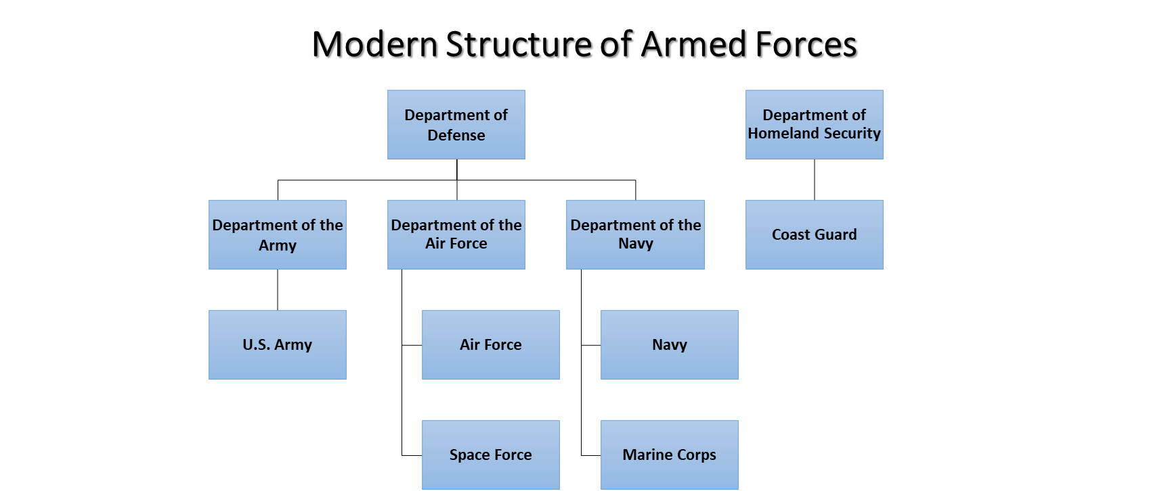

Slide 18
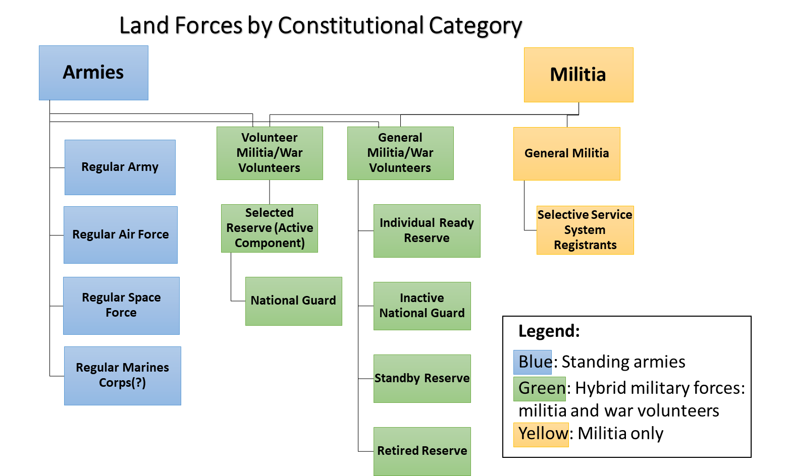

Slide 19
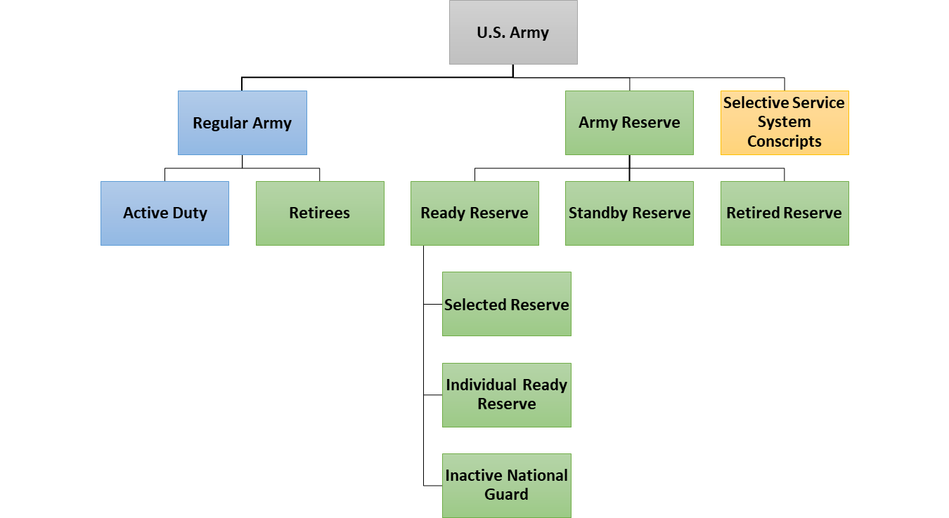
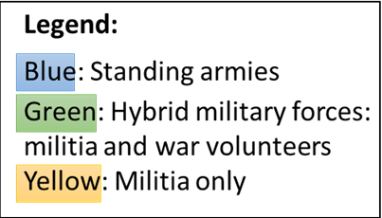
U.S. Army (by component)

