Slide 1
Digital Evidence
Mr. Ovie Carroll
Director, Cybercrime Lab
Computer Crime and Intellectual Property Section, Department of Justice
Mr. Gary Korn
Cyber Directorate Counsel, Office of Chief Counsel
Department of the Army Criminal Investigation Division
Major ReAnne R. Wentz
Associate Professor, Department of Criminal Law
The Judge Advocate General’s Legal Center and School

Slide 2
Roadmap
Connecting the dots on PC
The art and science of digital forensic examination
  DFE 101
  PC, plain view and why DFEs might be looking where they are
The post-Carpenter world of the third-party doctrine
Legal issues with geofencing
How all of this data paints a picture at trial

Slide 3
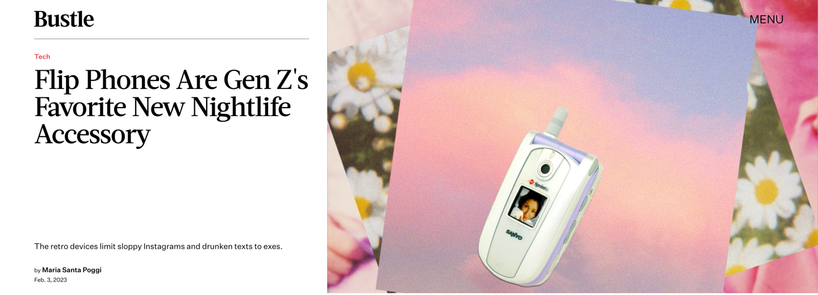
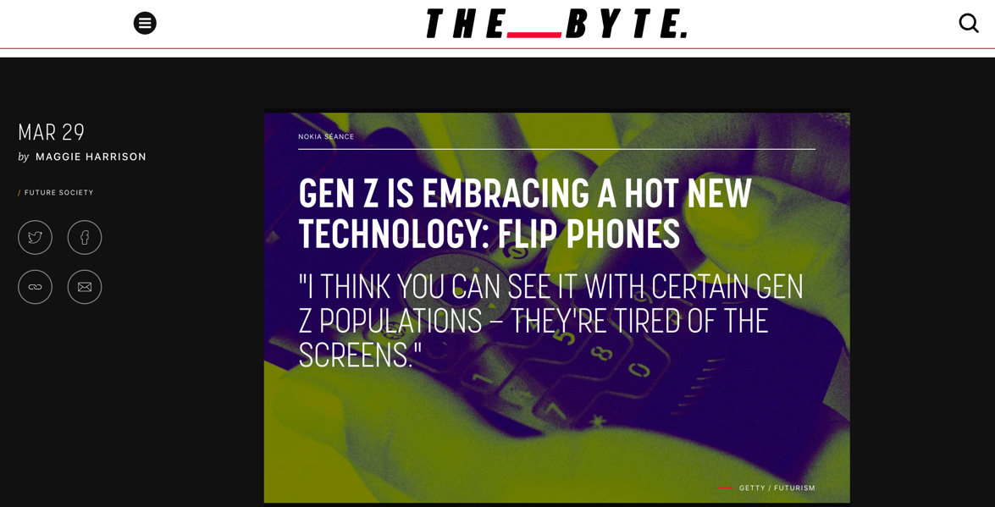
Tech is expanding and changing . . . but

Slide 4
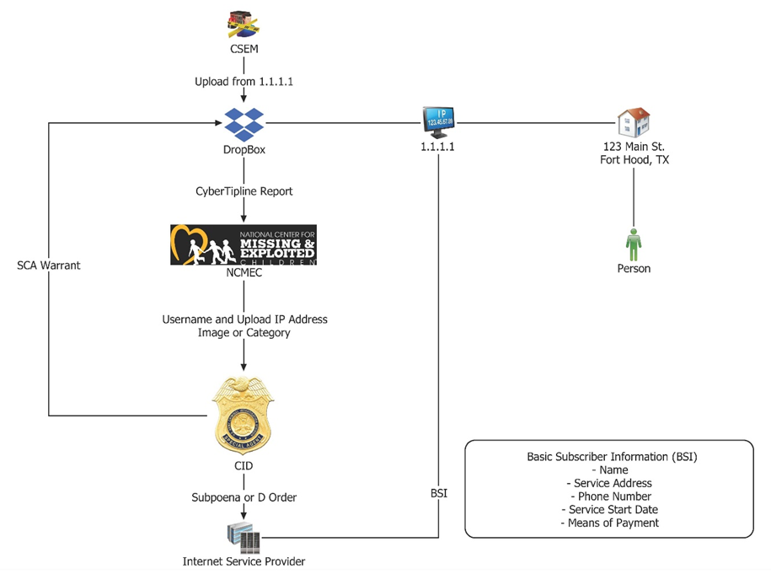
Notes:
Talk about how this works for military LE agencies

Slide 5
DFE 101
Terminology: “Before First Unlock”; “After First Unlock”; “Full File System”
Logical acquisition versus physical acquisition
What are logs?
What is an artifact?
Different types of software to perform examinations (e.g. Cellebrite) and broadly, how they work
What you can get from a phone that you can’t get with a Stored Communications Act warrant / subpoena
DFE gets a warrant and a phone – what happens next?

Slide 6
Forensic exams and the elephant in an envelope

Slide 7
Tech makes it easy to hide in plain sight
2023.05.04 Dental Appointments.docx (484 KB)
202305.04 Home Repairs.xltx (2.5 MB)
2023.05.04 Dog Food.pdf (2.5 MB)

Slide 8
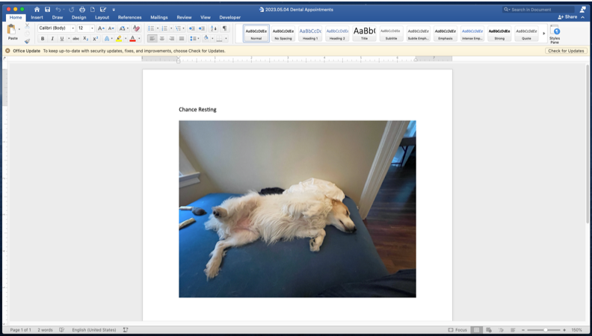
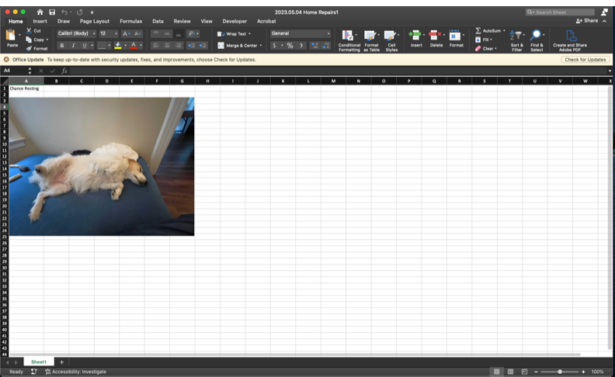
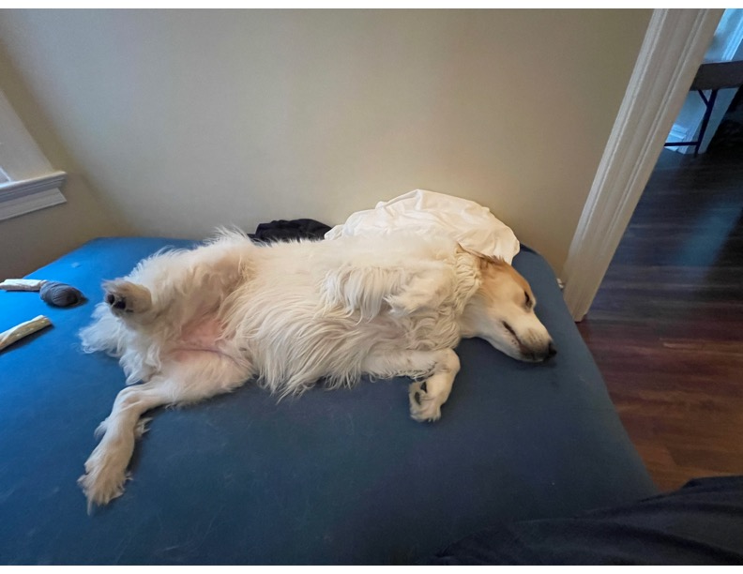

Slide 9
United States v. Hill,
459 F.3d 966 (9th Cir. 2006)
“Images can be hidden in all manner of files, even word processing documents and spreadsheets. Criminals will do all they can to conceal contraband, including the simple expedient of changing the names and extensions of files to disguise their content from the casual observer.”
“Forcing police to limit their searches to files that the suspect has labeled in a particular way would be much like saying police may not seize a plastic bag containing a powdery white substance if it is labeled "flour" or "talcum powder." There is no way to know what is in a file without examining its contents, just as there is no sure way of separating talcum from cocaine except by testing it.”

Slide 10
User attribution, exculpatory evidence, and pattern of life

Slide 11
Tension with the Fourth Amendment
“Courts have struggled to apply the plain view doctrine to searches of digital devices, given the vast amount of information they are capable of storing and the difficulty inherent in tailoring searches of electronic data to discover evidence of particular criminal conduct. In light of those difficulties, the application of the plain view doctrine in a digital context poses a serious risk that every warrant for electronic information will become, in effect, a general warrant, rendering the Fourth Amendment irrelevant.”
United States v. Gurczynski, 76 M.J. 381, 387–88 (C.A.A.F. 2017) (internal citations omitted).

Slide 12
Tension with the Fourth Amendment
“Federal courts have yet to strike a tenable doctrinal balance between protecting the constitutional rights of criminal suspects whose digital storage law enforcement agents intend to investigate and the practical challenges facing those same agents seeking specific information in the proverbial digital haystack. Neither has Congress struck a statutory balance nor the Executive branch via regulation.”
United States v. Perez, 712 Fed.Appx.136 (3d Cir. 2017).

Slide 13
Carpenter v. United States, 138 S.Ct. 2206
Holding: Law enforcement officers required to get a warrant to obtain cell-site location information.
“Given the unique nature of cell-phone records the fact that the information is held by a third party does not by itself overcome the user’s claim to Fourth Amendment protection.”
“Our decision today is a narrow one.”
Is it, though? Should it be?

Slide 14
Kinds of information exposed to third parties
Email and text metadata
Web-surfing data (IP addresses)
App data
Search terms
Video and audio recordings
Location data
Subscriber information
Credit card information
Medical and fitness data
DNA and biometric data
Smart home data
Digital Odor?

Slide 15
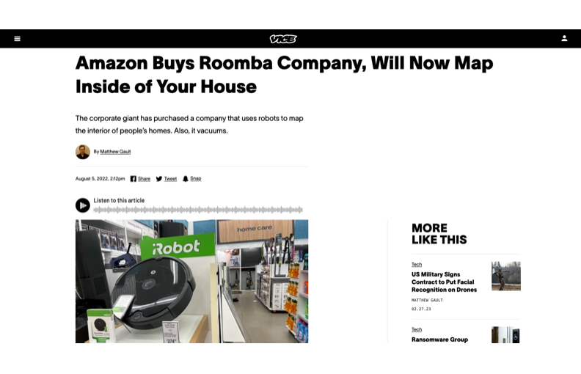

Slide 16
Post-Carpenter
United States v. Bledsoe 2022 U.S. Dist. LEXIS 150326 (D.C.C. 2022)
  Issue: “[W]hether, under Carpenter, the government’s acquisition from Facebook of non-content information derived from user-generated content of a highly public event that reveals the user’s location, i.e. user-generated location information (“UGLI”), was a Fourth Amendment search requiring a probable cause warrant.”
  Facts: Capitol attack on 6 January 2021. FBI relied on an emergency provision in the Stored Communications Act (SCA). FBI requested “any users that broadcasted live videos which may have been streamed and/or uploaded to Facebook from physically within the building of the United States Capitol during the time on January 6, 2021, in which the mob had stormed and occupied the Capitol building.”

Slide 17
Post-Carpenter
United States v. Bledsoe 2022 U.S. Dist. LEXIS 150326 (D.C.C. 2022)
  Holding: “Thus, unlike the CSLI data at issue in Carpenter, the only way that Facebook was able to determine when and where a user engaged in account activity on January 6, 2021, is by virtue of the user making an affirmative and voluntary choice to download the Facebook or Instagram application onto an electronic device, create an account on the Facebook or Instagram platform, and, critically, take no available steps to avoid disclosing his location, before purposefully initiating the activity of live-streaming or uploading a video of a highly public event, in a manner that occurs during the normal course of using Facebook as intended.”
TL;DR: CSLI ≠ using Facebook and Instagram

Slide 18
Post-Carpenter
United States v. Soybel, 13 F.4th 584 (7th Cir. 2021)
  Issue: ”[W]hether the use of a pen register to identify IP addresses visited by a criminal suspect is a Fourth Amendment ‘search’ that requires a warrant.”
  Facts: disgruntled former employee initiated a series of cyber attacks on a company. FBI sought a court order under the Pen Register Act “authorizing the installation of pen registers and ‘trap and trace’ devices to monitor internet traffic in and out of [the defendant’s] apartment building and Soybel’s unit generally.”
    NOTE: the standard here was not PC, but that the information to be obtained was “relevant to an ongoing criminal investigation.”
  Holding: “The unique features of historical CSLI data are absent for IP-address data.” Pen registers to not capture physical movements; even though it could provide an “intimate window” into his “familial, political, professional, religious, and sexual associations,” it was not a search.

Slide 19
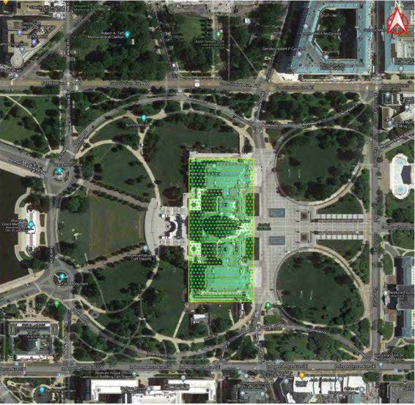
Geofencing

Slide 20
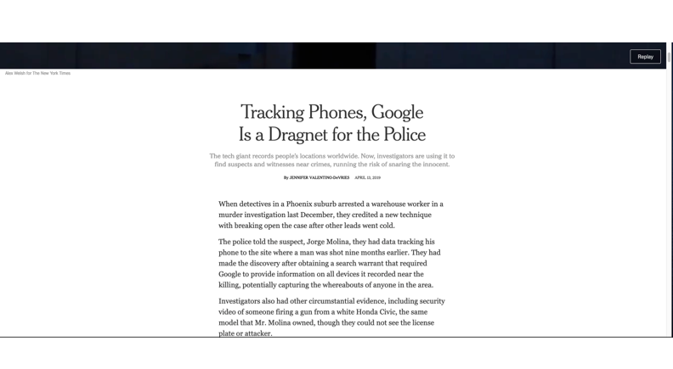

Slide 21
United States v. Rhine,
2023 U.S. Dist. LEXIS 12308 (D.C.C. 2023)
“At a basic level, a geofence warrant seeks cell phone location data stored by third-party companies like Google, which offers the Android operating system on which millions of smart phones run and offers other applications commonly used on phones running on other operating systems. The scope of location data captured by a geofence is limited by geographic and temporal parameters, so geofence warrants identify the physical area and the time range in which there is probable cause to believe that criminal activity occurred”

Slide 22
United States v. Rhine,
2023 U.S. Dist. LEXIS 12308 (D.C.C. 2023)
Geofence or Capitol Riot (6 January 2021)
Primary List: All devices from 1400 – 1830 hours
Control List 1: All devices from 1200 – 1215 hours
Control List 2: all devices from 2100 – 2115 hours
Gov’t requested: Exclude control list devices from primary list
Gov’t supplemental affidavit to request court order for Basic Subscriber Information

Slide 23
United States v. Rhine,
2023 U.S. Dist. LEXIS 12308 (D.C.C. 2023)
Supplemental Affidavit & Google BSI Return:

Slide 24
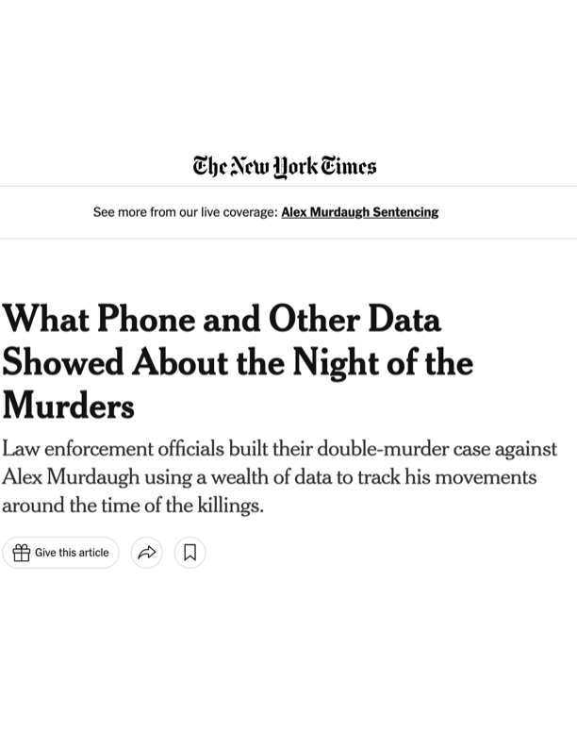
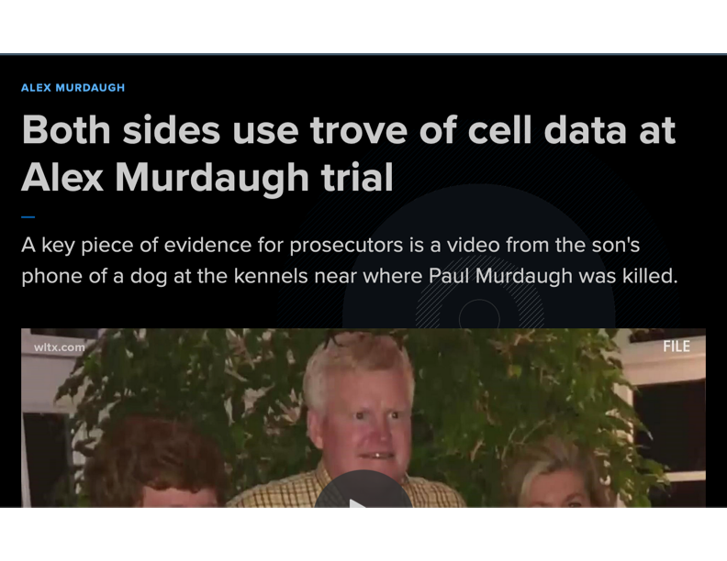
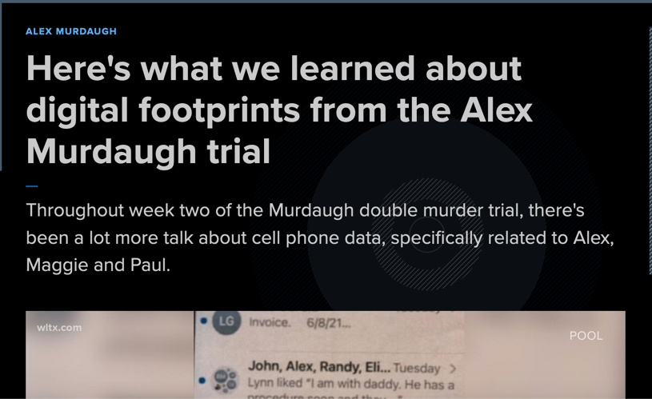
Painting a picture: The trial of Alex Murdaugh

Slide 25
Murdaugh: 25 Minutes of Digital Evidence
8:44 - 8:45: Paul Murdaugh records a video that captures Alex and Maggie Murdaugh’s voices near the dog kennels on their family hunting estate, where the shooting took place
  Paul’s phone (No REP), Snap Warrant (content and sent time / who received)
8:48: Paul Murdaugh and a friend text back and forth about movie recommendations
  Paul’s phone (No REP), Friend’s phone (consent)
8:49:01: The last moment that anyone unlocks Paul Murdaugh’s cellphone, which had a passcode. Prosecutors this was when he was killed
  Paul’s phone (No REP)

Slide 26
Murdaugh: 25 Minutes of Digital Evidence
8:49:31: The last moment when Maggie Murdaugh’s phone is unlocked
  Maggie’s phone (No REP)
8:53 – 8:55: Maggie Murdaugh’s phone records 59 steps
  Maggie’s phone (No REP)
8:53: Someone appears to activate the voice assistant (Siri) on Maggie Murdaugh’s phone very briefly by holding the lock button
  Maggie’s phone (No REP)
9:02 – 9:06: Alex Murdaugh’s phone records 283 steps
  Alex’s phone (search warrant or consent) (possible biometrics)

Slide 27
Murdaugh: 25 Minutes of Digital Evidence
9:04: Alex Murdaugh calls his wife’s phone. No one answers.
  Alex’s phone (search warrant or consent) (possible biometrics)
  Maggie’s phone (No REP)
  Subpoena Alex and Maggie’s provider for cell phone usage (not location data)
9:06: Alex Murdaugh shifts his car out of park
  Vehicle search warrant or consent
9:07: The car leaves the vicinity of the house
  Vehicle search warrant or consent
9:08: Alex Murdaugh’s car passes by an area where his wife’s phone was later found on the side of the road. The car does not slow down
  Vehicle search warrant or consent and pings on Maggie’s phone

Slide 28
Murdaugh: 25 Minutes of Digital Evidence
9:08:58: Alex Murdaugh texts Maggie Murdaugh: “Going to check on Em be rite back.”
  Alex’s phone (search warrant or consent) (possible biometrics) + Maggie’s phone (No REP)
  Alex’s provider (non-content); Apple iCloud (SCA Warrant for SMS and MMS content)
Alex Murdaugh calls Buster Murdaugh, his older son and they speak for one minute
  Subpoena Alex’s provider for cell phone usage; Buster witness interview as to what was discussed.

Slide 29
Murdaugh: 25 Minutes of Digital Evidence
References
Nicholas Bogel-Burroughs, What Phone and Other Data Showed About the Night of the Murders, N.Y. Times (Mar. 3, 2023) https://www.nytimes.com/2023/03/03/us/phone-records-murdaugh.html
Investigator testifying about detailed timeline produced through digital evidence, https://www.youtube.com/watch?v=EU0NBRej6D4

Slide 30
Questions?
Mr. Gary Korn: gary.c.korn2.civ@army.mil or (571) 247-4827
Mr. Ovie Carroll: ovie.carroll@usdoj.gov or (202) 938-9025
MAJ ReAnne Wentz: reanne.r.wentz.mil@army.mil or (785) 215-1326

