Slide 1
Issues before the Defense Advisory Committee on Sexual Assault in the Armed Forces (DAC-IPAD)
May 10, 2023
Ms. Suzanne Goldberg and
Brigadier General (USMC, retired) Jim Schwenk

Slide 2
Overview
Origin, Charter, and Membership
Methodology
Specific examples
Investigative Case File Review
Victim Impact Study
Article 25 criteria and the demographics of panel selection

Slide 3
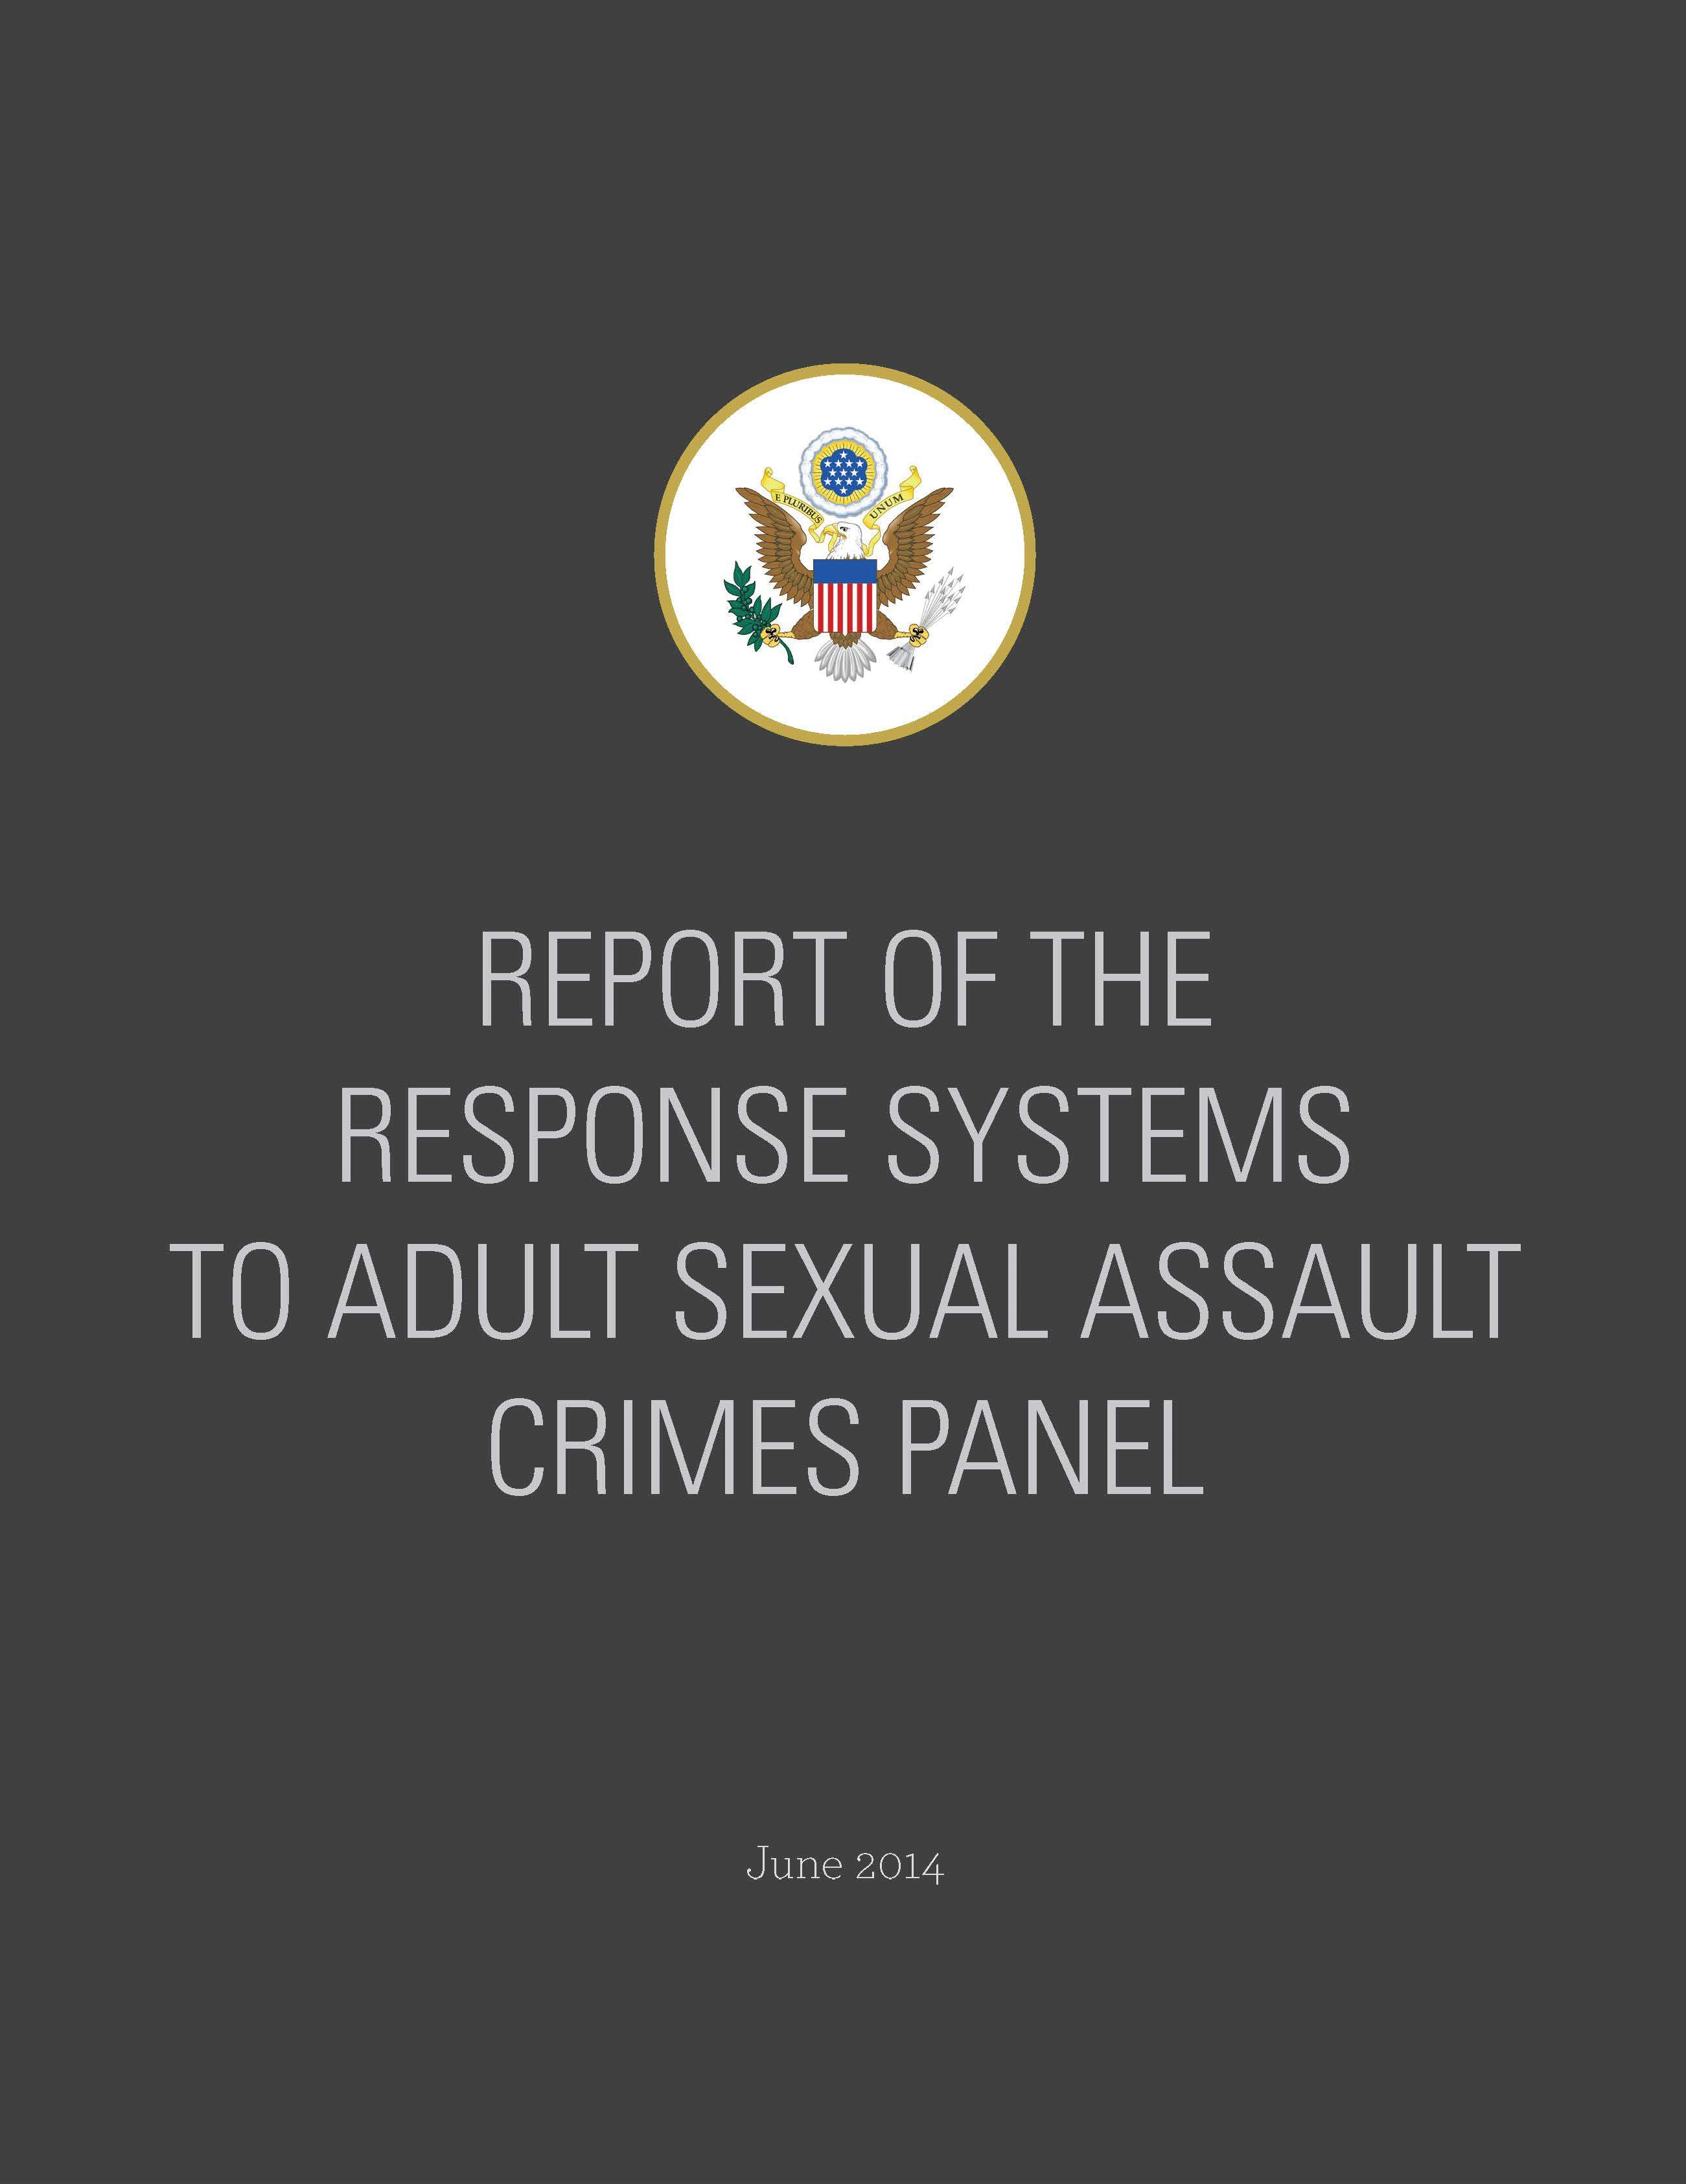
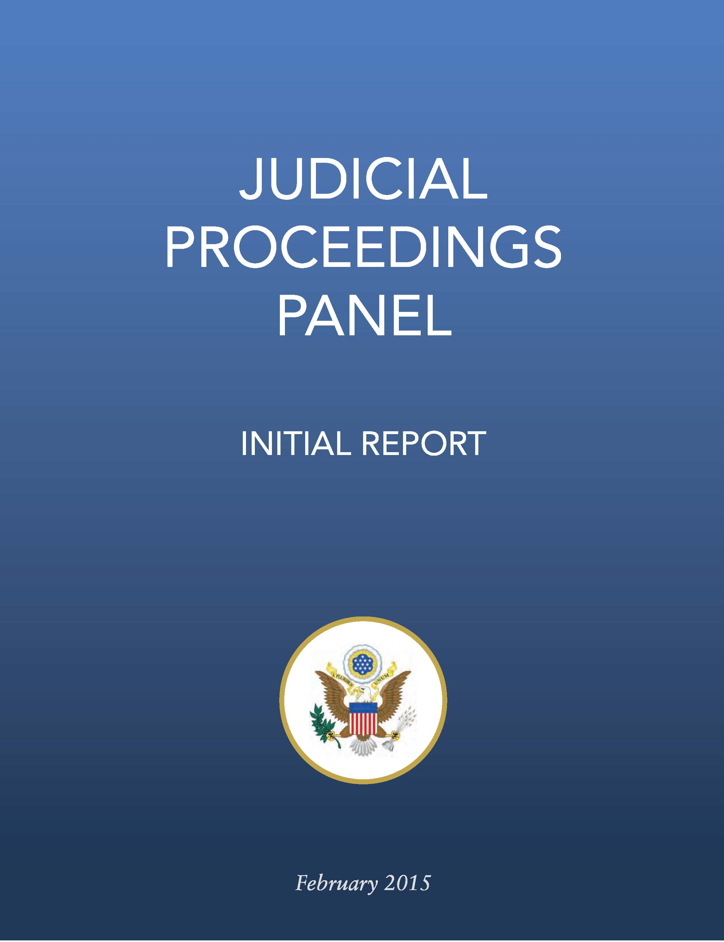
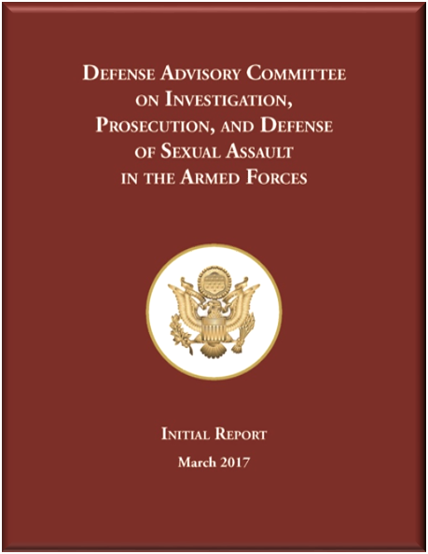
Origin

Slide 4
Statutory Authority and Mission
Section 546 of the National Defense Authorization Act for Fiscal Year 2015 [FY 2015 NDAA], as amended:
The DAC-IPAD shall provide independent advice and recommendations on the investigation, prosecution, and defense of allegations of rape, forcible sodomy, sexual assault, and other sexual misconduct involving members of the Armed Forces, based on its ongoing review of cases.
The Committee can make recommendations for systemic change when, in the DACIPAD members’ collective judgment, it will improve the investigation, prosecution, and defense of sexual misconduct

Slide 5
Website
https://dacipad.whs.mil
DAC-IPAD Charter
Reports
Meeting materials and transcripts
Public comments
Upcoming meeting information
Members

Slide 6
Members
Federal and State Judiciary
Prosecution
Defense
Victims’ Rights
Command
Judge Advocate General’s Corps
Academia
Forensic Medicine
Investigator

Slide 7
Selecting Topics for Review
Congressional Taskings
Requests from the DoD General Counsel
Committee Decision

Slide 8
Sources of Information
Witness testimony
Requests for Information
Case reviews
Site visits to military installations/courts-martial observation
Public comments
Civilian advocacy groups

Slide 9
Reports and Letters
Annual Reports: 2017 through 2023
Article 140a Implementation Letter to SecDef, September 2018
Victim Collateral Misconduct Letter to SecDef, September 2019
Court-Martial Adjudication Data Report, November 2019
Guardian Ad Litem Report, June 2020
Preservation of Restricted Reporting Option Letter to SecDef, May 2020
Report on Investigative Case File Reviews, October 2020
Report on Racial and Ethnic Reporting Data, December 2020
Report on SVC/VLC Tour Lengths and Reporting Structure, August 2022
Report on Victim Impact Statements, March 2023
Appellate Review Study, March 2023

Slide 10
Report on Investigative Case File Review
Investigative case files and courts-martial records (charge sheets, Art. 32 report, Result of Trial (pre-STR))
Checklist used to record observations
An independent criminologist performed data analysis
Members made qualitative assessments of the evidence

Slide 11
Report on Investigative Case File Review
There is not a systemic problem with the initial disposition decision.
There is a systemic problem with the referral of penetrative sexual offense charges when there is not sufficient admissible evidence to obtain and sustain a conviction on the charged offense.
The pretrial processes in Articles 32 and 34 allow cases to proceed to a general court-martial even when it is highly unlikely to result in a conviction, which contributes to a high acquittal rate for penetrative sexual offense charges.
Recommend amending Article 34, UCMJ, to elevate the referral standard.

Slide 12
Pretrial Procedures and Prosecution Standards
DAC-IPAD unanimously approved 3 recommendations:
Article 32, UCMJ
Appendix 2.1, MCM
Training judge advocates

Slide 13
Report on Victim Impact Statements
Congressional request
Reviewed ROTs from courts-martial completed in FY21
Considered pending changes to sentencing landscape
Found R.C.M. 1001(c) did not allow full opportunity for allocution and made 5 recommendations

Slide 14
Article 25, UCMJ, and Panel Selection Demographics
Review criteria for selecting the venire in Article 25, UCMJ
Race and gender diversity in panels in military sexual offense trials

Slide 15
Adoption of DAC-IPAD Recommendations
Expansion of the expedited transfer policy
Terminating an investigation at victim’s request after a third-party report
Improved process for submission of crime data to federal database
Standardizing military justice data collection and a uniform document management system

Slide 16
Adoption of DAC-IPAD Recommendations
Joint Explanatory Statement accompanying the FY22 NDAA emphasized:
When determining whether to refer charges and specifications to a court-martial for trial, the convening authority, or, when applicable, the special trial counsel, should first evaluate whether admissible evidence will likely be sufficient to obtain and sustain a conviction in a trial by court-martial.

Slide 17
DAC-IPAD References
Law reviews and journals
Research papers (SSRN)
News articles
Other advisory groups:
Independent Review Commission on Sexual Assault in the Military
Military Justice Review Panel

Slide 18
Conclusion

