Slide 1
The Judge Advocate General’s Corps
Military Justice: History & Change
Notes:
“THE LORE OF THE CORPS” = The history of our JAG Corps and Regiment

Slide 2
Roadmap
Three bottom lines
Judicialization
Civilianization
Decision-making
Future Trends

Slide 3
Competing Goals
Discipline
Justice

Slide 4
Judicialization
Why?

Slide 5
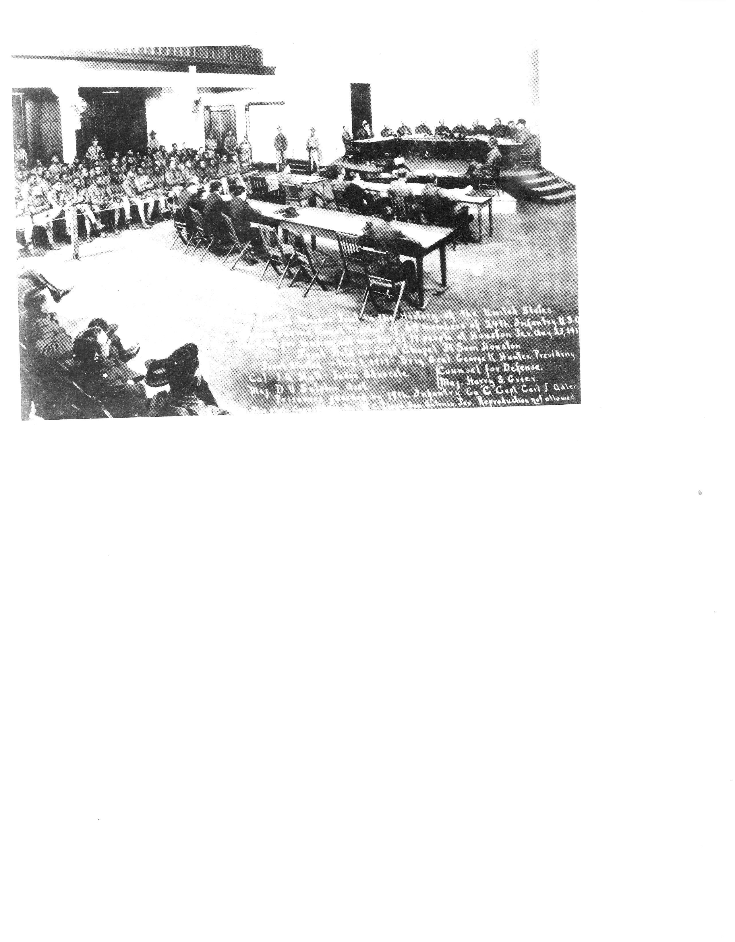
33

Slide 6
Courts-martial should be more like courts
(and not merely a discipline tool for the commander)

Slide 7
Starting points
(Some) appellate rights
(Some) due process

Slide 8
But
No right to legally qualified counsel
No military judge

Slide 9
How many courts-martial in World War I?
How many courts-martial in World War II?

Slide 10
Civilianization
World War II experience
Command influence
Arbitrary, capricious
Uniformity?

Slide 11
Courts-martial should look more like U.S. District courts
(Article 36, UCMJ)
(More due process)

Slide 12
Major Changes in Military Justice since 1950
Appellate framework
Statutory service courts (1950)
New civilian higher court (1950)

Slide 13
Enlisted personnel on panels (1950)

Slide 15
Counsel at Special Courts (1969)
Military Judge (1969)
Prior to 1969, all trials were by panels
After 1969?

Slide 16
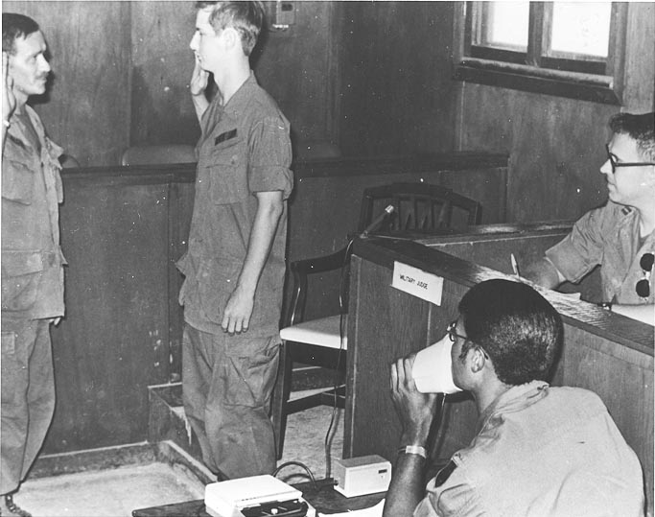

Slide 17
Rules of Evidence (1980)
Government appeals (1983)
Appeal to Supreme Court (1983)

Slide 18
Upcoming Changes in Military Justice
27 Dec 2023

Slide 19
Judge advocates are now decision-makers vice commanders
Murder & manslaughter
Rape & sexual assault, etc.
Kidnapping

Slide 20
(And all related offenses)

Slide 21
But is this a real change?
(and do commanders really care?)

Slide 22
No more panel sentencing; now judge alone
Sentencing parameters?

Slide 23
And—what is not changing
Larceny, burglary, drugs, all military offenses
Pretrial restraint

Slide 24
Article 25 (so far)
Convening CMs
Article 32

Slide 25
And – the TRIAL PROCESS

Slide 26
Future Trends
Decreasing commander decision-making
More JA decision-making

Slide 27
Who is responsible for good order and discipline in a command?

Slide 28
But if the commander is removed from the system, why have a separate system?

Slide 29
That’s all, folks
Questions? Comments?

