Slide 1

The Judge Advocate General’s Corps
Thievery in Germany—and Consequences
By Fred L. Borch
Regimental Historian
Professor of Legal History
Notes:
“THE LORE OF THE CORPS” = The history of our JAG Corps and Regiment

Slide 2
Roadmap
Some Context
The Criminals
The Crime

Slide 3
Courts-Martial
“The Rest of the Story”
Conclusion

Slide 4
Some Context
February 1946
Occupied Germany & “abnormal conditions”
A Royal Marriage!

Slide 5
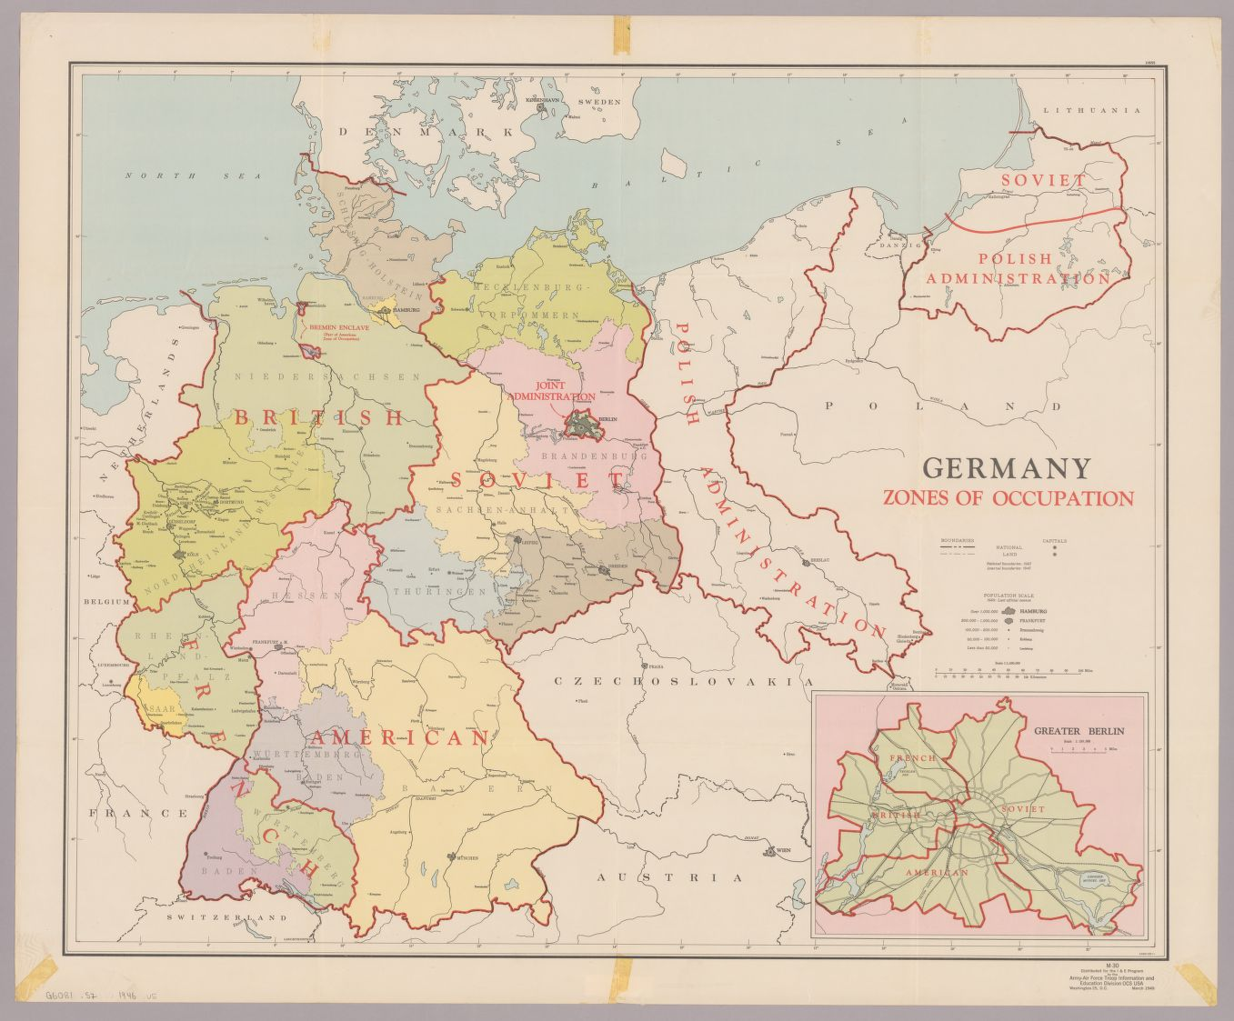

Slide 6
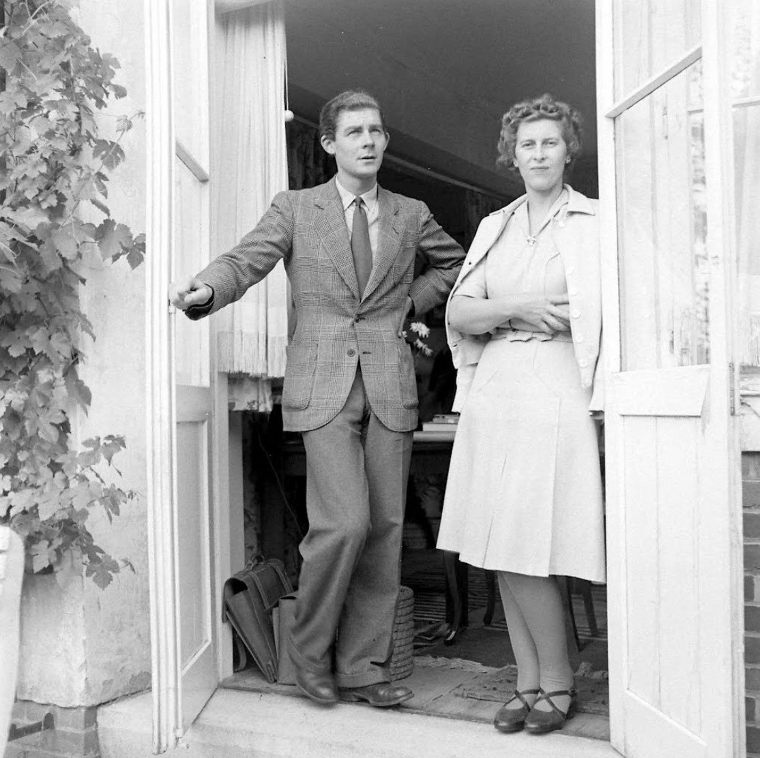

Slide 7
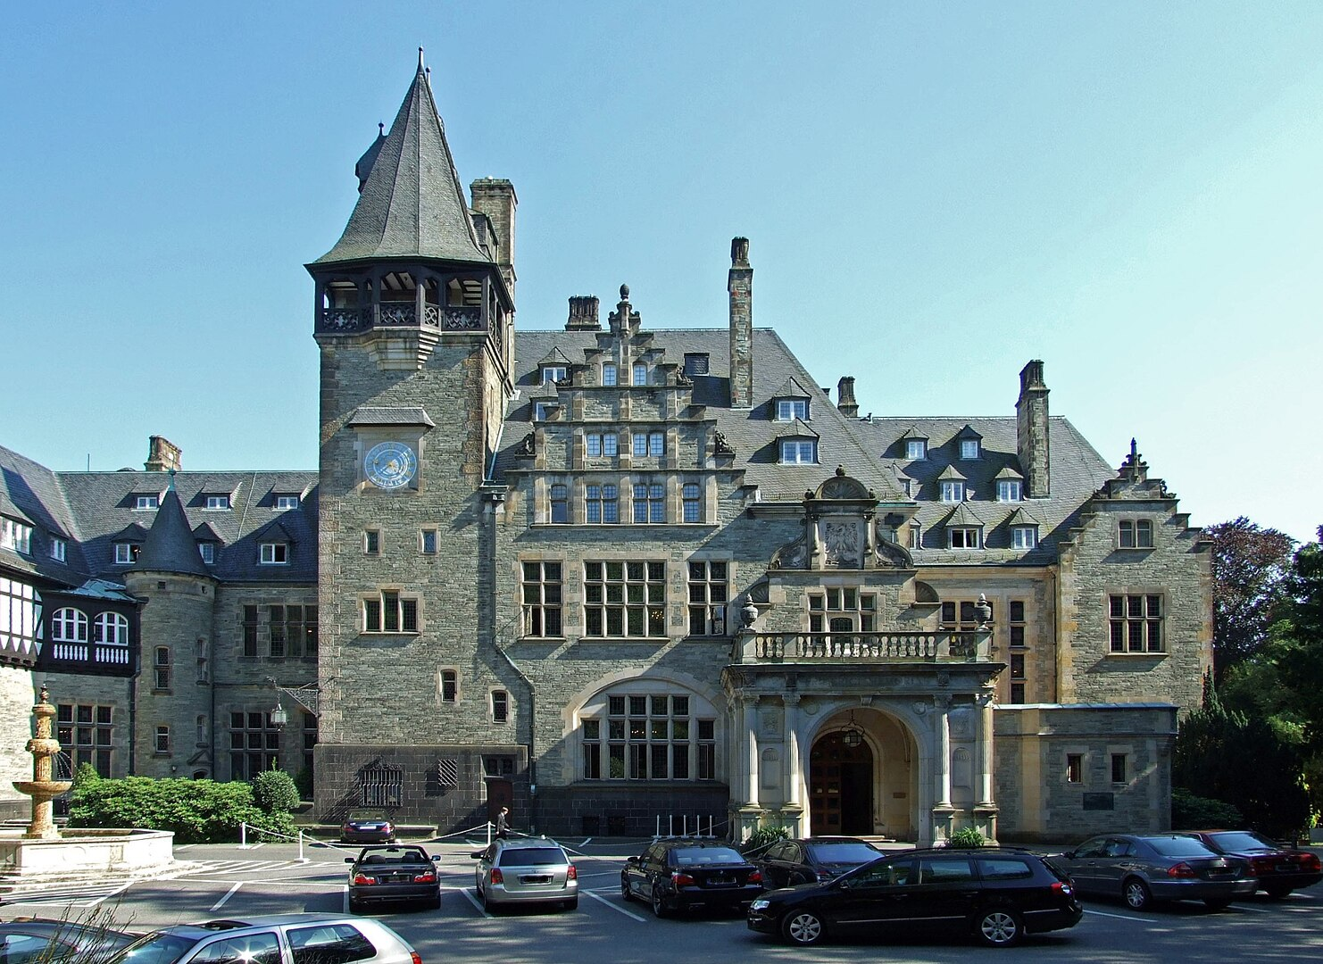

Slide 8
The Criminals
Colonel Jack W. Durant
Major David F. Watson
Captain Kathleen Burke Nash

Slide 9
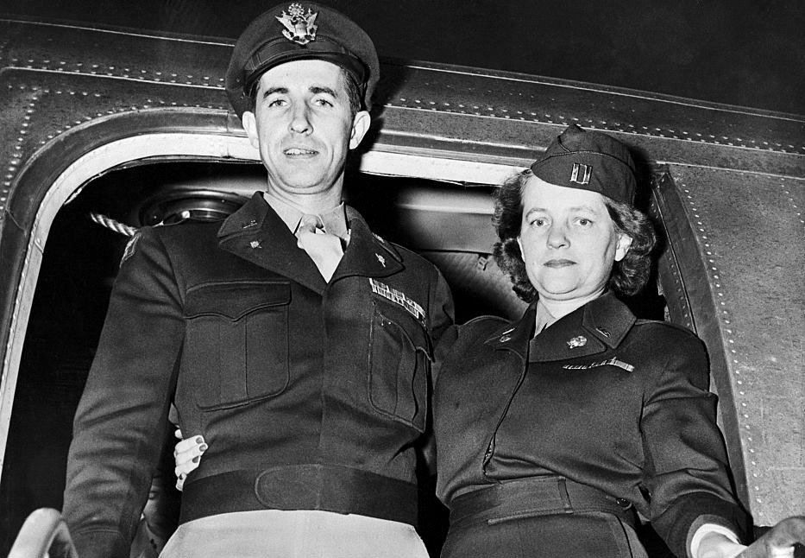

Slide 10
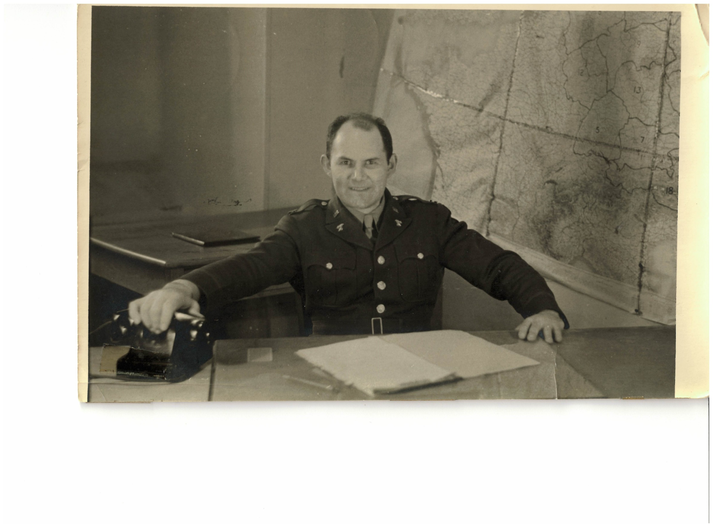

Slide 11
The Crime
November 1945
Schloss Friedrichshof is an O-Club
“Katie” Nash is Club Manager

Slide 12
She snoops around—a rumor
  Wine Cellar
  Fresh cement

Slide 13
Gold & Silver bracelets, tiaras, diamonds, sapphires, rubies, emeralds, jewels
  $2.5 million (about $40 million today)

Slide 14
Nash shares the secret with Colonel Durant and Major Watson

Slide 15
December 1945/January 1946
  Watson flies to Northern Ireland
  Durant & Nash travel to Switzerland
  APO & diplomatic mail

Slide 16
February 1946
  Where are the jewels?
  Countess Margaretha complains to Provost Marshal in Frankfurt; CID launches investigation

Slide 17
May 1946
  CID arrests Watson in Frankfurt

Slide 18
June 1946
  Durant and Nash arrested at LaSalle Hotel in Chicago
  (What were they doing at the LaSalle?)

Slide 19
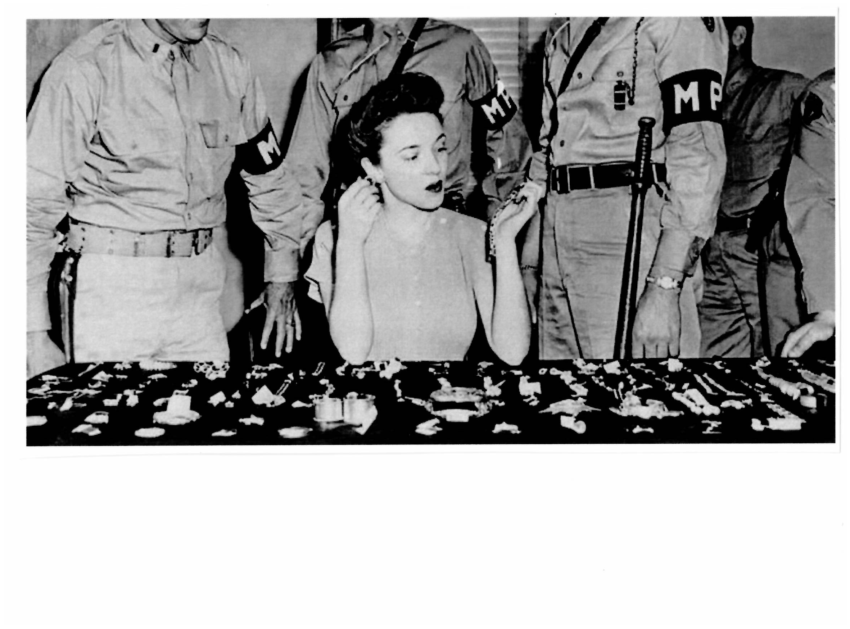

Slide 20
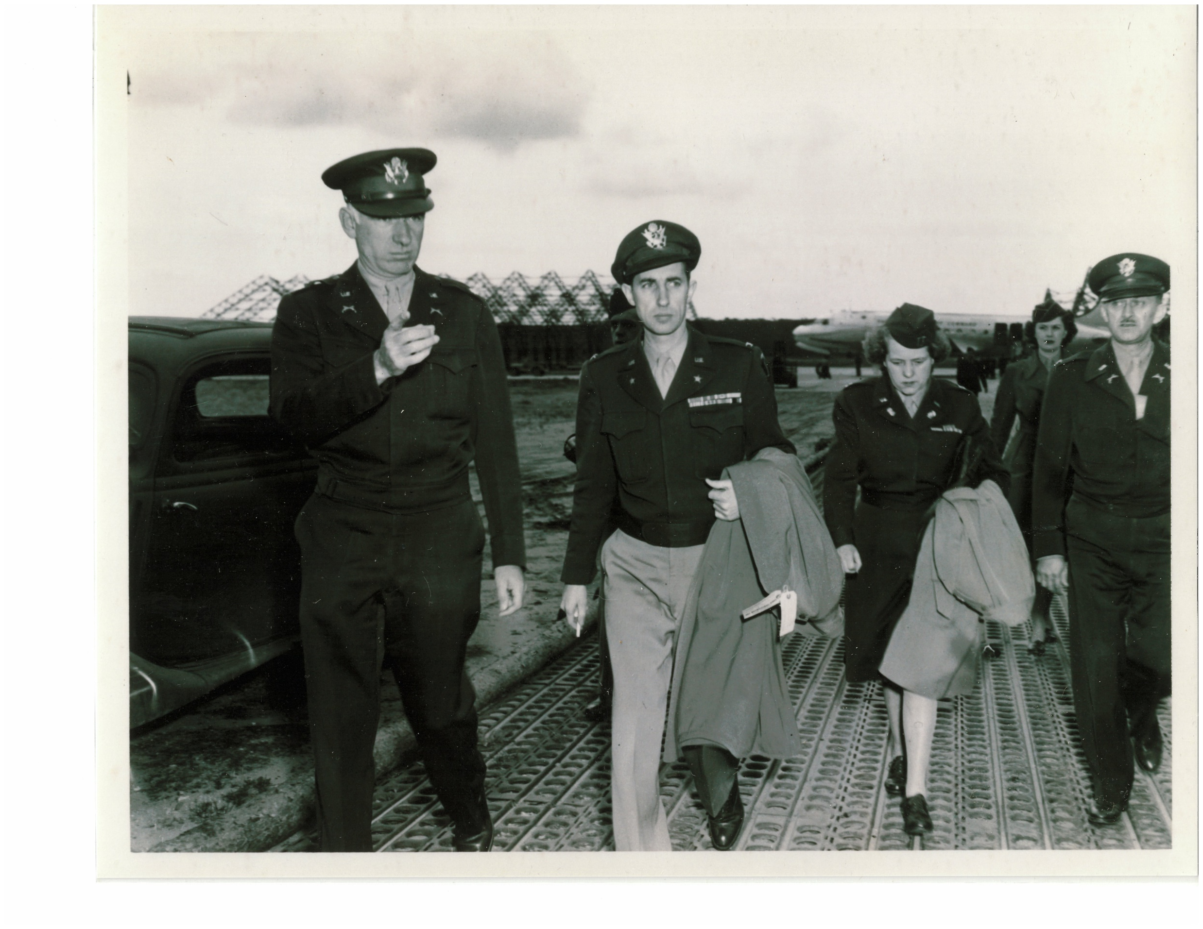

Slide 21
Courts-Martial
Durant & Nash returned to Frankfurt to stand trial
(Tickets printed for civilians who wished to attend trials)

Slide 22
Courts-Martial
Katie Nash
  AWOL
  Larceny, conspiracy
  Fraud
  Conduct Unbecoming

Slide 23
Defenses?
  (Refused to enter plea)
  No in personam jurisdiction
  Von Hessen family had abandoned the treasure

Slide 24
Jewels were legitimate “spoils of war” because of von Hessen family ties to Nazi Party

Slide 26
Result?
  Guilty
  Dismissal, 5 years CHL

Slide 27
David Watson
  Larceny
  Conspiracy
  Conduct Unbecoming

Slide 28
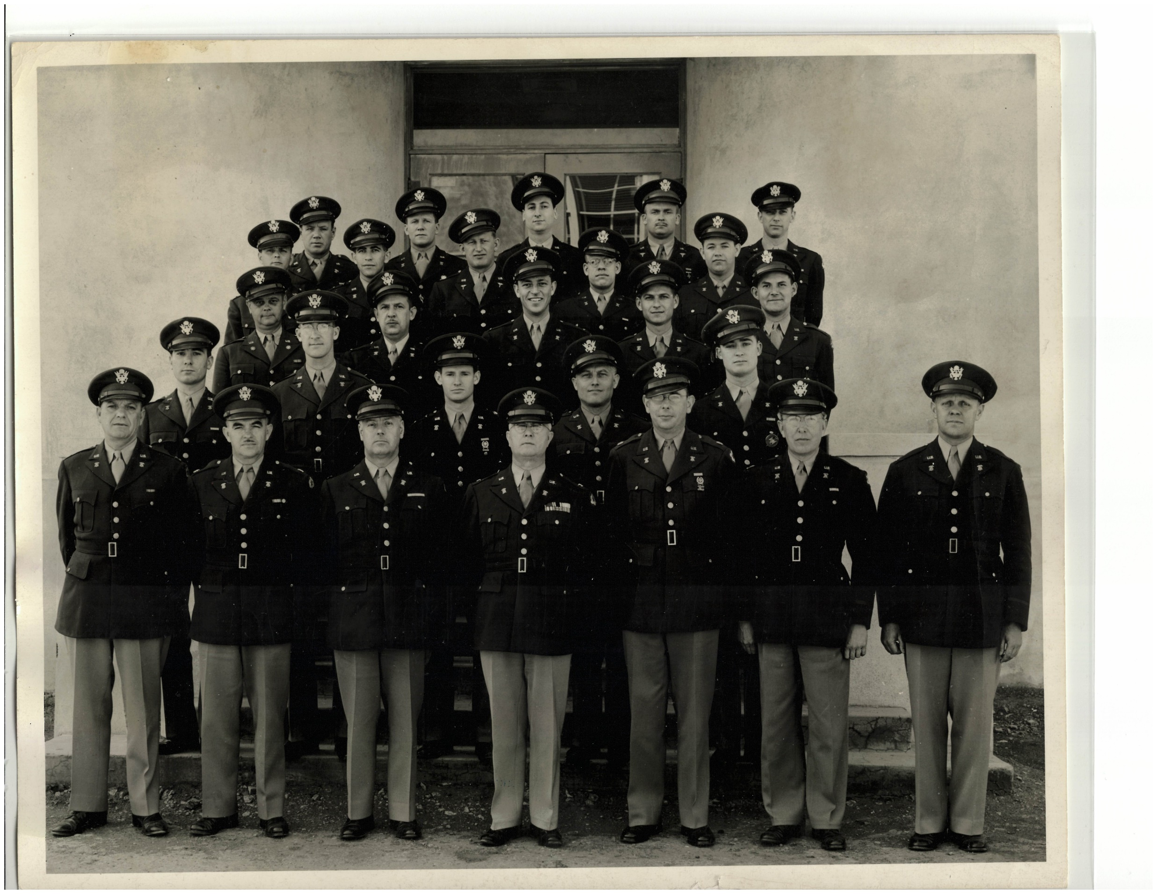

Slide 29
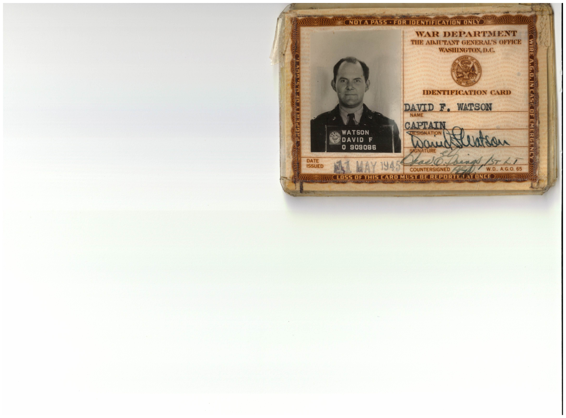

Slide 30
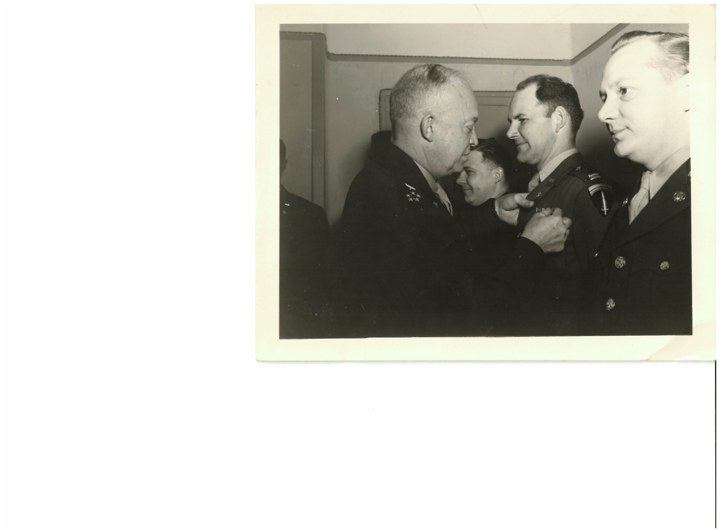

Slide 31
Defenses?
  “I only did what everyone else was doing”
  “I never stole anything”
  (no mens rea)

Slide 32
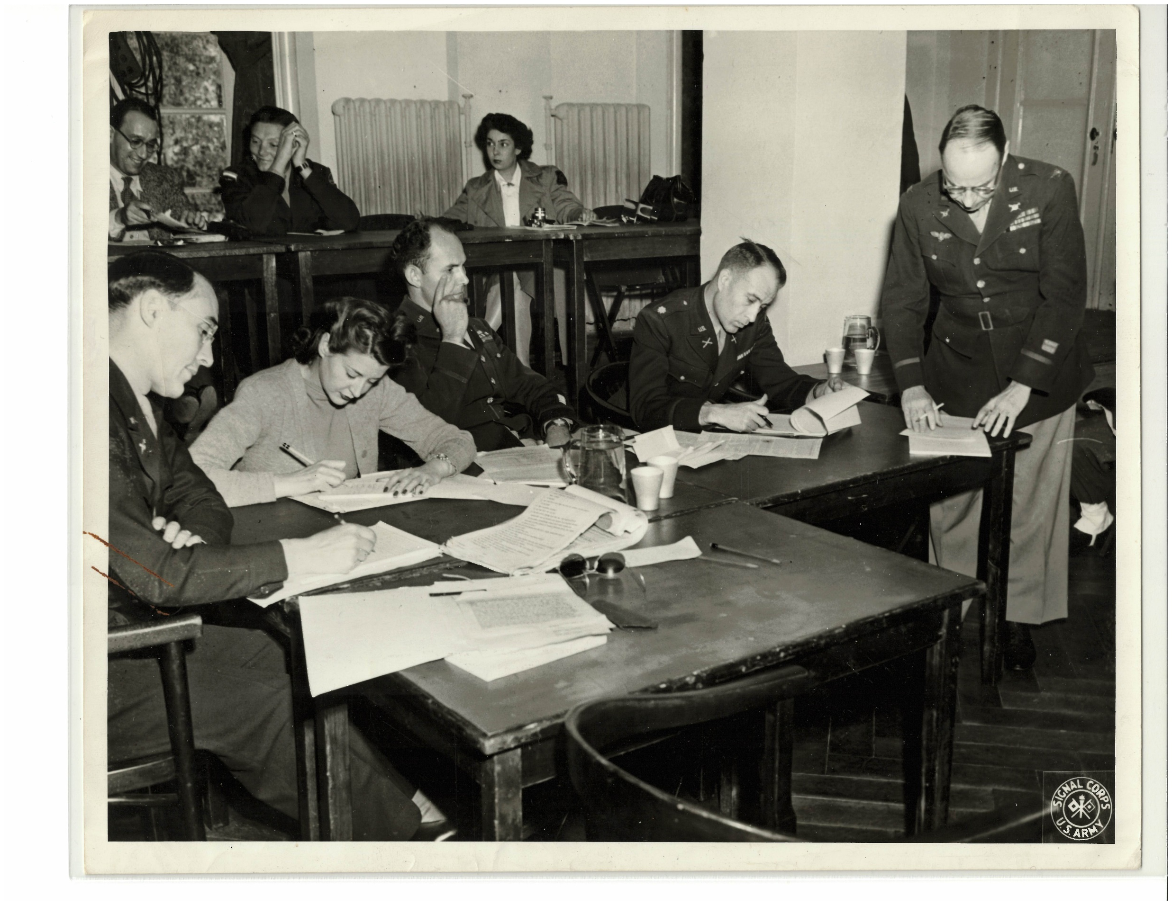

Slide 33
Result?
  Not guilty of larceny but guilty of receiving stolen property
  Guilty of Conduct Unbecoming
  Dismissal, 3 years CHL

Slide 34
Jack Durant
  Larceny, conspiracy
  Fraud
  Conduct Unbecoming

Slide 35
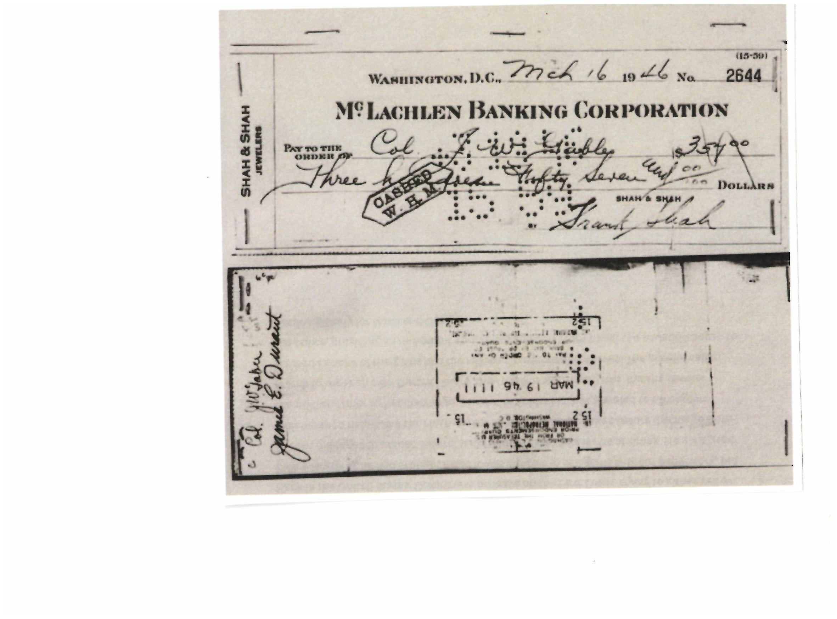

Slide 36
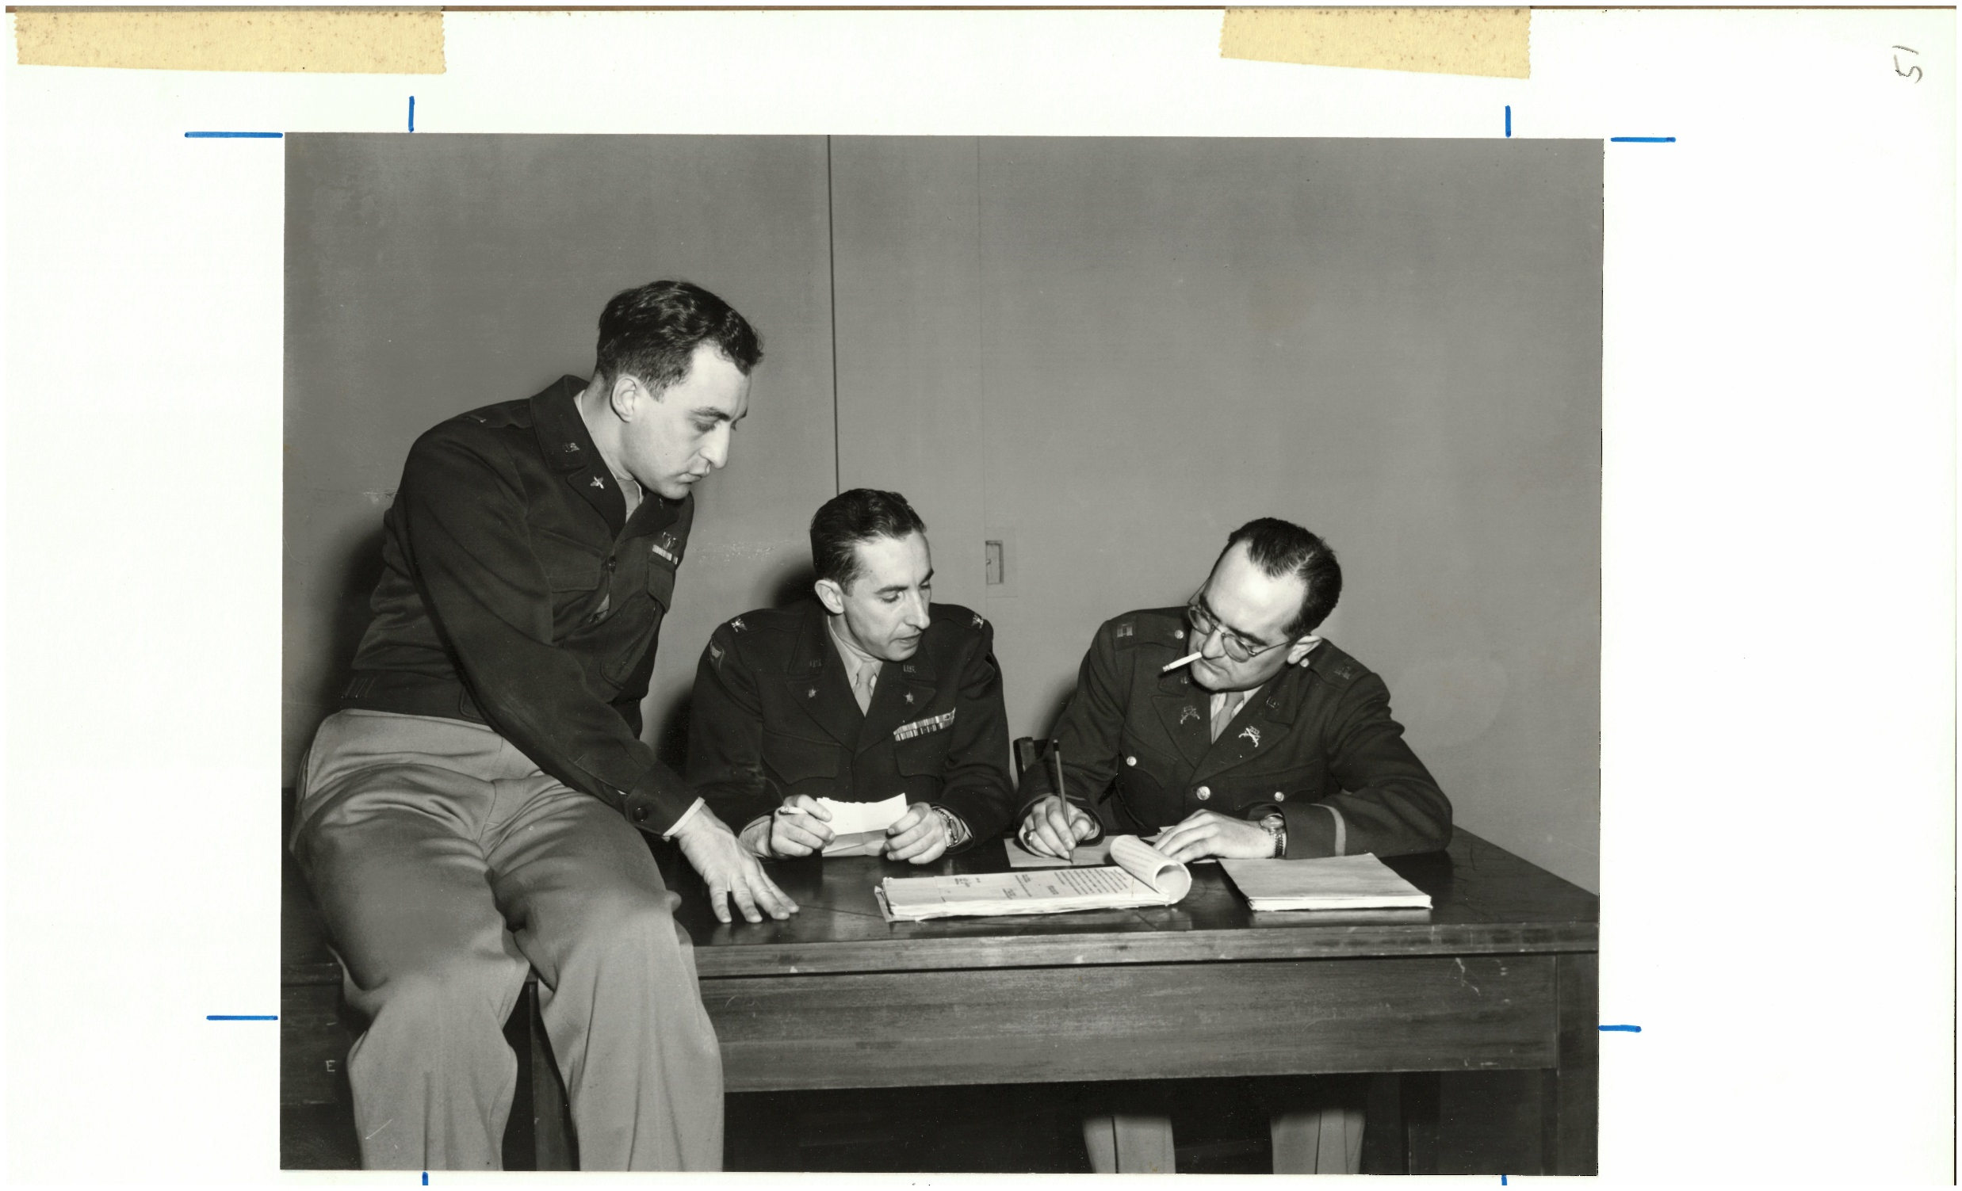

Slide 37
Katie Nash called to testify by trial counsel
Result?

Slide 38
Durant’s brother, sister-in-law, old girlfriend called to testify in Frankfurt
Result?

Slide 39
Defenses?
  Abandoned property
  War loot

Slide 40
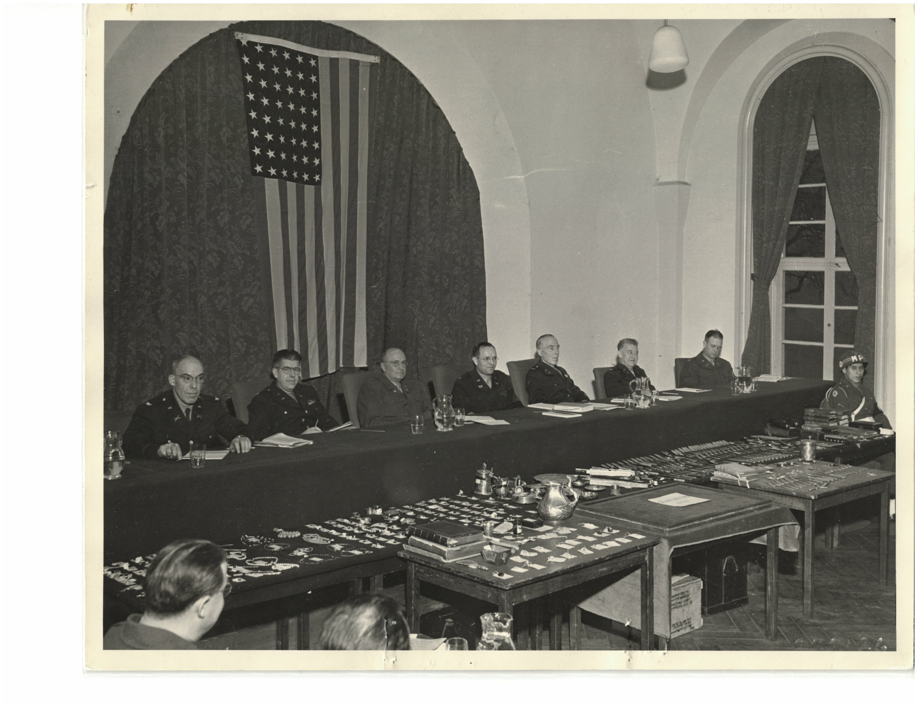

Slide 41
Result?
  Guilty on all charges and specifications
  Dismissal, 15 years CHL

Slide 42
(By the way, Durant was an attorney; LL.B., Georgetown, 1941)

Slide 43
“The Rest of the Story”
Appeals
  Nash
  Durant

Slide 45
Katie Nash confined at Federal Reformatory for Women (West Va.)
Habeas attack . . .
U.S. District Court agreed but . . . Fourth Circuit . . .

Slide 46
Released in 1952
Divorced Durant but lived with him for years
Died 1972 (69 years old)

Slide 47
Durant confined at U.S. Penitentiary (Atlanta)
Habeas attack . . No in personam jurisdiction
Released, 1952
Died in Miami, 1984 (75 years old)

Slide 48
Watson?
  Paroled in 1947
  Returned to California

Slide 49
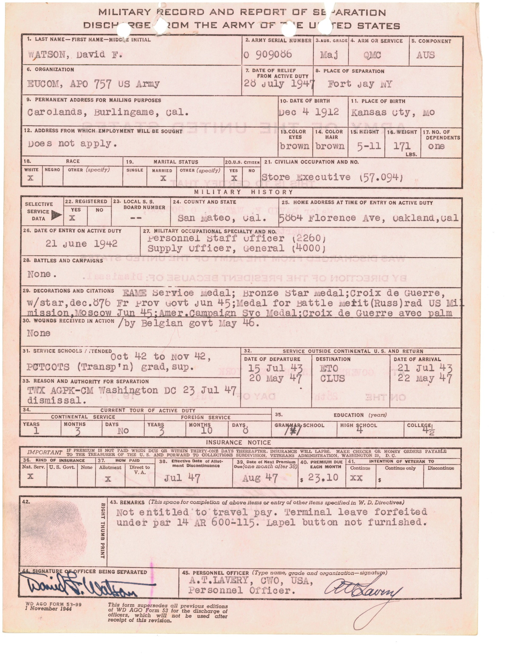

Slide 51
“I never stole anything and I really thought the treasure was enemy property . . . I never had any criminal intent”

Slide 52
“I only did what everyone else was doing”
(and really, it was all Jack Durant’s fault)

Slide 53
Two options:
  Return to duty as enlisted soldier?
  Presidential Pardon?

Slide 54
Applied for pardon, 1952
TJAG Mike Brannon opposes; DoJ declines to take action

Slide 55
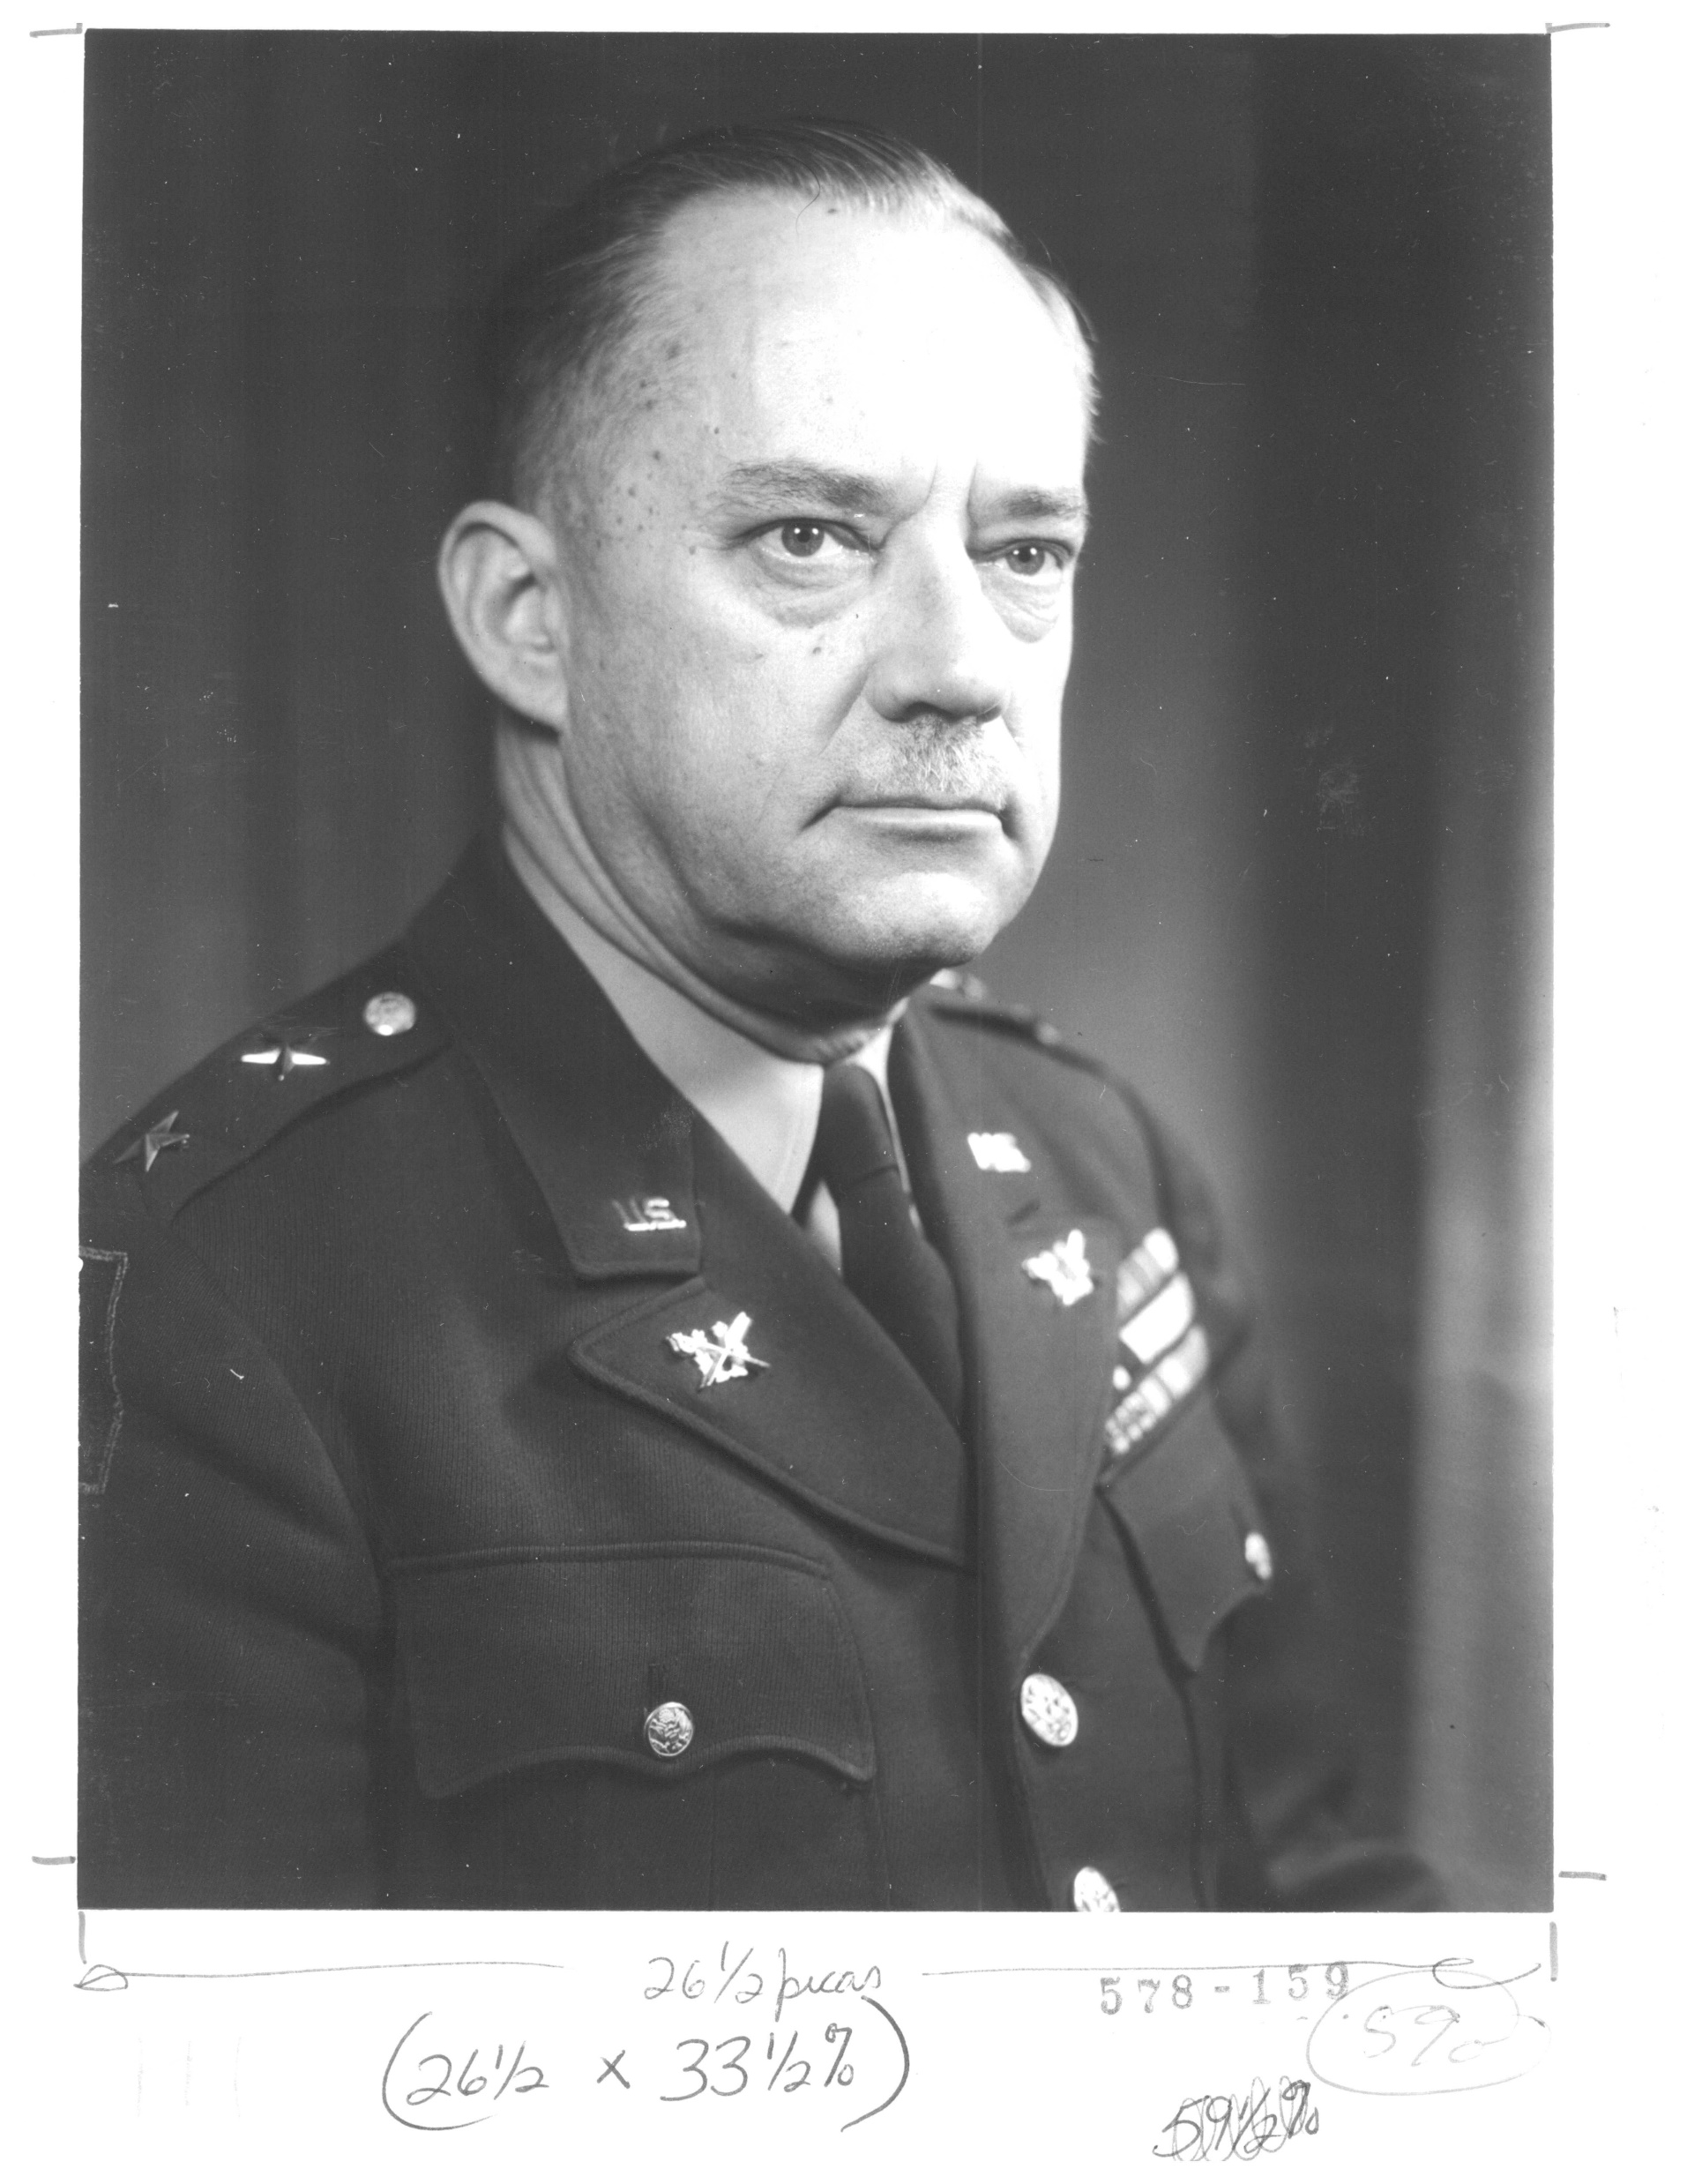

Slide 56
But – people leave & times change
Pardon application resubmitted, 1956

Slide 57
Success, 1957

Slide 58
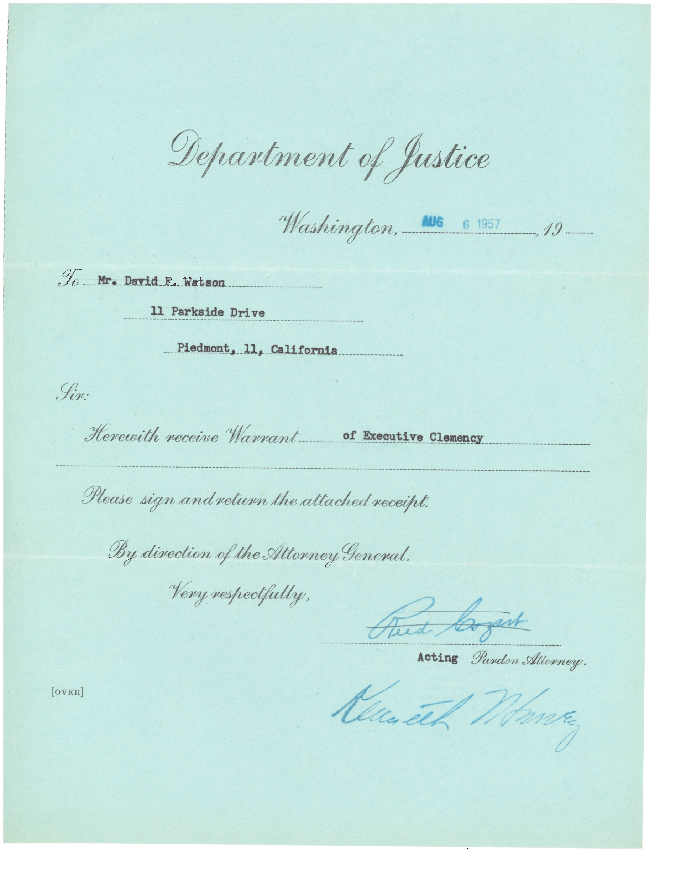

Slide 59
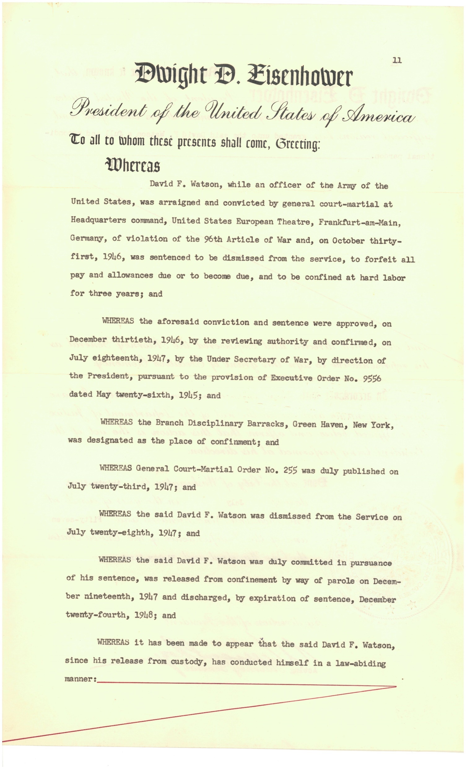

Slide 60
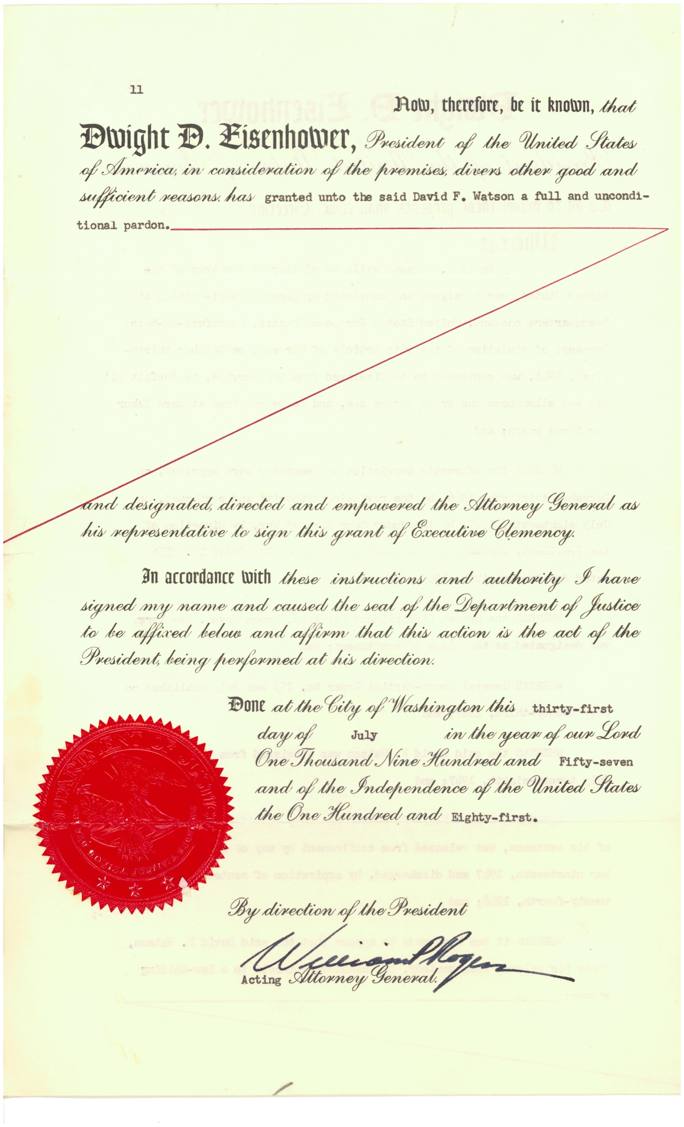

Slide 62
Watson
  Manager of Safeway (grocery) Store
  Manager of Handyspot Company
  Owned Hallmark Gift & Card Shop

Slide 63
“The Rest of the Story”
Treasure not returned to von Hessen family until 1951
Less than half treasure recovered. Why?

Slide 64
Two paintings stolen from castle (by others) were recovered in 2014
Returned to family by “Monuments Men Foundation” in 2015

Slide 65
Conclusion
So ends the story . . . perhaps

Slide 66
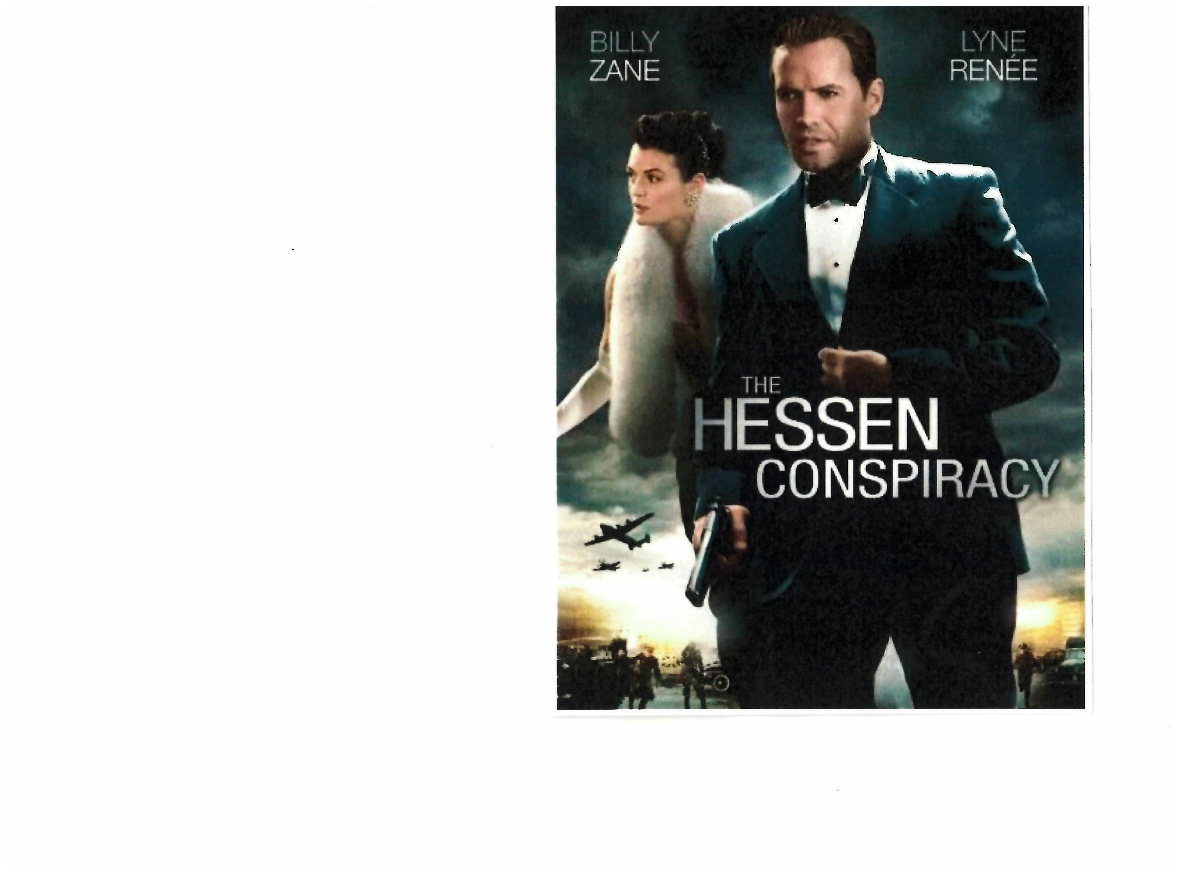

Slide 67
That’s all, folks
Questions? Comments?

