Slide 1
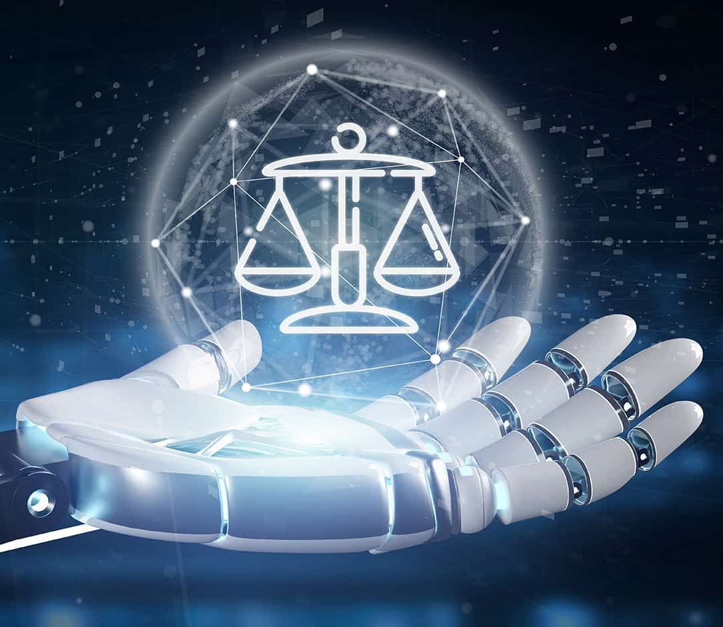
From Principles to Practice: AI for Judges (and Litigators)
USCAAF Conference
March 2022
(NJC image)

Slide 2
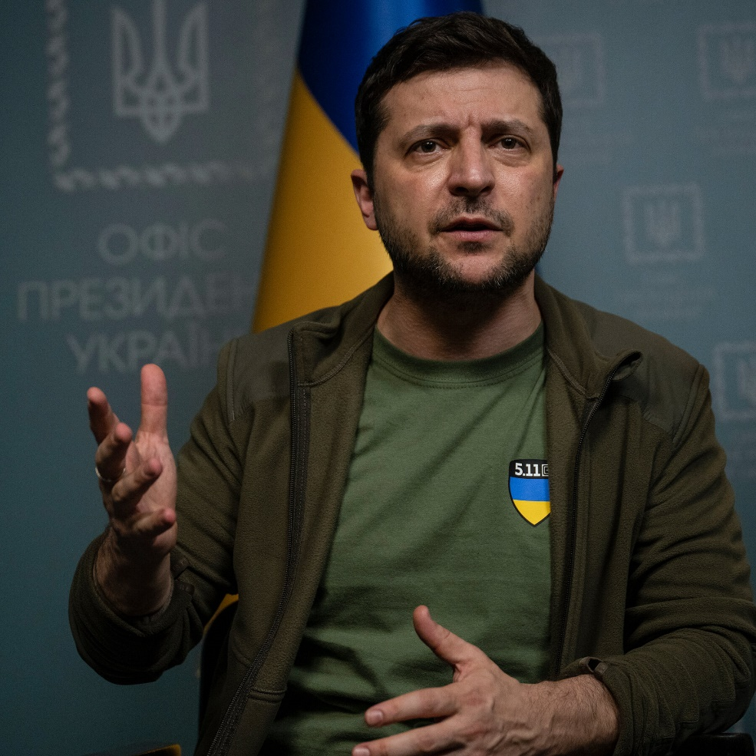
Purpose and Outline
1. Artificial Intelligence Reviewed
Definitions and Vocabulary (quick look)
Strengths and Weaknesses
NS Uses/Risks
2. Toward a Legal Framework
What Happens when Law not Clear
Five Phases of AI Regulation
Principles to Practice Checklist
Legal Policy Debates …
EU Regulation
3. AI for Judges
The Role of Judges
Some Key Cases
Conclusion: The Role of Judge Advocates
Caveats and Complaints

Slide 3
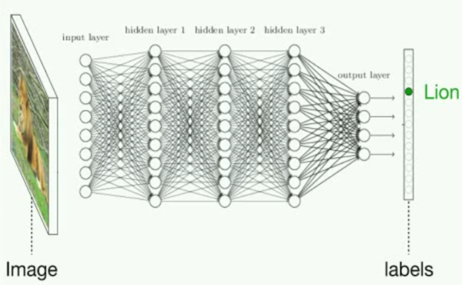
Definitions and Terms
The term “artificial intelligence” means a machine-based system that can, for a given set of human-defined objectives, make predictions, recommendations or decisions influencing real or virtual environments. Artificial intelligence systems use machine and human-based inputs to –
perceive real and virtual environments;
abstract such perceptions into models through analysis in an automated manner; and
use model inference to formulate options for information or action. Section 5002(3) of the NAII Act 2020 (Division E of NDAA 2020)
AI is not a single piece of hardware or software, but rather a constellation of technologies that give a computer system the ability to solve problems and to perform tasks that would otherwise require human intelligence. (NSCAI)
AI/ML The term “machine learning” means an application of artificial intelligence that is characterized by providing systems the ability to automatically learn and improve on the basis of data or experience, without being explicitly programmed.
Section 5002(11)e
Three notional categories of AI.
Deep Learning
Algorithm

Slide 4
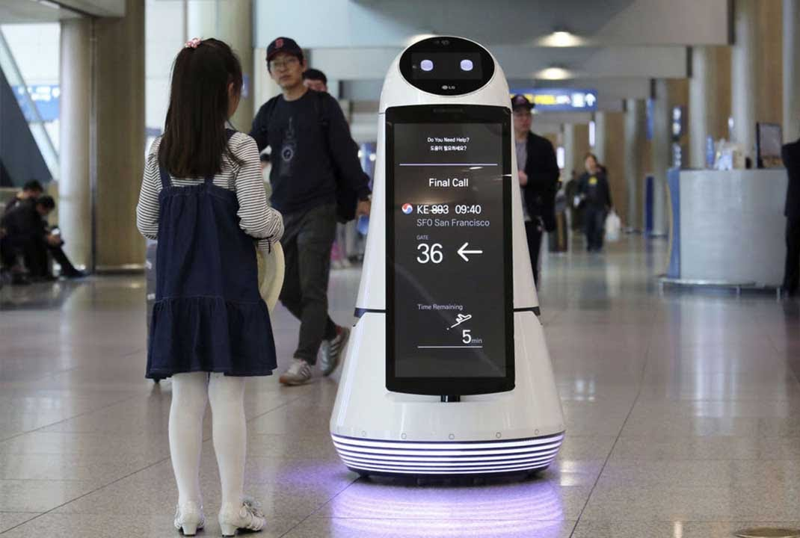
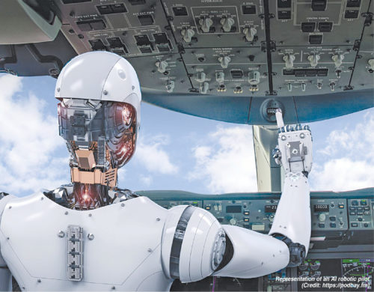
Strengths/Weaknesses
Aggregate data, structure data, and derive meaning from data, at machine speed
Pattern recognition
Natural language processing
Personalization prediction
Anomalies
Future events
Nimble
If well designed, trained, tested, and validated for the purpose used*
Complete predictability
Complete Transparency
Subjective judgment
Bias
Brittle

Slide 5
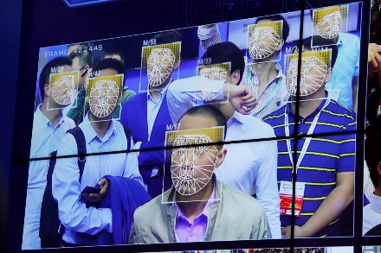
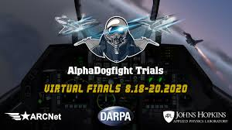
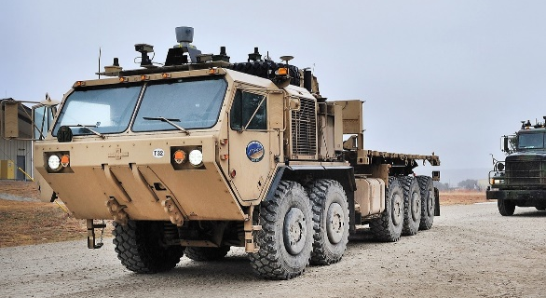
National Security Uses and Risks
Military
Intelligence
Law Enforcement
Commercial
Social Media
Medical
Diagnosis
Suicide Prevention
Logistics
Unintended Consequence
Human-Machine Teaming
Misunderstand
Fumble
Misuse
“Arms” Race (3 X S); first mover
Authoritarian Regimes
Information Warfare
Increase in conflict?
Decision-making pathologies
Existential?

Slide 6
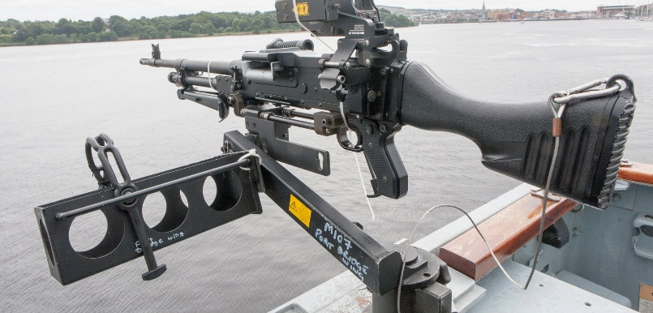
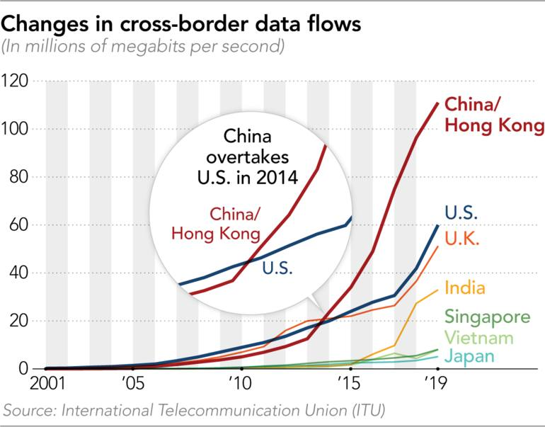
What Happens When Law is not Clear or Complete
The Law you Have
Constitutional Law
Litigation – Case Law
Law by analogy and metaphor
Ethics and Principles
First Movers “Set” the rules
A different kind of First Mover (EU and California)

Slide 7
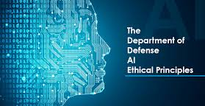
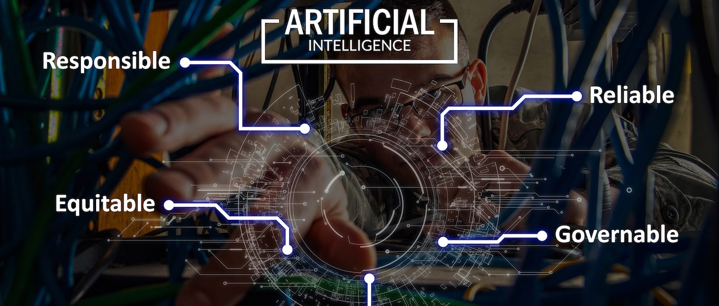
Five Phases of AI Regulation
Realization
Ethics and Principles Framework
What: DOD/ODNI
What: Bias/Data/Centaur’s Dilemma
Why
Mind the gap
Talent/Culture/Advocacy
2.1
The Edge
Authoritarian/Democratic
Ethics and Principles into Practice
DOD Directive
“Appropriate”
Training, Doctrine, TTP
Legislation
Organizational
Competition
Design/Use/Data
Collateral
International Adoption/Adaption

Slide 8
Principles to Practice Checklist (Please Report Back this Afternoon)
Process
DOD Directive
ODNI Framework
Contracting/Hiring
How lawyers operate
The CD Suite
Verification
Privacy Impact Statements
What should go in law, or policy, or leave as principle
Alignment x 2
LOAC
LOAC by Analogy
Bias in context
Data management generally
And in context
Speed!
Legal Policy Debates and Solutions

Slide 9
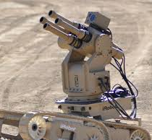
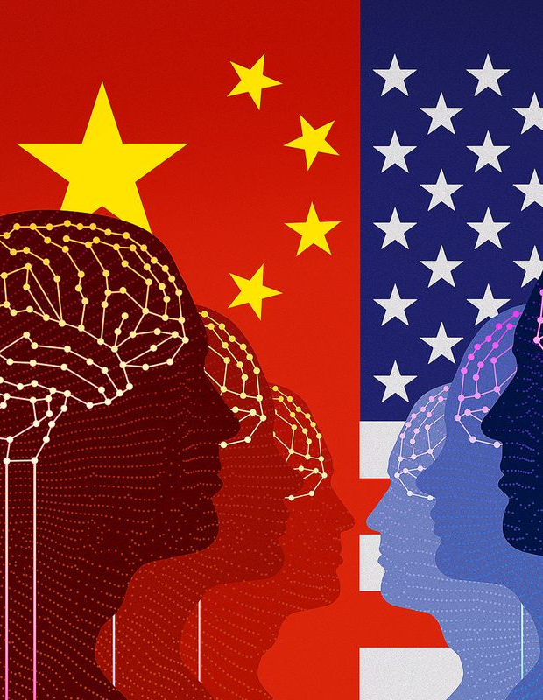
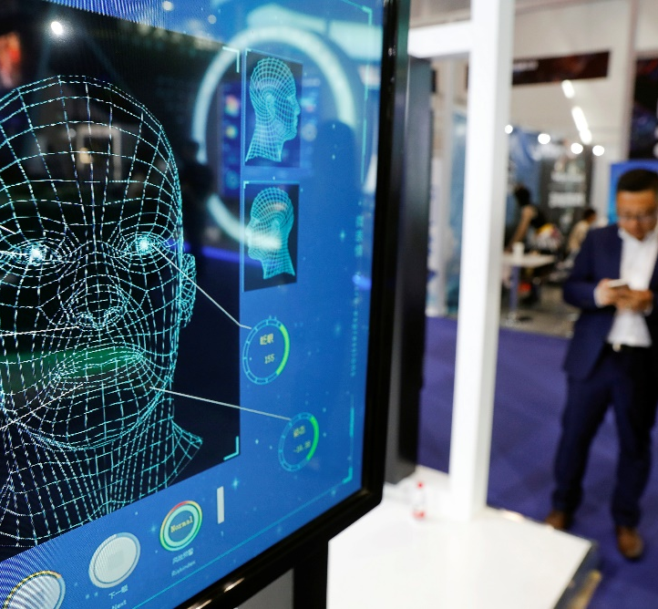
Legal Policy Debates
First Amendment – Thresholds, Myths, and Walls
Fifth Amendment - DP Under the Hood
Fourth Amendment - Third Party Doctrine
What it means to be an American Corporation
Facial Recognition
Social Media
Dare I say it: LAWS
So What? Why Does it Matter
Google, etc.
DOD
EU
Courts
China
Democratic/Authoritarian
E + L = NS*

Slide 10
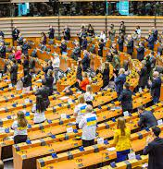
EU Regulation in Brief
Purpose and Principles
Technology neutral and future proof
Health, safety, fundamental rights of natural persons
Risk Management
Necessary and proportionate
Categories
Unacceptable risk
Real time biometric ID systems, but
Subliminal techniques
Social scoring
High risk
Safety component
Administration of Justice
Democratic Processes
Access to Services
Law Enforcement
Low or minimal risk
High Risk
Risk management system
Data and data governance
Transparency
Human oversight
Conformity Assessment

Slide 11
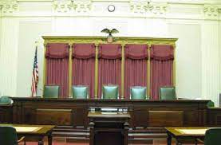
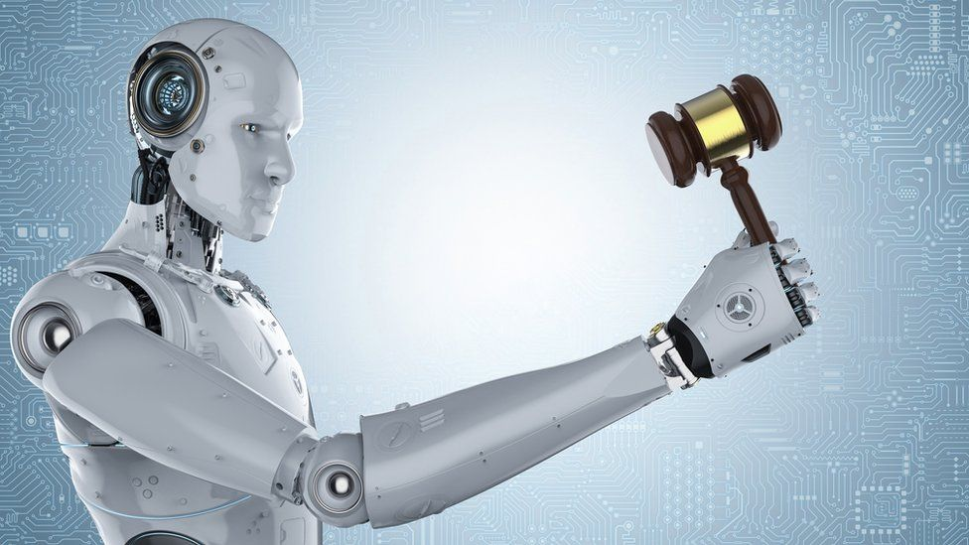
AI and Courts Outline and Discussion Pause
Role of Judges
Types of Cases
Case Law and Takeaways
Role of Judge Advocates

Slide 12
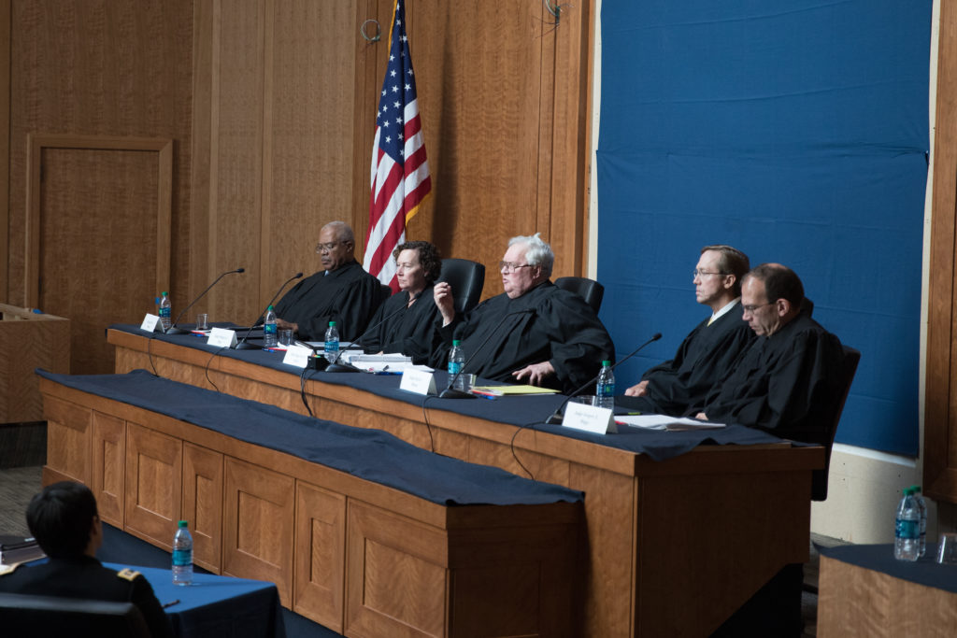
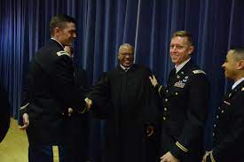
Role of Judges
Gatekeepers
Guardians
Consumers
Communicators
MJ Caveat +/-
Types of Cases
Tort
First Amendment
Privacy and Fourth Amendment
Due Process
Equal Protection

Slide 13
[Some] Takeaways for Judges (to Avoid Embarrassing the Future)
There are many different AI Methodologies
Most AI is iterative and should be tested and validated on an ongoing basis
Humans are always involved
AI predicts; it does not necessarily “conclude”
At present: Quality = Data = Volume
The Heart of the AI is the Algorithm
AI is Brittle
AI is Nimble
Issues: Predictive Algorithms; Bias; Deepfakes

Slide 14
A Word on Bias
Statistical Bias
Moral Bias
Training Data Bias
Inappropriate Bias
Inappropriate Deployment Bias
Interpretation Bias
Unwitting Human Bias…Cognitive Bias suite
Intentional Bias
Overfitting and Outliers
Design Bias

Slide 15
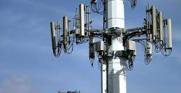
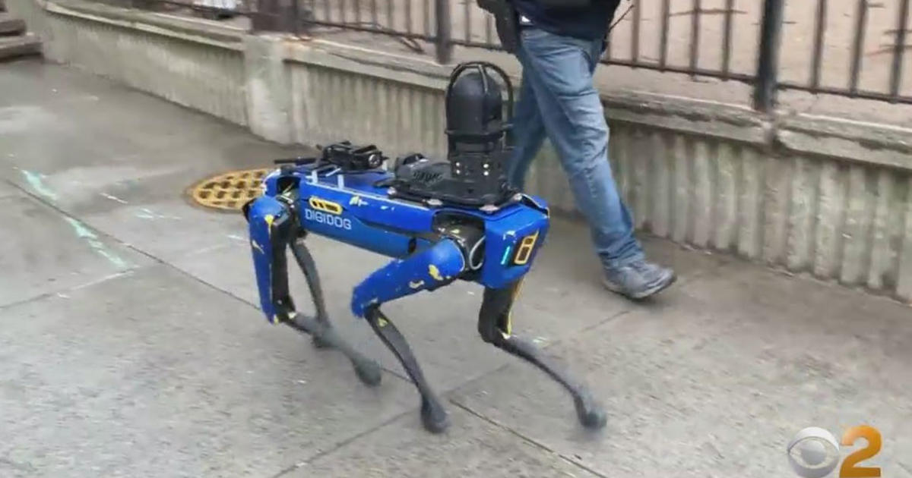
[Some] Cases for Your Kit
Crawford
Daubert
Matthews v. Eldridge
Loomis
Kyllo
Jones
Riley
Riley
Ciraolo

Slide 16
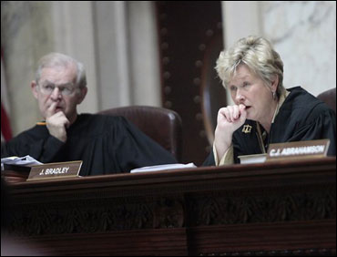
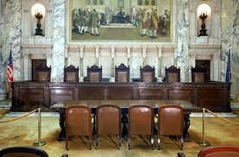
State v. Loomis, 881 N.W. 2d 749 (2016).
Facts
Conclusions
Critiques
And another thing

Slide 17
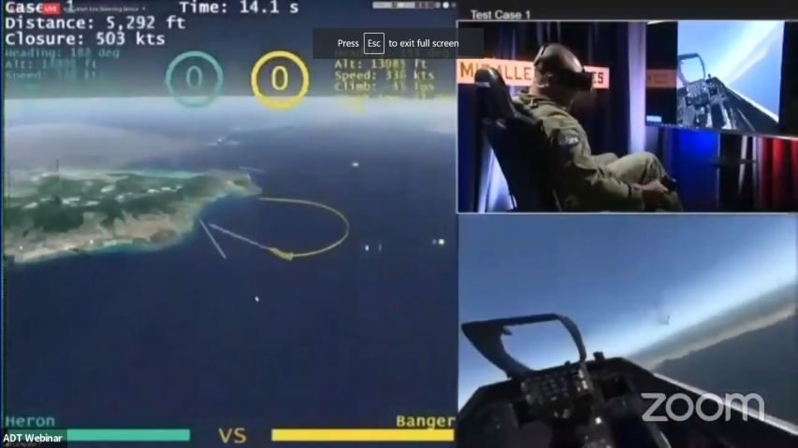
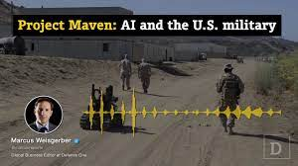
Role of Judge Advocates Conclusion
Implement Principles
Implement DOD Directives
Appropriate Levels of Human Judgment
Design, Deployment, Use, Validation
Training, Doctrine, Tactics, Techniques, and Procedures
Coding in/Coding Out and how do you do it
LOAC
LOAC by analogy
Practice Points
Backroom stuff
Role of Military Judges?
E + L = NS
Speed

Slide 18
At Last

Slide 19
Notes:
Brendan Hoffman NYT 3/5/22

