Slide 1
Unsworn Victim Statements: How Impactful are they?
Professor Elizabeth lippy, temple law

Slide 2
But first… Who am I?

Slide 3
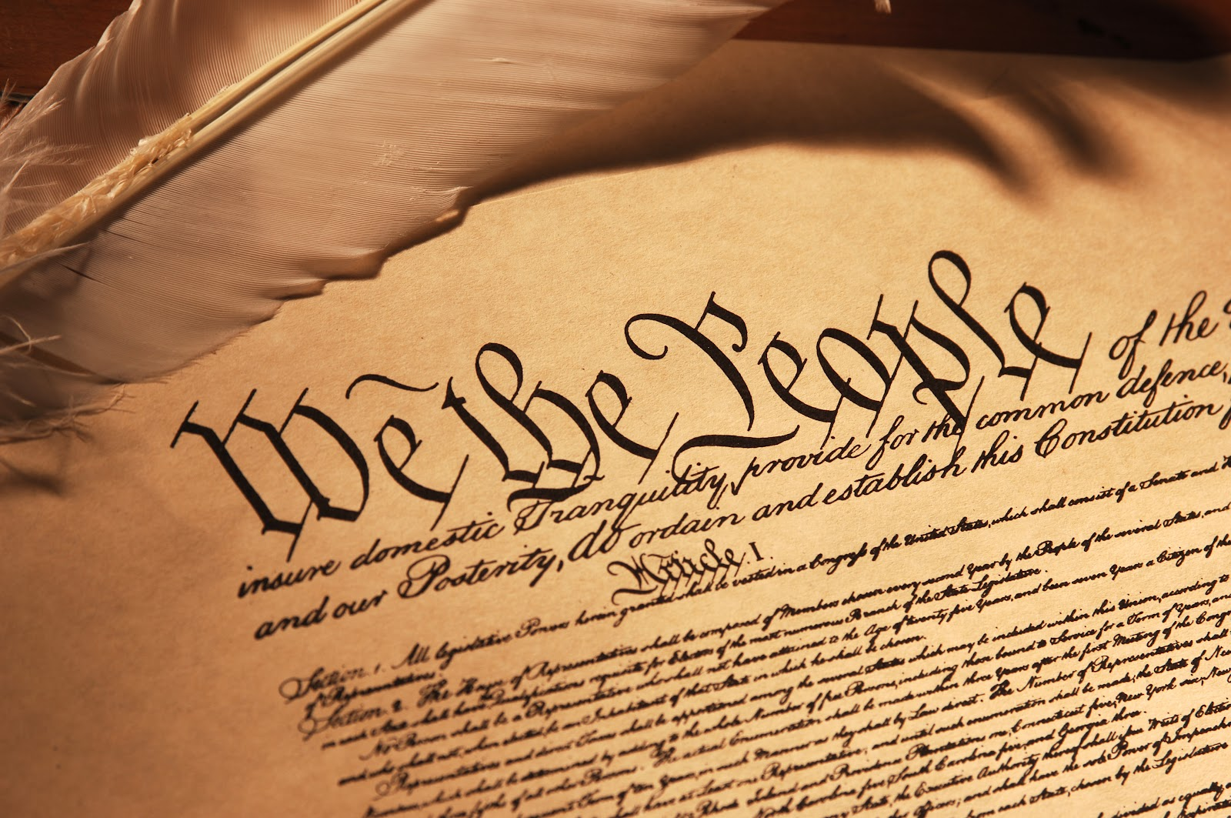
Balancing a Defendant’s Constitutional Rights and Victim’s Rights in the Realm of Rape Shield Law
By Elizabeth L. Lippy, Esquire

Slide 4
The Role of the Special Victim’s Counsel: The Good, the Bad, the Ugly
Professor Elizabeth L. Lippy
Major Jenna Reed, USMC Reserve

Slide 5
Changes to the Article 32
1949 Congressional Floor Debate
Prof. Elizabeth Lippy & Major Frank Kostik
Notes:
Quote from the 1949 Congressional Floor Debate.
Over the past several years there has been much debate in the field concerning the role of the Article 32, its effect on the Convening Authorities, and the tactical advantages of the presentation of evidence
The basic premise remains the same – they are important because the convening authority should be relying on the information contained in them to determine the appropriate disposition of the charges and the level of Court

Slide 6
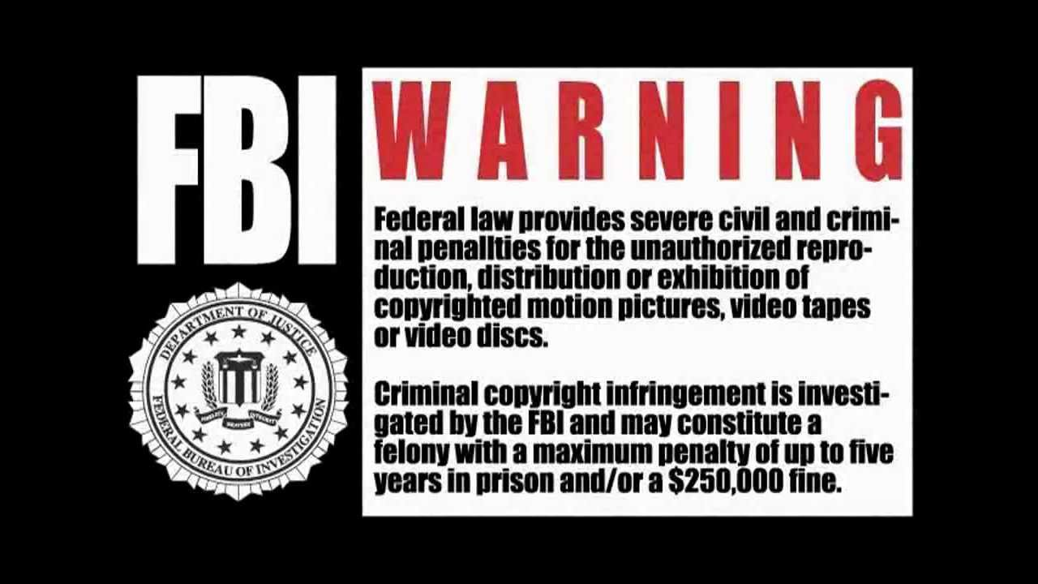
I truly am honored to be here
I do not practice military law, although intrigued by it
I am not fluent in, nor do I speak, “acronym”
I am a criminal defense lawyer by trade
I do not intend to offend anyone
I am only a law professor
I have no real answers
I do not take myself too seriously
I have more fun when people interrupt me

Slide 7
Roadmap of Presentation
Evolution of victim’s rights at sentencing
Practical Ramifications
The influence of the unsworn statement in sentencing
Defendant’s rights balanced against the victim’s rights
Appellate issues
The future of sentencing & victim’s rights

Slide 8
Victim Defined
§806(b) Art. 6b
(b) Victim of an offense under this chapter defined. -- …the term “victim of an offense under this chapter” means an individual who has suffered direct physical, emotional, or pecuniary harm as a result of the commission of an offense under this chapter.
RCM 1001A
(b) Definitions
(1) …a “crime victim” is an individual who has suffered direct physical, emotional, or pecuniary harm as a result of the commission of an offense of which the accused was found guilty.

Slide 9
Right to be Heard
§806(b) Art. 6b
Rights of a victim of an offense under this chapter –
(4) The right to be reasonably heard at any of the following:
(B) A sentencing hearing relating to the offense.
RCM 1001A
(a) In general
A crime victim… has the right to be reasonably heard at a sentencing hearing relating to that offense. A victim under this rule is not considered a witness for purposes of Article 42(b).

Slide 10
Right to Notice
§806(b) Art. 6b
Rights of a victim of an offense under this chapter –
(2) The right to reasonable, accurate, and timely notice of any of the following:
(D) A post-trial motion, filing, or hearing that may address the finding or sentence of a court-martial…
RCM 1001A
(a) In general
…Trial counsel shall ensure the victim is aware of the opportunity to exercise that right…

Slide 11
Scope of Victim Impact
RCM 1001A
(b) Definitions
(2)Victim impact. .. “victim impact” includes any financial, social, psychological, or medical impact on the victim directly relating to or arising from the offense of which the accused has been found guilty.

Slide 12
Being reasonably heard at sentencing
RCM 1001A (2016)
(b) Definitions
(4) Right to be reasonably heard.
(B) Non-capital cases. In non-capital cases, for purposes of this rule, the “right to be reasonably heard” means the right to make a sworn or unsworn statement.*
RCM 1001A (2014)
…For the purposes of this rule, the right to be reasonably heard means the right to testify under oath….
***in capital cases, the VIS must be sworn (RCM 1001A(b)(4)(B))

Slide 13
No Cross-Examination
RCM 1001A
(e) Unsworn statement
The victim may make an unsworn statement and may not be cross-examined by the trial counsel or defense counsel upon it or examined by the court-martial…

Slide 14
This is a good change, right?

Slide 15
Some Positive reflections
Victims do not have to be re-traumatized by cross-examination
In reality, how much cross-examination of victims happens at sentencing?
The rules are more akin to Crime Victims Right Act
Fulfilling congressional mandates

Slide 16
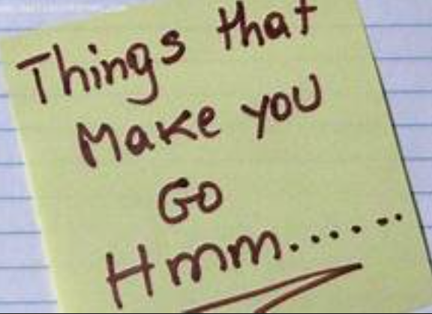

Slide 17
Procedure at Sentencing
Presentation by trial counsel
Victim’s right to be reasonably heard
Presentation by defense
Rebuttal
Argument by Trial Counsel
Argument by Defense Counsel
Rebuttal argument (if allowed)

Slide 18
Don’t get it twisted…
Unsworn Victim Statement v.
Evidence in aggravation
NOT Evidence, so rules of evidence do not apply (US v. Tyler, 81 M.J. 108 (2021)
TC can comment on UVS during argument (Id.)
RCM 1001(B)
Rules of Evidence apply
Evidence that can be used to argue aggravated sentence

Slide 19
Without MRE, what are the bounds?
UVS must be provided to trial counsel & defense counsel after announcement of findings (RCM 1001A(e)).
Military judge may waive this requirement for good cause shown
Objections can be made pre-sentencing striking portions
UVS should not exceed what is permitted under RCM 1001A(c) and may not include a recommendation of a specific sentence
A victim, victim’s counsel, or designee cannot present argument about potential sentences

Slide 20
Whose right to be reasonably heard?
Introduction of statements are prohibited without either the presence or request of the victim, the special victim’s counsel or the victim’s representative.
Issues arise involving “repeat” victims
US v. Barker, 77 M.J. 377 (2018) – 3 impact statements offered by KF, victim of “Vicky series” was improper
US v. Hamilton, 78 M.J. 335 (2019) – law enforcement may not be the mouthpiece for UVS from B, B’s mother, and J (“Marineland” victim)
The right to be reasonably heard has is specific to the victims

Slide 21
Unresolved question of how Unsworn Statement may be presented
Can it be offered in a Q & A format?
RCM 1001A(e)(2) Upon good cause shown, the military judge may permit the victim’s counsel to deliver all or part of the victim’s unsworn statement
Trial counsel may not offer unsworn testimony in Q & A format (US v. Cornelison, 78 M.J. 739 (A. Ct. Crim. App. 2019)(ruled harmless error)
It was not error for victims to provide their unsworn statements as answers to trial counsel’s questions, of which questions defense was on notice (US v. Harrington, Not Reported, WL 4807174 (A.F.Ct.Crim.App. 2021).

Slide 22
How far is too far?
Thursday, July 15, 2021
Order Granting Petition for Review
No. 21-0245/AF. U.S. v. Isaiah L. Edwards. CCA 39696. On consideration of the petition for grant of review of the decision of the United States Air Force Court of Criminal Appeals, it is ordered that said petition is granted on the following issue:
WHETHER THE MILITARY JUDGE ABUSED HIS DISCRETION BY ALLOWING THE VICTIM TO PRESENT AS AN IMPACT STATEMENT A VIDEO—PRODUCED BY THE TRIAL COUNSEL—THAT INCLUDED PHOTOS AND BACKGROUND MUSIC.

Slide 23
What role does it even have in argument?
“In the absence of explicit statutory limitation, or other clear evidence of Congress’s or the President’s intent to limit comment on unsworn victim statements in presentencing argument, we hold either party may comment on properly admitted unsworn victim statements.” – US v. Tyler, 81 M.J. 108 (2021)

Slide 24
But beware of the “mishmash”
Judge Ryan warns of the “mishmash” and misuse of the unsworn statement in U.S. v. Scott, 81 MJ 79 (2021)
Despite stipulation that Appellant did not know HM was married until several months after the adulterous affair, the court admitted the unsworn statement of SFC MacKay (husband).
Government’s argument skewed the truth and cast Appellant as a predator who knew all along
Judge perceived the unsworn testimony as allowable under RCM 1001(b)

Slide 25
How do the members consider UVS?
Member instruction:
An unsworn statement is an authorized means for a victim to bring information to the attention of the court and must be given appropriate consideration. The victim cannot be cross-examined by the prosecution or defense or interrogated by court members, or me, upon an unsworn statement but the parties may offer evidence to rebut statements of fact contained in it. The weight and significance to be attached to an unsworn statement rests within the sound discretion of each court member. You may consider that the statement is not under oath, its inherent probability or improbability, whether it is supported or contradicted by evidence in the case, as well as any other matter that may have a bearing upon its credibility. In weighing an unsworn statement, you are expected to use your common sense and your knowledge of human nature and the ways of the world.

Slide 26
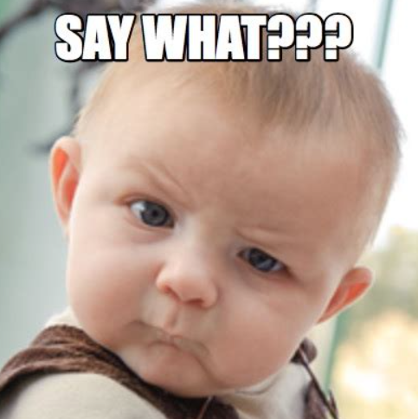

Slide 27
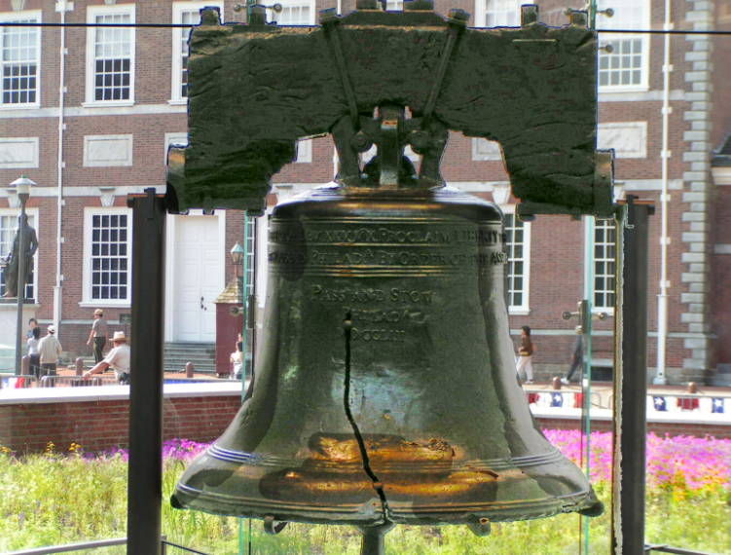

Slide 28
So… Does an Unsworn Impact Statement have any Impact?
We just don’t know
But why shouldn’t it?
Is the victim’s right to be reasonably HEARD fulfilled?
Are victims being told that their UVS cannot be used in aggravation?
Would that make a difference as to whether a victim wants to give sworn impact testimony?
Should this change with your upcoming sentencing changes?

Slide 29
Appellate Review of Cases
Test for prejudice = whether the error substantially influenced the adjudged sentence
4 factor analysis (US v. Barker):
1. the strength of the Government’s case;
2. the strength of the defense case;
3. the materiality of the evidence in question; and
4. the quality of the evidence in question.
Most find that even if there was error, no prejudice.

Slide 30
Relax the rules of evidence?
There’s no guaranty that a defense will relax the rules, but once they do, does that open the door to trial counsel introducing an UVS as aggravating evidence and not just 1001A?
Most civilian courts do not strictly apply the rules of evidence, BUT…

Slide 32
Members verdict v. Judge Sentencing
No unanimous verdicts
See disparate sentences to make up for a conviction
If members do not have this ability, do we see less convictions?

Slide 33
Judicial Sentencing Schemes
Judges are deemed able to properly view and weigh UVS
How will the new sentencing guidelines affect this?
Should a VIS be part of the criteria under the new guidelines? If so, will the VIS be required to be sworn?
If a judge relies on UVS for an upward departure from the new guidelines, will that be an Apprendi violation?

Slide 34
Thank you! elippy@tactlawyer.com www.tactlawyer.com

