Slide 1
JUSTICE WAS “A CASUALTY OF WAR”
Fred L. Borch
Professor Of Legal History & Leadership
Regimental Historian & Archivist
The Judge Advocate General’s Corps, U.S. Army
March 9, 2022

Slide 2
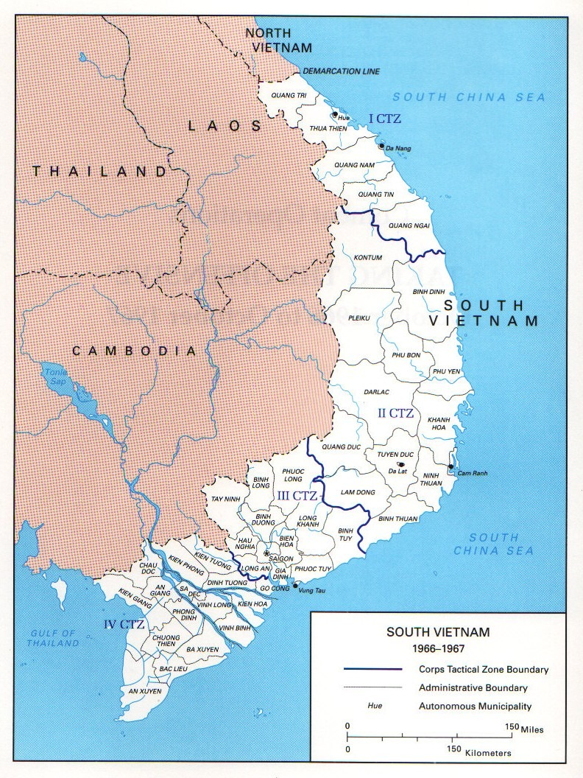

Slide 3
Roadmap
  Some context – Vietnam War
  “Incident on Hill 192”
  Trials by Courts-Martial
  Aftermath

Slide 4
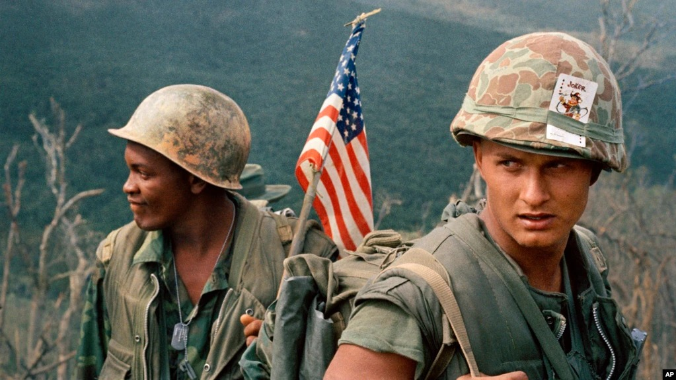

Slide 5
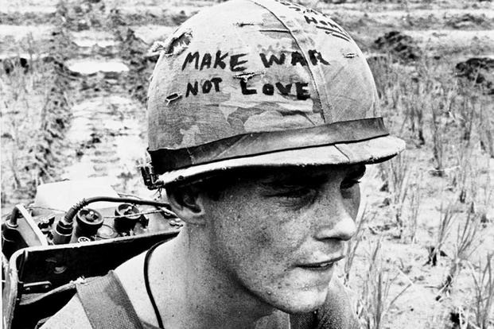

Slide 6
Vietnam War
1964: Tonkin Gulf incident
1965: Westmoreland requests additional U.S. troops; “Americanization” of the war

Slide 7
LBJ: Best-trained, best-equipped Army will overpower NVA & VC—and buy time for Saigon to establish functioning civilian government
1965: 180,000 American troops
1966: 385,000 American troops
(April 1969: 543,000)

Slide 8
Incident on Hill 192
17 November 1966
  SGT David Gervase, 20
  PFC Steve Thomas, 21
  PFC Jos. Garcia, 20
  PFC Cipriano Garcia, 21

Slide 9
And
  PFC Robert Storeby, 22
  All members of C Co., 2d Bn (Abn), 8th Cav., 1st Cav. Div.
  Mission?

Slide 10
On 16 November, Recon of Hill 192 – “extremely dangerous mission” – looking for VC complex
Gervase announces that:

Slide 11
“We will find a pretty girl for the purpose of boom-boom; good for the morale of the squad.”
Phan Thi Mao, 20

Slide 12
What happened?

Slide 13
Law officer Paul Durbin:
  The real hero was Storeby . . .

Slide 14
Trials by Courts-Martial
March & April 1967
All four prosecuted for rape and murder

Slide 15
Defense counsel:
  Storeby is liar; Storeby killed Mao; Storeby fabricated story to escape future hazardous assignments

Slide 16
Results:
  Gervase: G, unpremeditated murder, NG of rape; 10 years
  Thomas: G, premeditated murder & rape; Life

Slide 17
  Joseph Garcia: G, premeditated murder & rape; 15 years
  Cipriano Garcia: G, premeditated murder & rape; 8 years

Slide 18
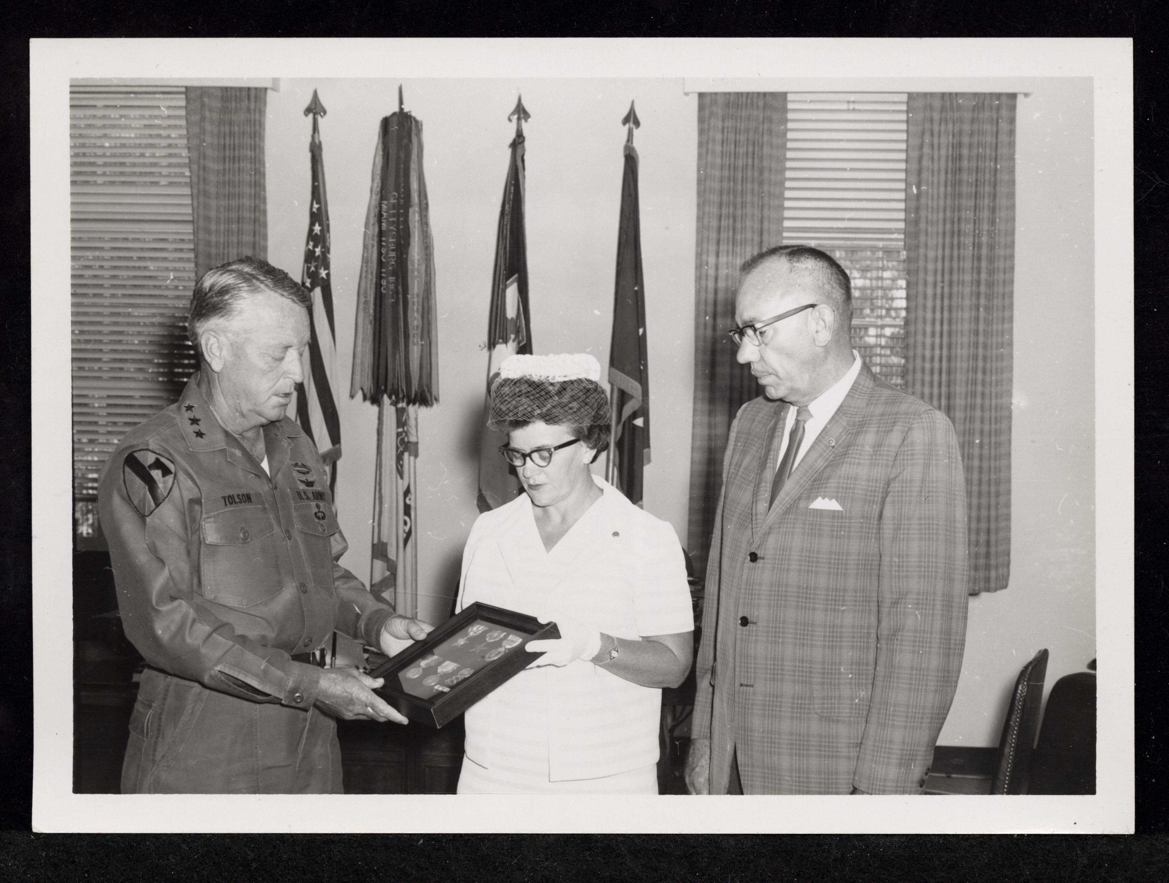

Slide 19
Letter for Storeby:
  You are to be commended . . .

Slide 20
Aftermath

Slide 21
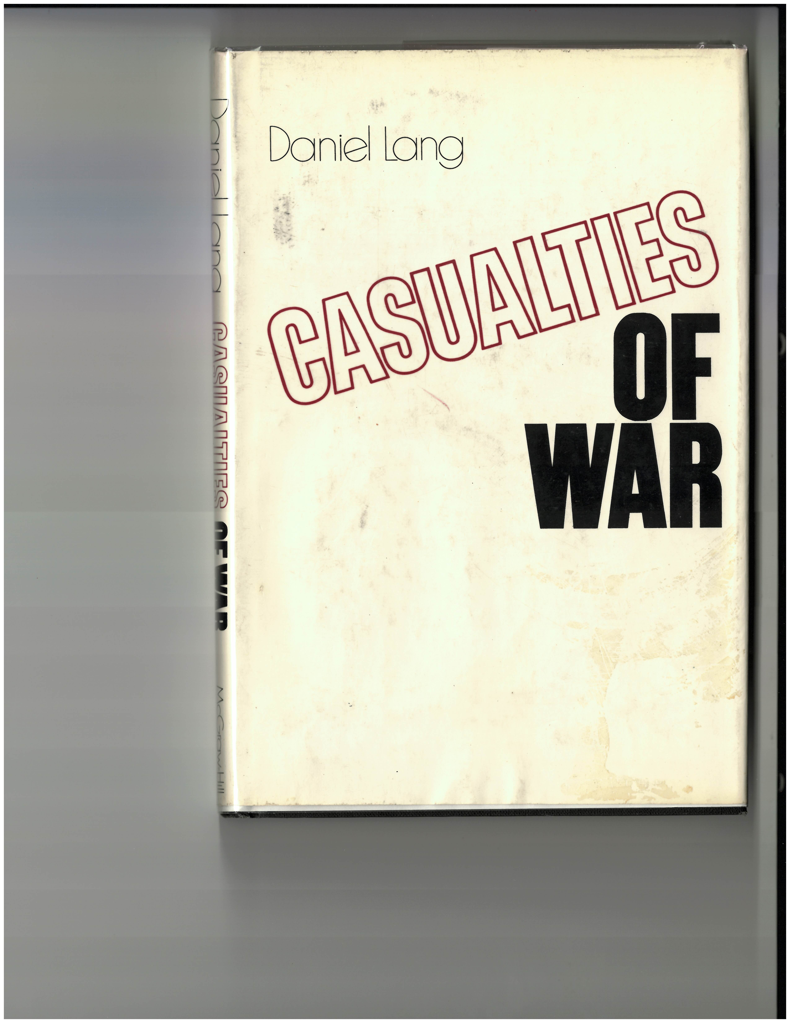

Slide 22
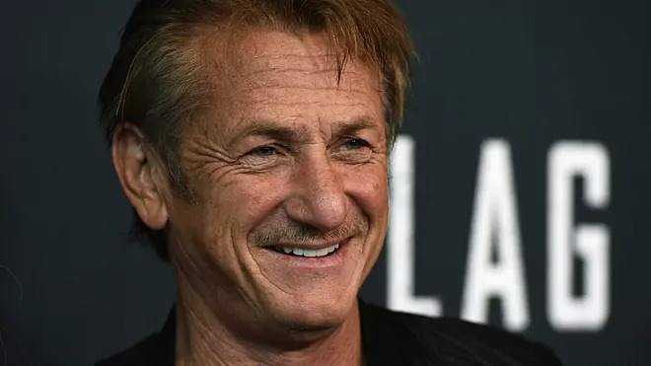

Slide 23
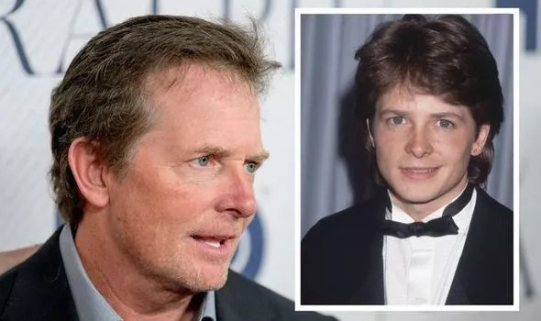

Slide 24
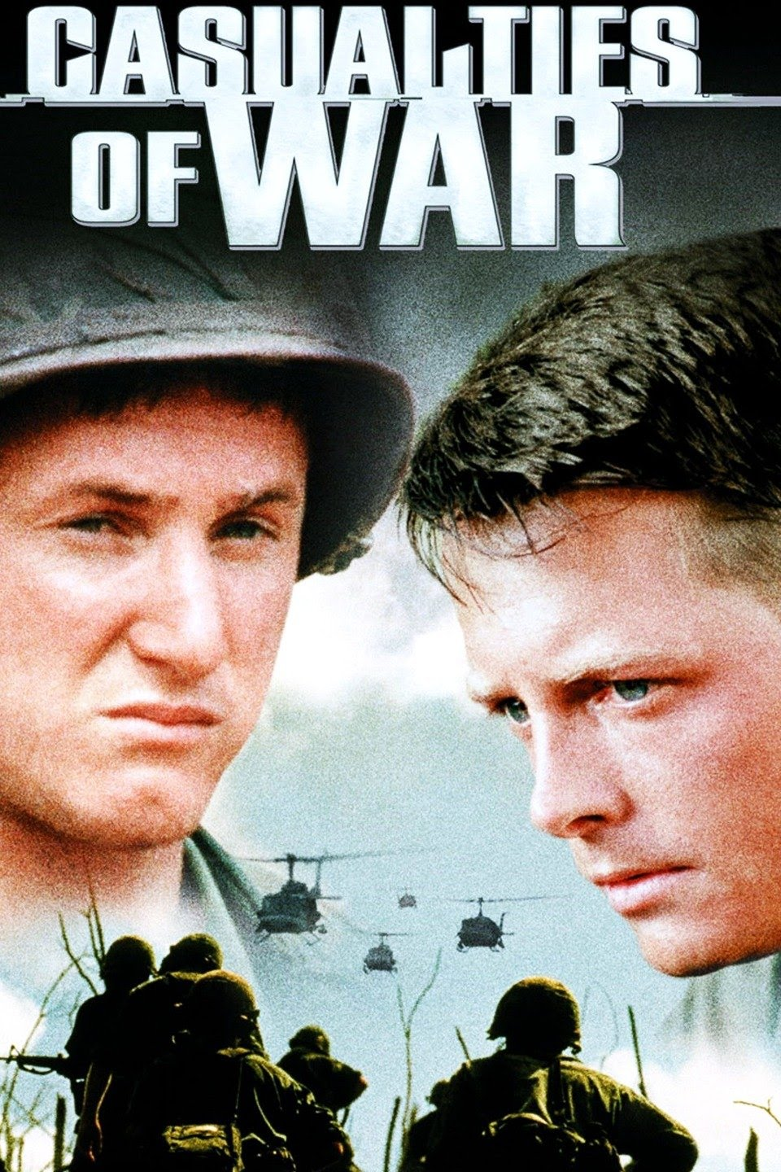

Slide 25
Action at the USDB
  Thomas—life sentence reduced; released on parole 18 June 1970
  Gervase—10 years; released on parole on 9 Aug 1969

Slide 26
Courts-martial on appeal
  Joseph Garcia; Board of Review finds error in Article 31 warnings; retried.
  What result?

Slide 27
  Cipriano Garcia; Board of Review examines identical Article 31 issue but affirms; COMA reverses
  What result?

Slide 28
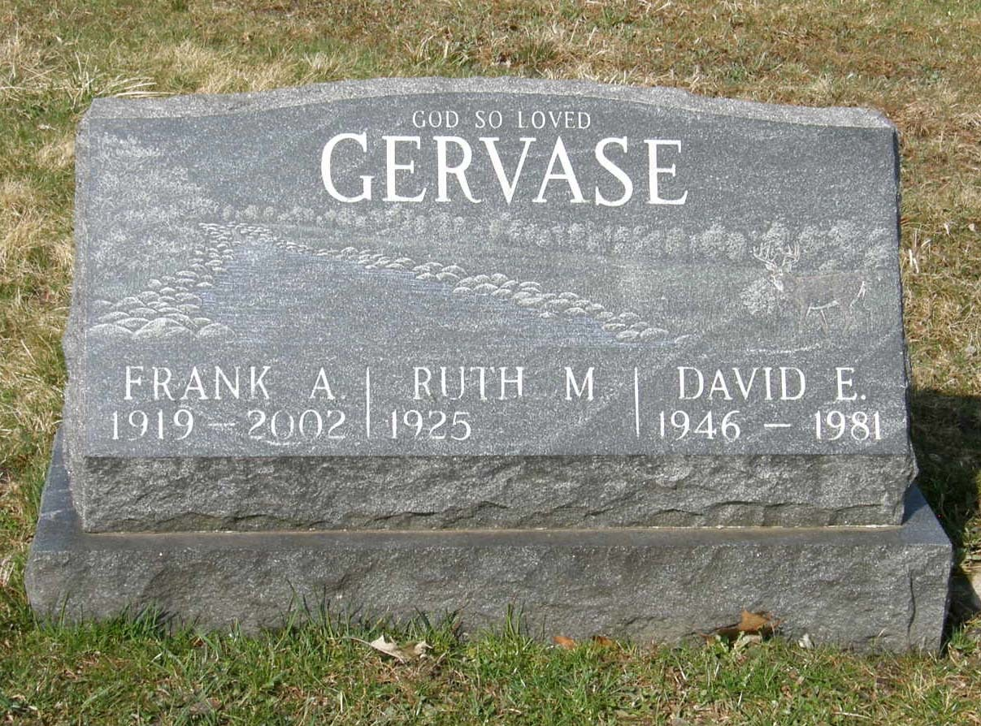

Slide 29
What about Steven Cabbott Thomas?
  Leader in Church of the Creator, a White Supremacist church
  Accessory in murder of US sailor Harold Mansfield, Jr. in 1991 in Jacksonville, Fla.

Slide 30
And the Garcias??

Slide 31
That’s all, folks!
Questions? Comments?

