Slide 1
THE JUDICIAL COUNCIL 1949-1951
Fred L. Borch
Professor Of Legal History & Leadership
Regimental Historian & Archivist
The Judge Advocate General’s Corps, U.S. Army
March 9, 2022

Slide 2
Bottom line up front
Not COMA, not CAAF; not even a half-step to civilian appellate court
  All military; not independent
  Limited authority
  Short-lived; Feb 1949 to May 1951

Slide 3
But worth talking about because . . .

Slide 4
Roadmap
  Some context:
        Ansell-Crowder Dispute (1918-20)
        Articles of War in a Citizen-Soldier Army (1941-45)

Slide 5
  Post-World War II Articles of War Reforms:
    Judicial Council
      Purpose & configuration
      Process
      Illustrative trial
  Conclusion

Slide 6
Some Context
Ansell-Crowder Dispute
What is the proper role of the commander in the military justice process?
Should courts-martial be more like civilian courts and, if so, to what extent?

Slide 7
Maj Gen Enoch H. Crowder
Born 1859, USMA 1881 (Cavalry), transferred to JAGD in 1891, tJAG (1911-1923)
  Provost Marshal General & Selective Service Act May 1917
  (67 percent of Army was drafted in World War I, compared with six percent in Civil War)
Notes:
Finding officers was major problem: 5800 Regular Army/ 3200 NG officers but Army needed 200,000 officers
54 divisions; 28,000 men each; 42 deployed to France

Slide 8
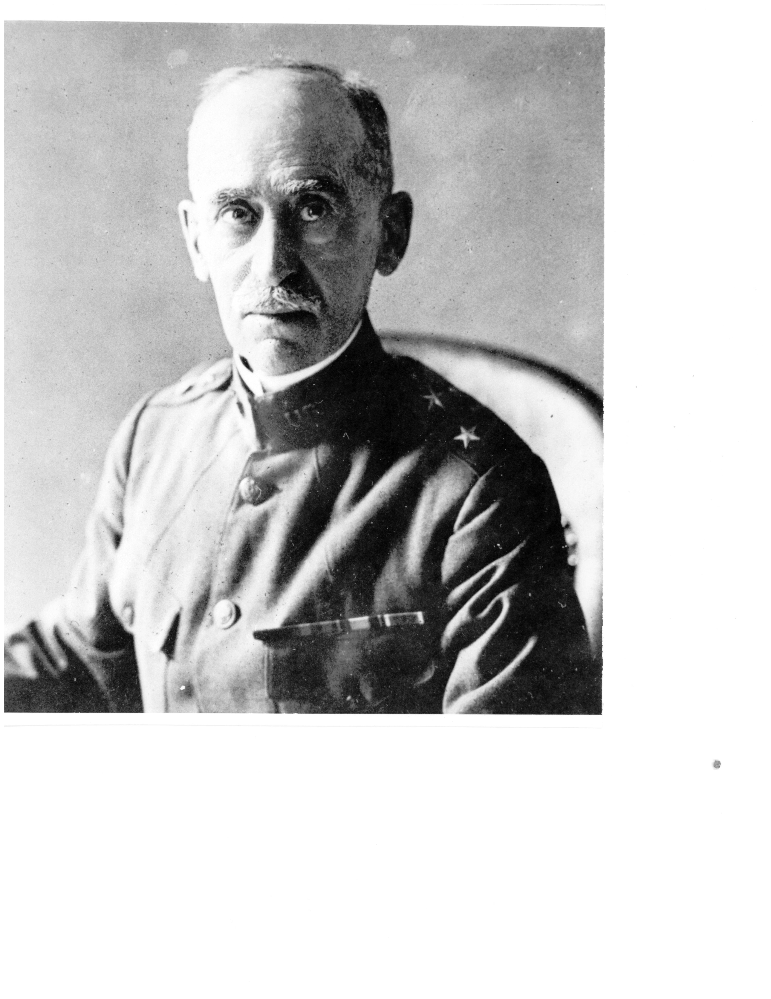

Slide 9
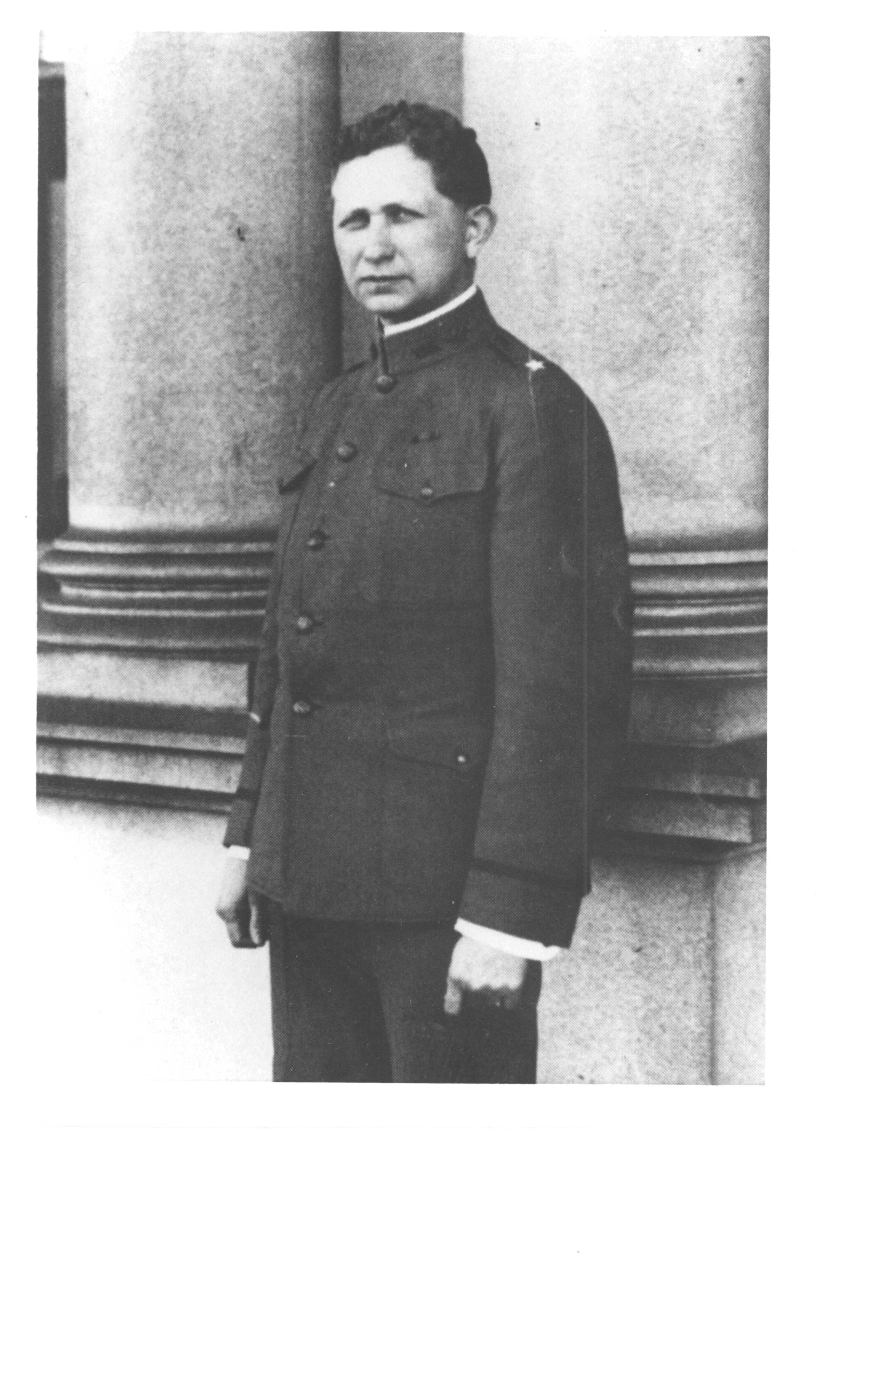

Slide 10
Brig Gen Samuel T. Ansell
Born 1875, USMA 1899 (Infantry), UNC law 1894
USMA 1904-1909; Prosecutor, Philippines 1909-1911; War Department 1911-1917
Acting tJAG, 1917-1918

Slide 11
How many CMs in 1918?
  20,000 (8,000 in 1917)

Slide 12
Catalyst for change
Houston Riot Cases –
Nov. 1917, Houston, Texas

Slide 13
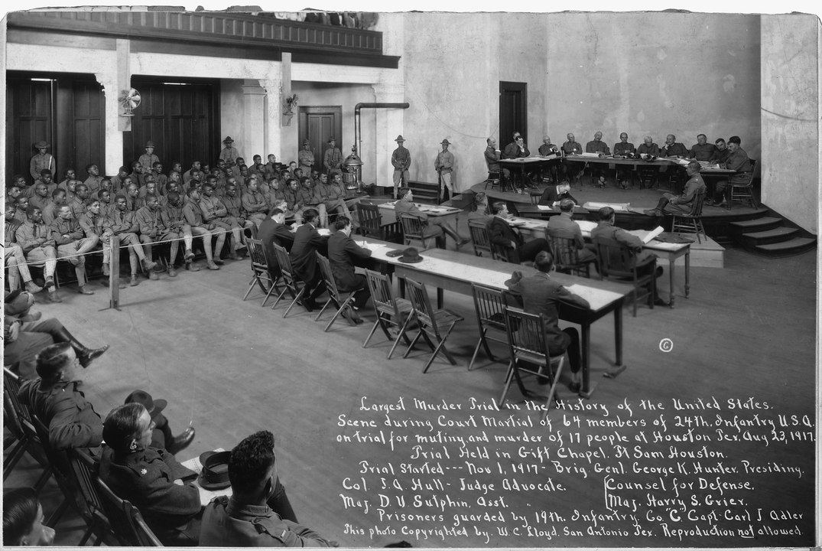

Slide 14
Facts
Trial
  63 accused
  Trial counsel
  Defense counsel
  Results?

Slide 15
Crowder’s view
Disciplining troops is the commander’s business . . .
If a commander is trusted to take 15,000 men into combat, then . . .

Slide 16
Ansell & Others
December 1918: Senator George Chamberlain (Oregon) says there must be an appellate tribunal that will “formulate rules and equalize unjust sentences”
(CM results are arbitrary, capricious . . . and no uniformity in results)

Slide 17
Ansell launches public campaign & proposes:

Slide 18
New Appellate Court
  Three civilian judges
  Lifetime tenure; pay & retirement of U.S. Court of Appeals judge

Slide 19
  Jurisdiction over all GCMs where sentence of death, DD/dismissal, confinement more than 6 months
  (no review of SPCMs or SCMs)
  Power to disapprove finding of guilty, or approve lesser included offense

Slide 20
  Power to disapprove sentence in whole or in part
  Power to order new trial

Slide 21
Result??
    No civilian court of appeals, but Art. 50 ½ required tJAG to establish Board of Review of three more or more officers to review records of trial
    (first statutory basis for appellate review; forerunner of CsMR and CsCA)

Slide 22
Articles of War (1941-45)
Widespread complaints, chiefly about command influence
  80,000 GCMs (11 million in Army)
  1.7 million total CMs
  (How many total CMs last year?)

Slide 23
  Reform Articles of War
(What is Army [JAGD] worried about? loss of control = indiscipline)

Slide 24
Some reforms:
  Enlisted soldiers on panels
  Trial & defense counsel must be attorneys
  Military judge?

Slide 25
Article 50:
  TJAG shall “constitute, in his office,” Board of Review of not less than three officers of JAGD . . .
  TJAG shall “constitute, in his office,” a Judicial Council of three general officers of JAGD

Slide 26
Judicial Council within OTJAG
  Additional Boards & Councils authorized at discretion of TJAG

Slide 27
Who is a member of the Judicial Council?

Slide 28
Three JA general officers detailed by TJAG
But TJAG could detail non-GOs under ‘exigent circumstances” (and did)
And what are “exigent circumstances?”

Slide 29
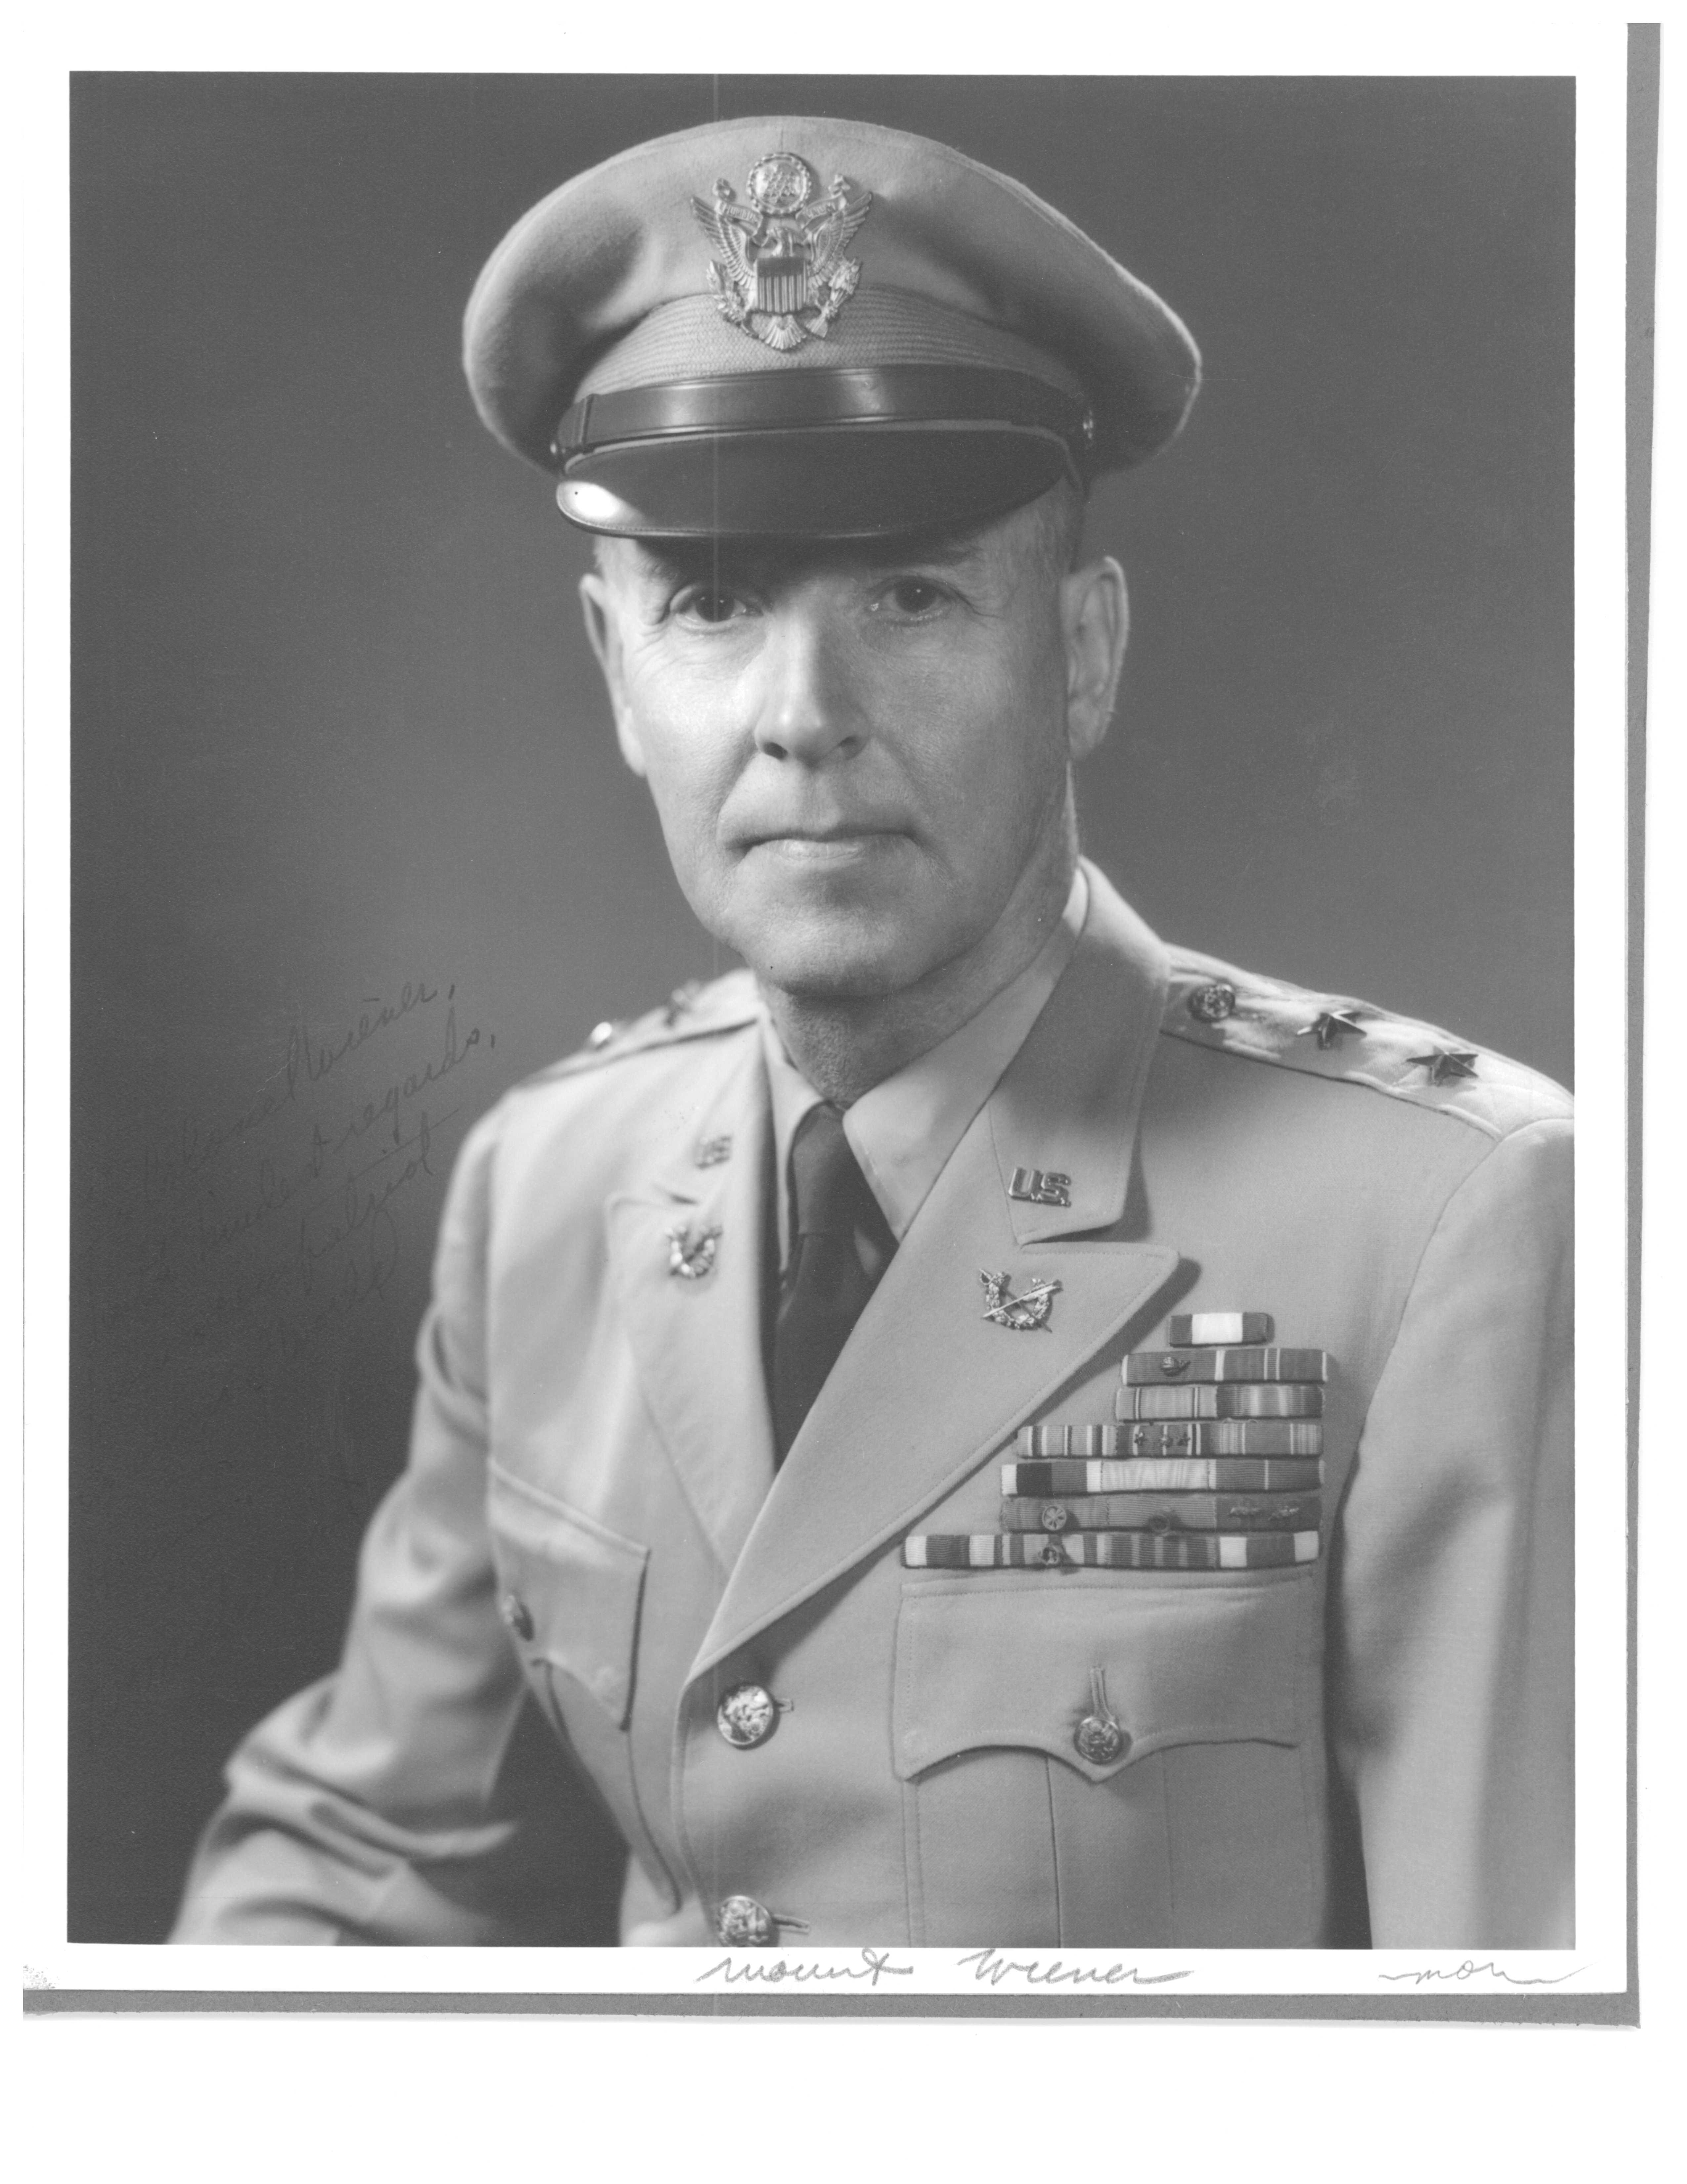
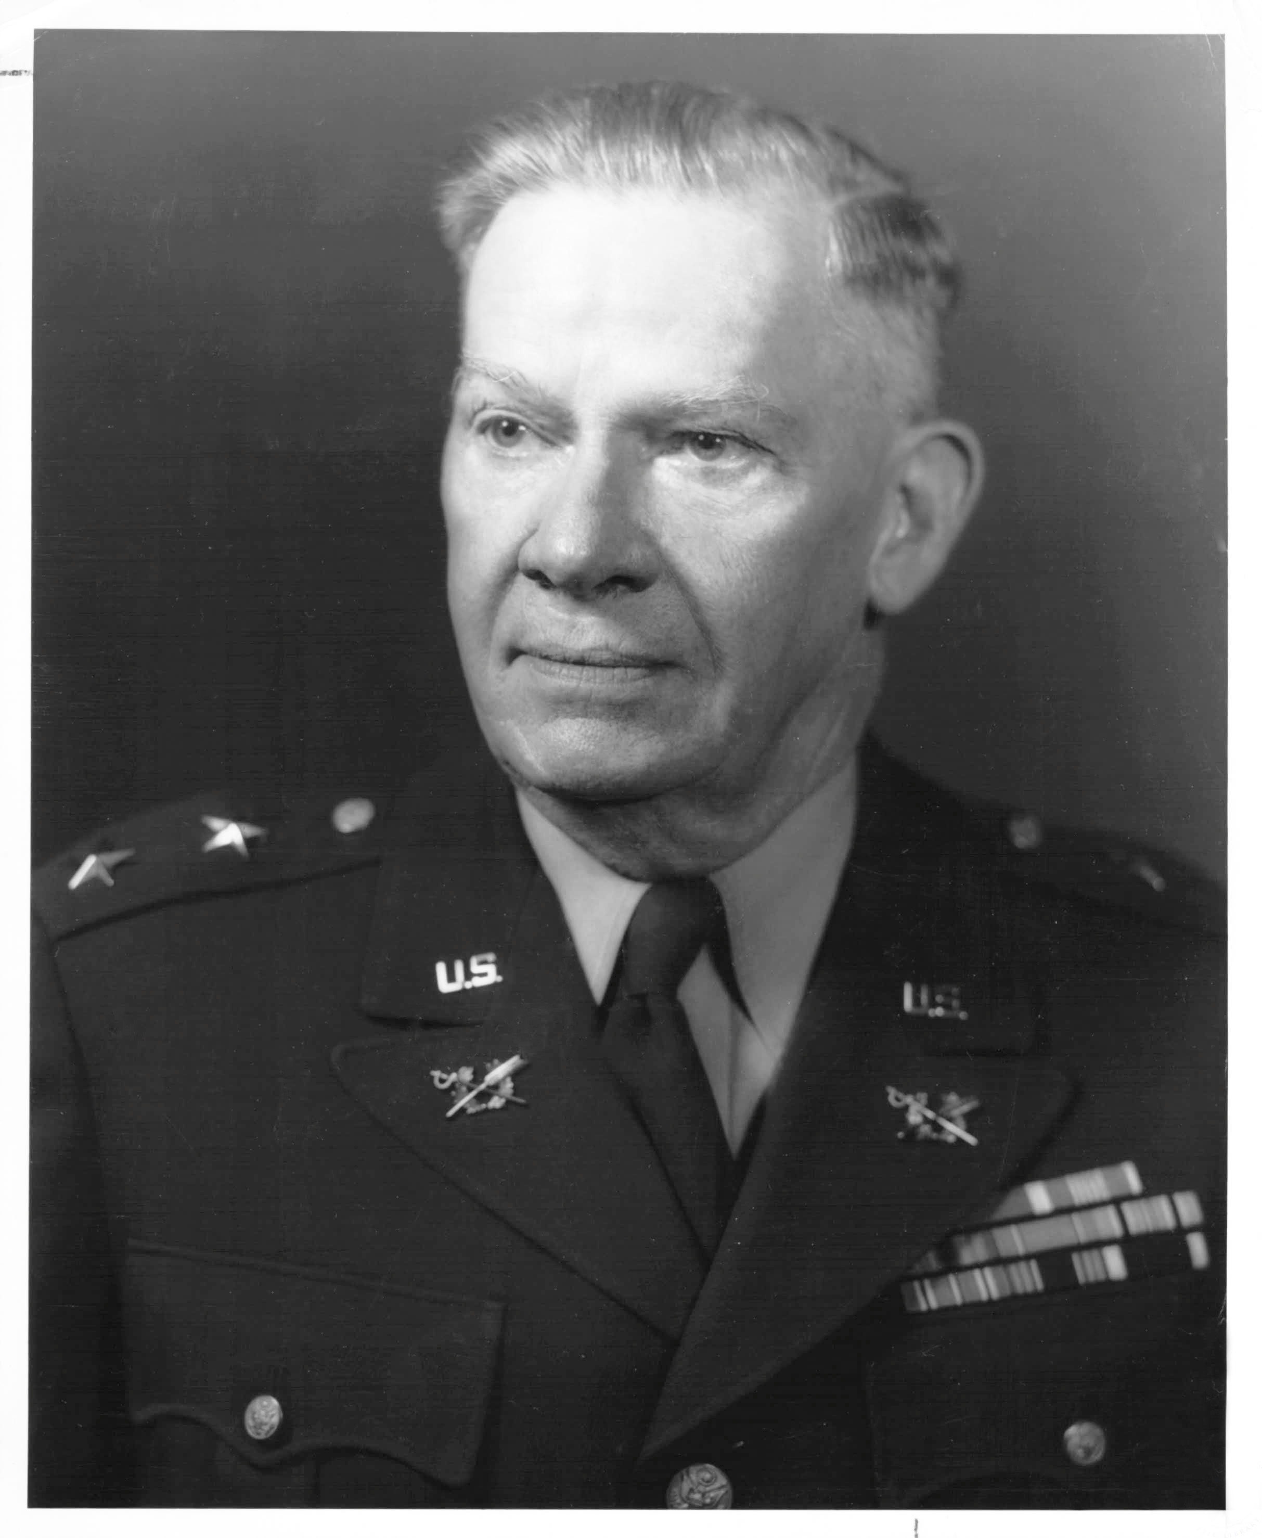

Slide 30
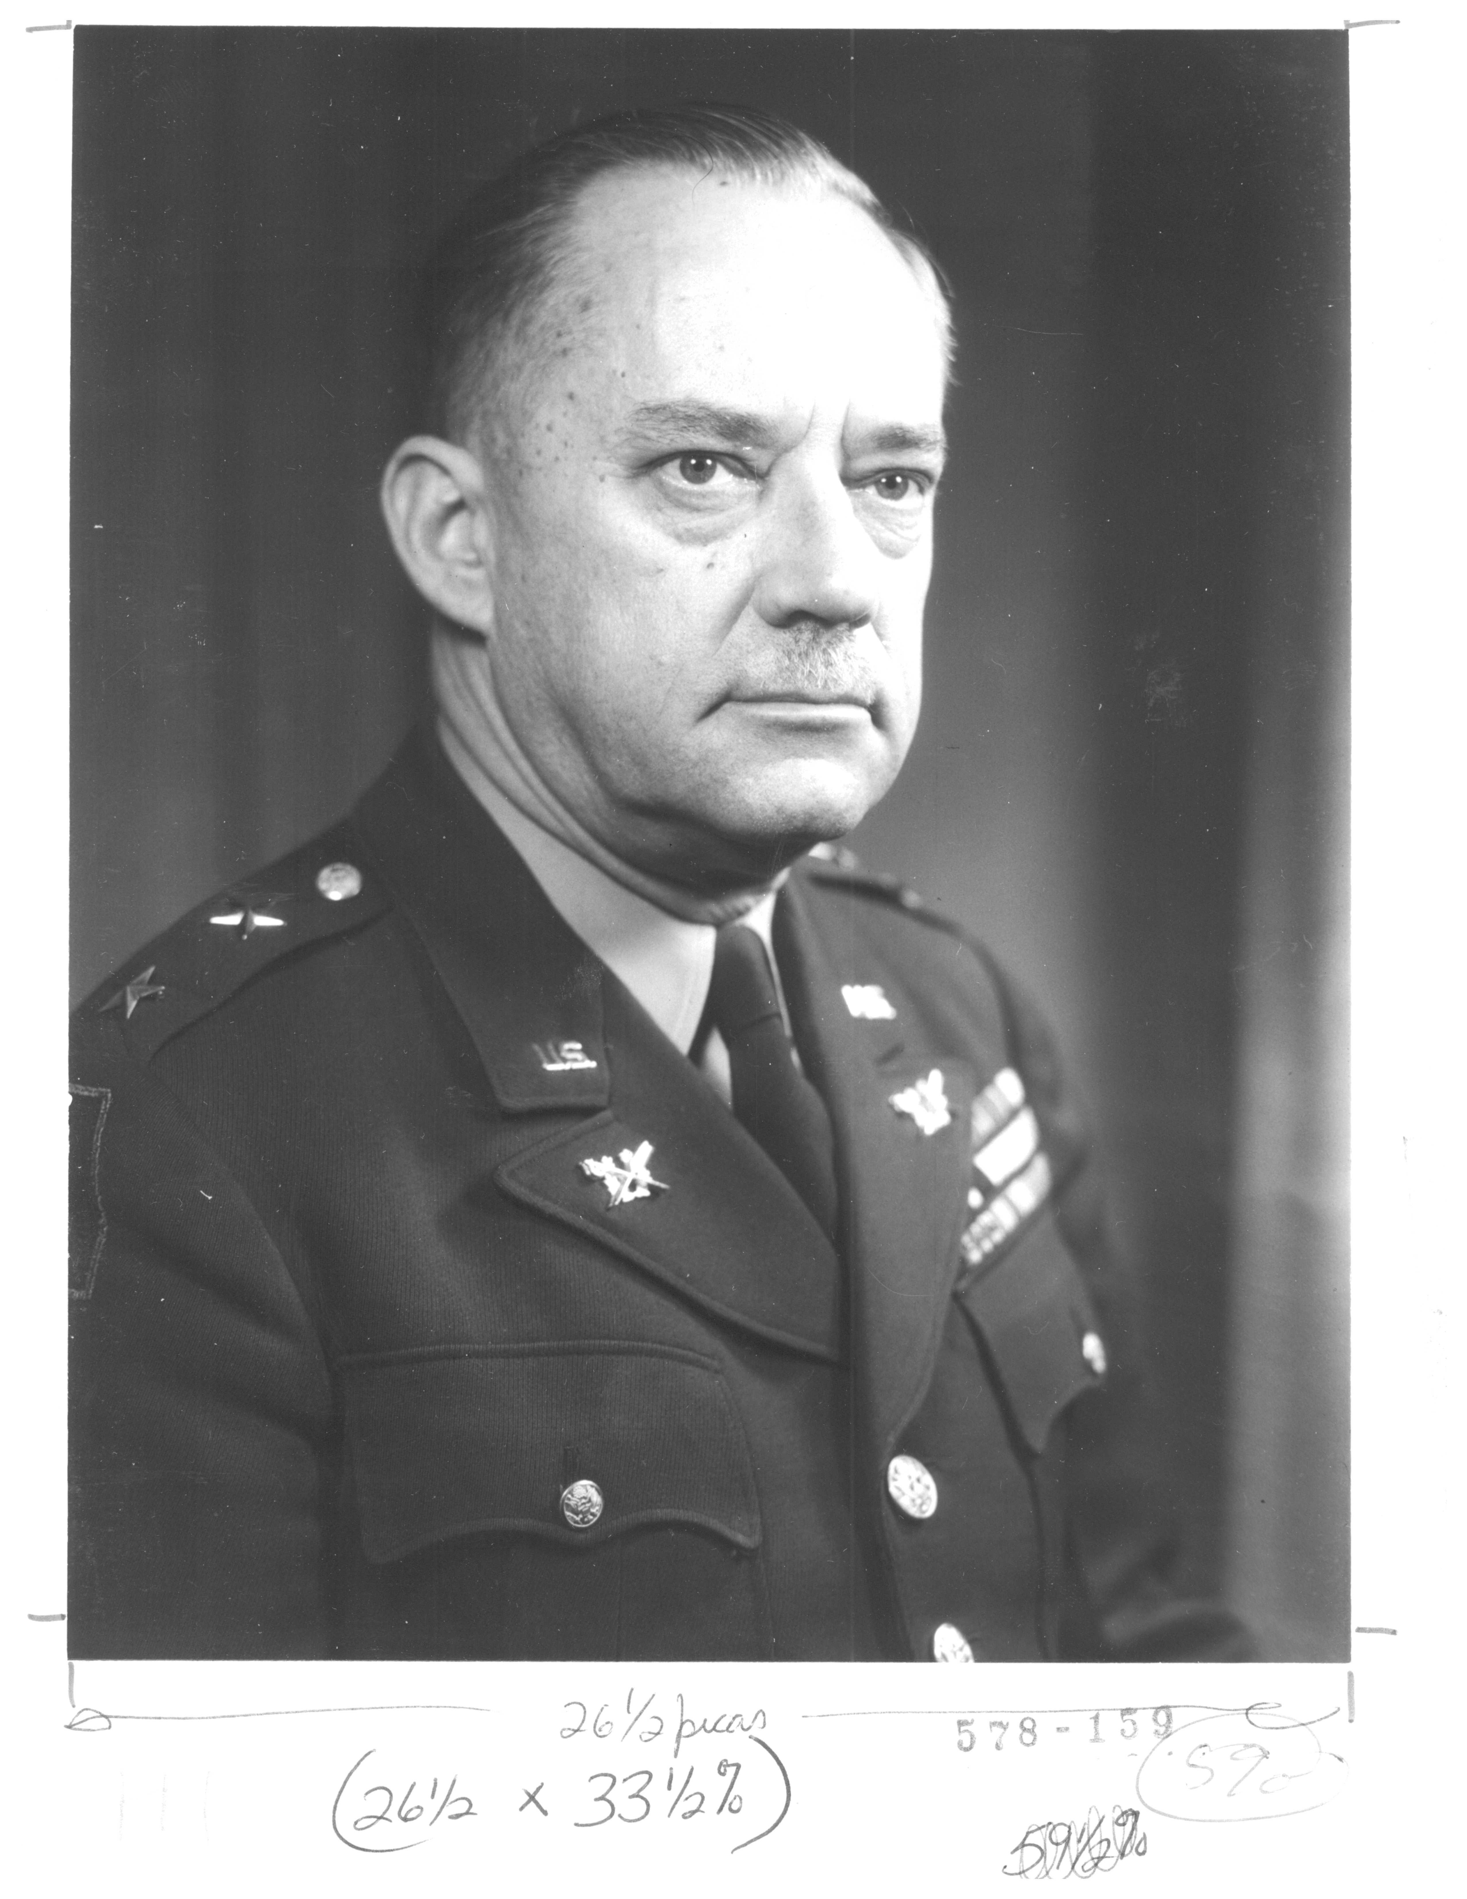
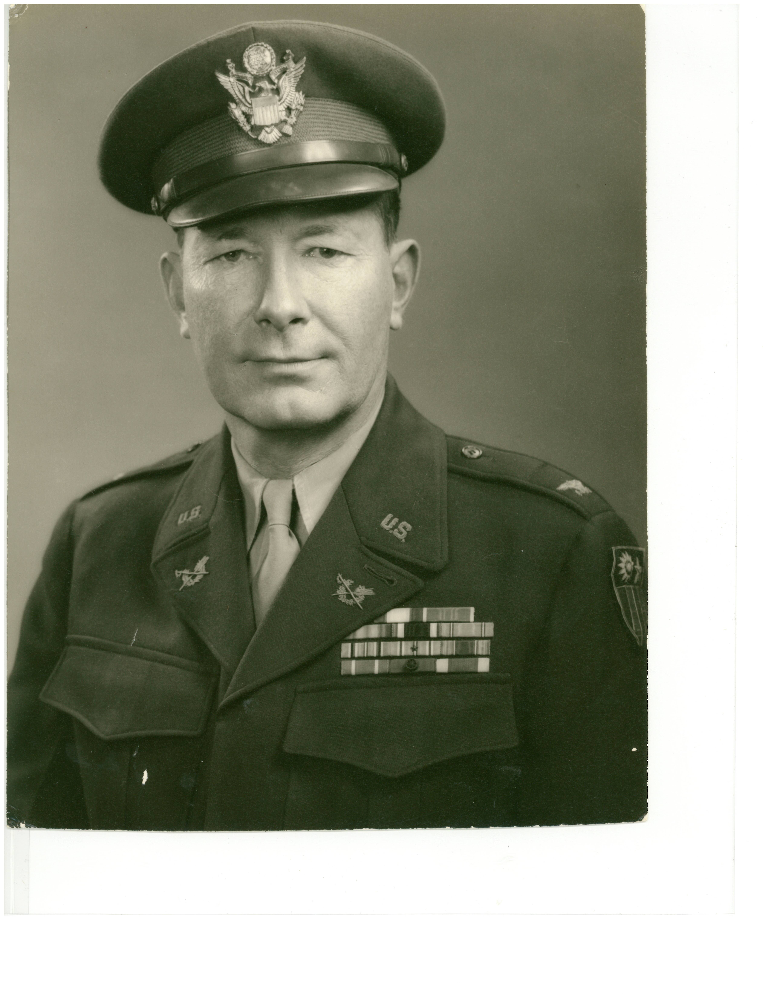

Slide 31
Authority of Judicial Council
  Primarily a confirming authority
  (e.g., prior to 1947, president required to confirm all officer dismissals)

Slide 32
  Confirmation power under AW
    Approve, disapprove finding of guilty &/or sentence
    Approve finding of guilty of lesser included offense
    Restore rights, privileges, etc. affected by disapproved finding

Slide 33
All “appellate agencies” within OTJAG have authority to “weigh evidence, judge credibility of witnesses and determine controverted questions of fact”

Slide 34
  But Judicial Council did not have authority to “mitigate, remit or suspend” any sentence (no clemency power)
  So any recommendation for clemency went to TJAG

Slide 35
And what if TJAG disagreed with Judicial Council??

Slide 36
Judicial Council Procedure
ROT referred to Council
Accused may appear, may submit briefs; may argue
Legally sufficient?

Slide 37
Did any errors prejudice “substantial rights” of accused?
Allied papers & accused military records examined to determine “propriety” of sentence

Slide 38
If Judicial Council agreed with Board of Review, then no opinion (& confirmation)
If Judicial Council disagreed with Board of Review, then confirmation with written opinion to TJAG

Slide 39
  But what if TJAG disagrees with Judicial Council?
  Then confirmation decision goes to SECARMY

Slide 40
Cases
First 12 months (Feb 1949-Feb 1950)
  79 GCMs; 2 SPCMs
  Including 6 death penalty CMs, 61 officer dismissal CMs, 9 life sentence CMs
(Judicial Council superseded by COMA on 31 May 1951)

Slide 41
Illustrative Court-Martial
United States v. Leon Gilbert

Slide 42
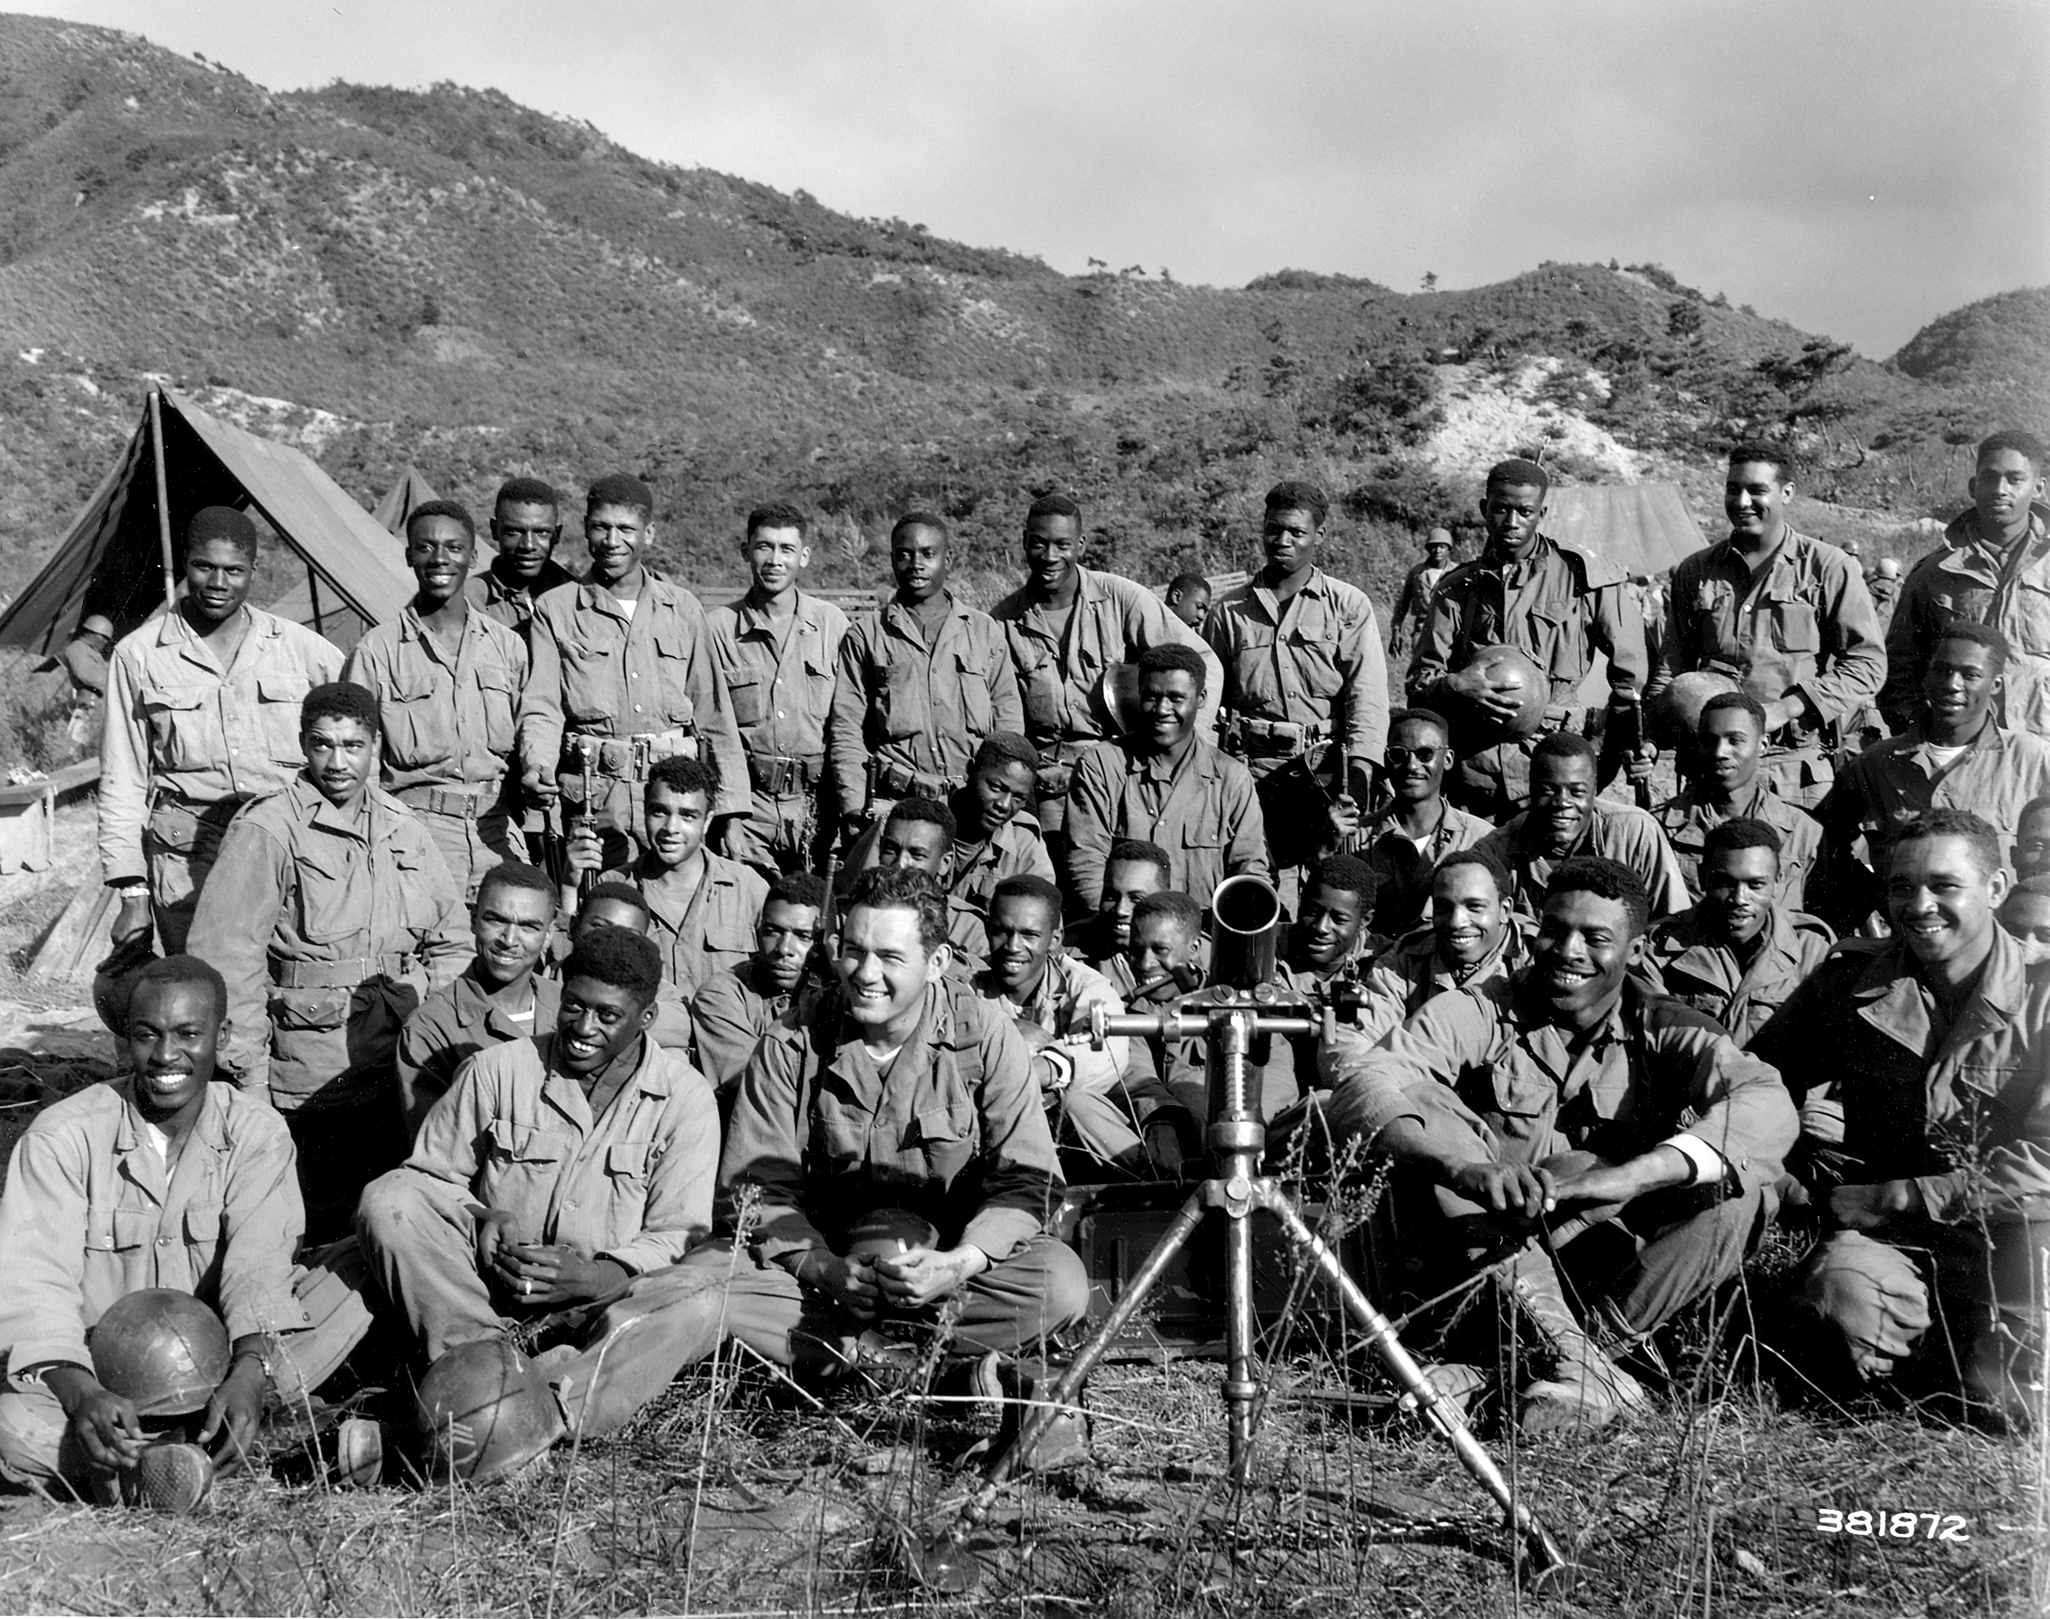

Slide 43
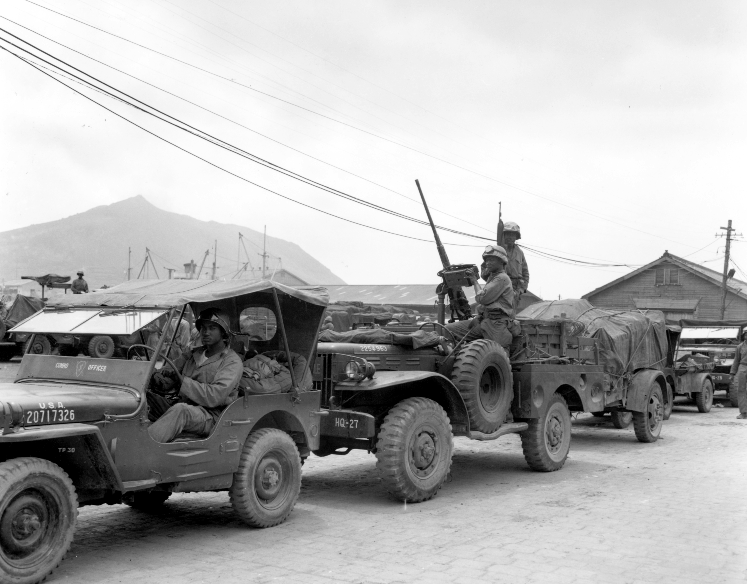

Slide 44
“Misbehavior Before the Enemy”
Violation of 75th Article of War:
  . . . did, at Sangju, Korea, on or about 31 July 1950, misbehave himself before the enemy, by refusing to advance with his command, which had been ordered forward by Colonel White, to engage with North Korean forces.

Slide 45
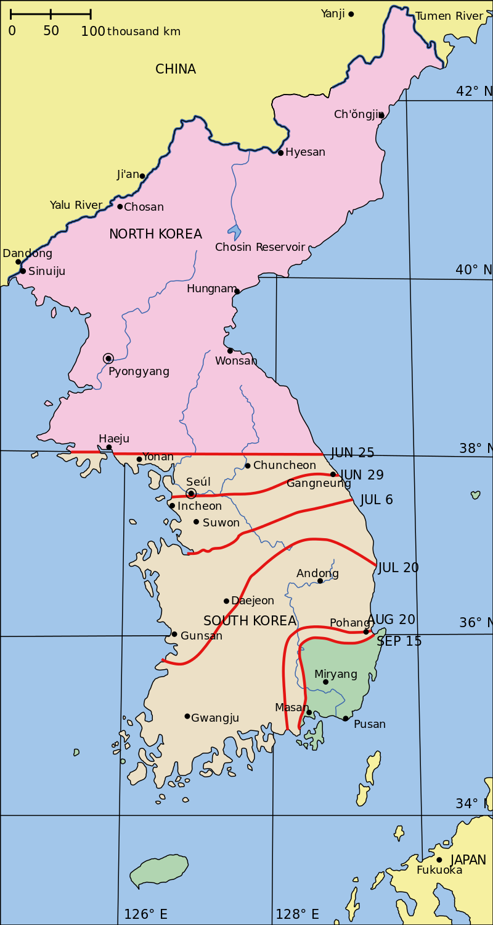

Slide 46
31 July 1950, Sangju, Korea
Company A, 24th Infantry Regt
  Occupied right flank of Regimental “outpost line of resistance” (OPLR)

Slide 47
COL White, Regimental Cdr: “Return to the front, to the OPLR”
Gilbert: “Yes sir.”

Slide 48
20 min. later, at Regt CP:
Gilbert to White: “I’m scared; I will not go back to the OPLR.”

Slide 49
White to Gilbert: “Do you understand the seriousness of your refusal?”

Slide 50
General Court-Martial: “Misbehavior before the Enemy”
  Trial 200 yards from front
  (Note: UCMJ enacted but not in effect)

Slide 51
    25, 26 Aug; 5, 6 Sept 1950
    Testimony at trial

Slide 52
    Defense?
      Lack of mental responsibility
        World War II in Italy
        Medical examination . . .
      Gilbert did not testify
  Guilty

Slide 53
Sentence?

Slide 54
(Inchon – 15-19 September 1950)

Slide 55
Board of Review
  9 Oct 1950
  Evidence is “legally insufficient” to support verdict
  Why? b/c prosecution failed to prove Gilbert’s sanity beyond a reasonable doubt

Slide 56
But perhaps because . . .

Slide 57
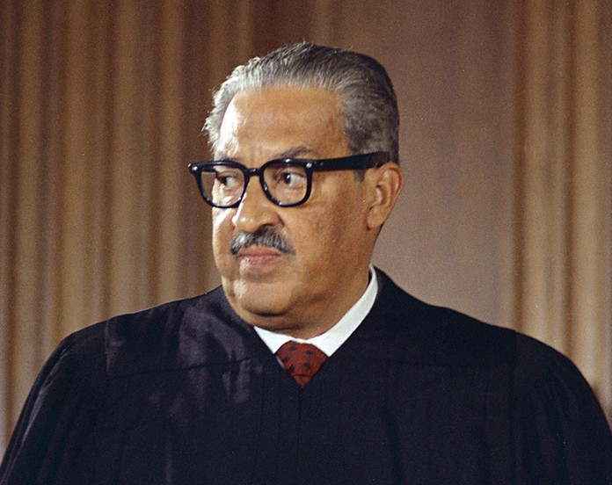

Slide 58
Judicial Council
  10 Nov 1950
  Gilbert is mentally responsible; sufficient evidence to support verdict, but . . .

Slide 59
Recommends Truman commute sentence to dismissal and 30 years confinement at hard labor

Slide 60
TJAG recommends . . .

Slide 61
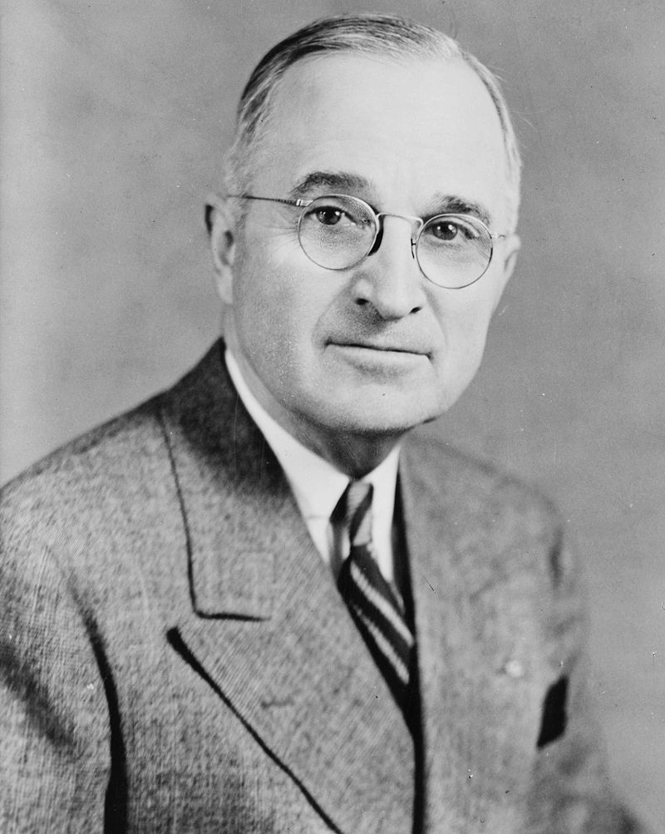

Slide 62
27 November 1950
Truman commutes Gilbert’s sentence to dismissal and 20 years confinement at hard labor

Slide 63
Conclusion
Judicial Council was:
  Short-lived appellate experiment
  Real reform?

Slide 64
That’s all, folks!
Questions? Comments?

