Slide 1
MRE 413 Five Years After united states v. hills

Slide 2
Part I
1. Background
2. Analysis
3. Conclusion

Slide 3
Survey!

Slide 5
The VIOLENT CRIME CONTROL AND LAW ENFORCEMENT ACT
And an unusual course of business

Slide 6
FRE 413/414 → MRE 1102 → Mre 413/414
An exception to the ordinary rule against propensity

Slide 7
United States v. Wright, 53 M.J. 476 (C.A.A.F. 2000)
MRE 413 is constitutional provided
MRE 403 balancing test
Proper instructions

Slide 8
And then there was hills
Below—
ACCA: “Case of first impression”
5-0

Slide 9
United States v. Hills--Construction
Textual Structure
Notice provision could only speak to uncharged misconduct.
Charged misconduct is admissible.
Legislative History
Discussed only uncharged misconduct*

Slide 10
Congressional Record

Slide 11
Congressional Record

Slide 12
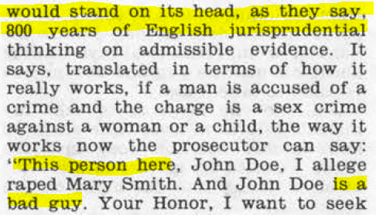
Congressional Record

Slide 13
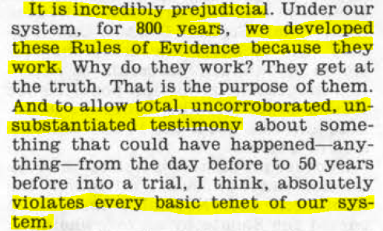
Congressional Record

Slide 14
If not 800, at least 300 years!
"Hold, what are you doing now? Are you going to arraign his whole life? Away, away, that ought not to be; that is nothing to the matter."
Harrison’s Trial, 12 How. St. Tr. 834, 864 (Old Bailey 1692)

Slide 15
United States v. Hills--Construction
Legislative History
Congress amended the Federal Rules of Evidence.
Not the Military Rules of Evidence.
Consider RCM 601(d).

Slide 16
United States v. Hills--Instruction
Each offense must stand on its own, and you must keep the evidence of each offense separate....
The burden is on the prosecution to prove each and every element of each offense beyond a reasonable doubt. Proof of one offense carries with it no inference that the accused is guilty of any other offense.

Slide 17
United States v. Hills--Instruction
First, you must determine by a preponderance of evidence that it is more likely than not that the sexual assault offense occurred;
If you determine by a preponderance of the evidence that one or more of the offenses alleged in Specifications 1, 2, or 3 of the Charge occurred, even if you are not convinced beyond a reasonable doubt that the accused is guilty of one or more of those offenses, you may nonetheless consider the evidence of such offenses, or its bearing on any matter to which it is relevant in relation to the other sexual assault offenses;
You may also consider the evidence of such other acts of sexual assault for its tendency, if any, to show the accused's propensity to engage in sexual assault.

Slide 18
United States v. Hills--Instruction
First, you must determine by a preponderance of evidence that it is more likely than not that the sexual assault offense occurred;
If you determine by a preponderance of the evidence that one or more of the offenses alleged in Specifications 1, 2, or 3 of the Charge occurred, even if you are not convinced beyond a reasonable doubt that the accused is guilty of one or more of those offenses, you may nonetheless consider the evidence of such offenses, or its bearing on any matter to which it is relevant in relation to the other sexual assault offenses;
You may also consider the evidence of such other acts of sexual assault for its tendency, if any, to show the accused's propensity to engage in sexual assault.

Slide 19
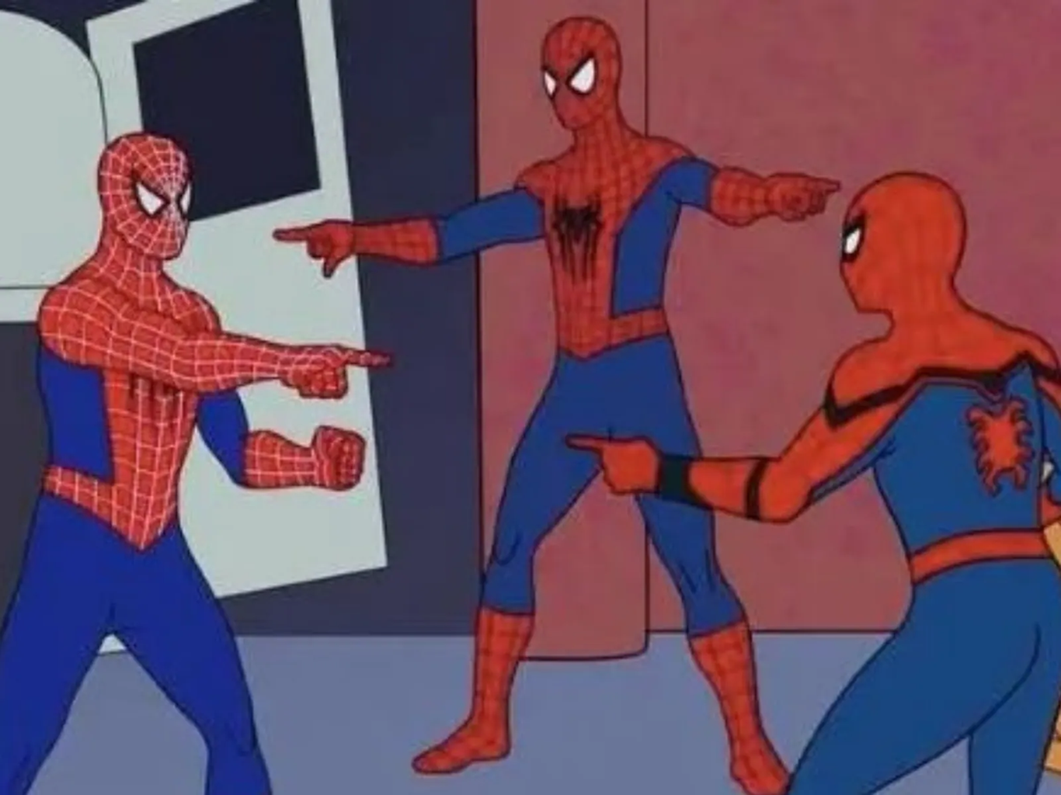
Ch II Spec 3
Ch I Spec 2
Ch II Spec 1

Slide 20
United States v. Hukill, 76 M.J. 219 (C.a.A.F. 2017)
Apply Hills reasoning to CMs by MJ alone
5-0

Slide 21
United States v. Guardado, 77 M.J. 90 (C.a.A.F. 2017)
“We are not convinced that any harm that resulted from allowing propensity evidence from one specification was necessarily extinguished by an acquittal of that same specification.”
5-0

Slide 22
United States v. Williams, 77 M.J. 459 (C.a.A.F. 2018)
There is no “flow” exception to charged propensity.
Overwhelming corroborating evidence can result in HBRD.
Also, RCM 810(d) only helps so much.
5-0

Slide 23
United States v. hazelbower, 78 M.J. 12 (C.a.A.F. 2018)
Decision without published opinion. HBRD. Possibly HB*U*D.
Unpublished

Slide 24
United States v. tovarchavez, 78 M.J. 458 (C.a.A.F. 2019)
Clear and obvious forfeited constitutional errors are reviewed for HBRD
3-2: Dissent—Shouldn’t use HBRD standard for forfeited nonstructural constitutional errors

Slide 25
United states v. Prasad, 80 M.J. 23 (C.A.A.F. 2020)
Convicted pre-Hills of three offenses, AFCCA set aside one and affirmed two.
The convening authority dismissed the set-aside charge and ordered a rehearing.
AFCCA affirmed.
CAAF set aside the remaining two specifications.
3-2: Disagreement about prejudice

Slide 26
United States v. Upshaw, 81 M.J. 71 (C.a.A.F. 2021)
“We are not convinced that, under these circumstances, the evidence against Appellant reaches the level of overwhelming.”
3-2: Disagreement about prejudice

Slide 27
United States v. Long, 81 M.J. 362 (C.a.A.F. 2021)
Greer v. United States, 141 S. Ct. 2090 (2021) may change the forfeited constitutional error analysis, but here the court finds material prejudice to Appellant’s substantial rights under Art. 59(a), so moot.
5-0

Slide 28
United States v. Adams, 81 M.J. 475 (C.a.A.F. 2021)
Hills + rehearing + new preferral + 2016 statute of limitations amendment = Hold on to your seat.
ACCA: “[various appellate dispositions] change[] the landscape to a degree which precludes a confident reassessment of the sentence in consideration of the remaining offenses.”

Slide 29
United States v. moore, 79 M.J. 483 (C.a.A.F. 2019)
Below, ACCA set aside five of six findings for MRE 413 reasons, but on authorizing a rehearing, contemplated the government using the affirmed specification as MRE 413 propensity evidence for those specifications undergoing rehearing.

Slide 30
There and Back Again, a Sample
U.S. v. Arturo A. Tafoya. CCA 20140798
U.S. v. William P. Moynihan. CCA 20130855
U.S. v. Gene N. Williams. CCA 20130582
U.S. v. Douglas E. Reynolds, Jr. CCA 20140856

Slide 31
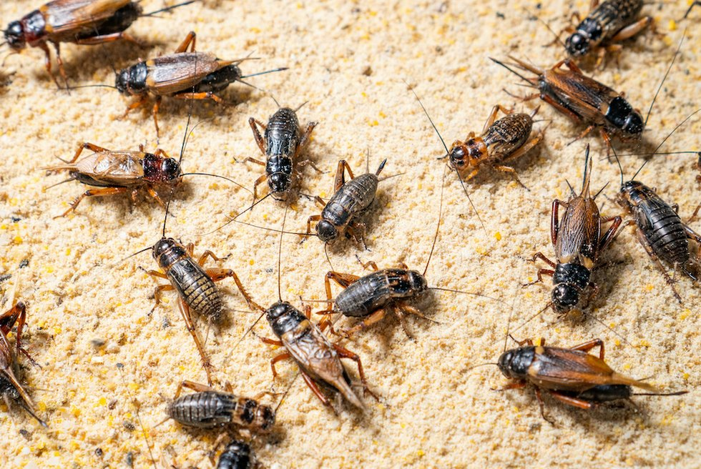

Slide 33
Post-conviction efforts
United States v. Lewis (A.F. Ct. Crim. App. 2017)
Lewis v. United States (9th Cir. 2021)
Burleson v. United States, (N-MC Ct. Crim. App. Feb. 26, 2018)
Evans v. Horton (10th Cir. 2019)
Coleman v. Commandant, USDB (D. Kan. Nov. 22, 2019)
Ward v. United States (4th Cir. 2020)
Teague v. Lane, (1989) + Edwards v. Vannoy, (2021)

Slide 34
Part II
Current Trial Counsel/Prosecutor Considerations
Old Instructions Could Have Worked
Why We Need This Rule

Slide 35
GOING FORWARD: INTERESTING INCENTIVES

Slide 36
Two Possible Tracks
Judicial Economy
Full MRE 413

Slide 37
Judicial Economy
One Trial –
If you think BARD, charge and no MRE 413 instruction
If unsure BARD, don’t charge and MRE 413 instruction

Slide 38
Judicial Economy
Advantages
Disadvantages
Judicial Economy – cost/time savings
Victims only testify once (minimize revictimization)
Mistrial/Remand if trial counsel steps over line and brings up propensity
All or nothing
Leaving MRE 413 in your quiver
No conviction?
Explaining to victim why not using all tools

Slide 39
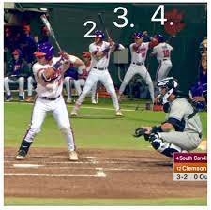
Full MRE
First trial:
-Use victim/charge with best set of facts, leaving other victims/charges uncharged, using MRE 413 for all others
-If no conviction, move onto next victim/offense
Second trial:
-Use next best victim/charge, all other
victims/charges uncharged with MRE 413
Third Trial, etc.: repeat the process

Slide 40
Full MRE
Advantages
Disadvantages
Full MRE – total advantage of propensity instructions
No chance of inadvertent mistrial/remand for improper propensity
Multiple chances for conviction(s)
Revictimization (multiple trials)
Possible unwillingness to continue
Cost/time
Same Panel?

Slide 41
Full MRE – RCM Considerations
-RCM 601(e)(2): “Ordinarily all known charges should be referred to a single court martial.”
-RCM 601(d)(1)’s discussion: CA not not obligated to refer all charges which the evidence might support
-RCM 601(e)(2): joinder is “in the discretion of the convening authority.”

Slide 42
Defense Considerations
Which scenario would you advise your client is better?
Multiple trials has multiple exposure and propensity instructions
One trial has more exposure at one time (chance of one set of unfavorable jurors) and implicit problems of having multiple charges/victims in front of one panel

Slide 43
TC Considerations
Regardless of Charging/Trial Methodology – Communication and relationship with SVC/VLC and their clients are paramount
Must communicate WHY charges related to their assault are being charged or not charged
Must understand victims’ desired outcomes (e.g. can you stop after a conviction on another charge?)

Slide 44
Other Thoughts/Considerations
Instructional problems with charged misconduct as MRE 413 evidence falls into two categories:
Confusion based on the instructions (juggling preponderance and BARD)
Violating Presumption of Innocence for charged offenses
Shouldn’t an Accused be presumed innocent of all allegations, charged or uncharged? Is Hills just a half-measure where the Court should declare all of MRE 413 invalid?

Slide 45
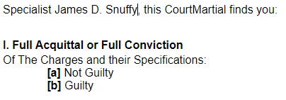
Other Thoughts/Considerations
DOES PRESUMPTION OF INNOCENCE MEAN COMPLETELY INNOCENT IF NOT CONVICTED?
We don’t declare innocence

Slide 46
Instruction Difficulty/Pres. Of Innocence
How hard were those old instructions?
Just follow an Order of Operations (evaluate in order on sheet) :
Charge II, Spec 1
Charge I, Spec 1
51%
51%
BARD
51%

Slide 47
Instruction Difficulty/Pres. Of Innocence
How hard were those old instructions?
Just follow an Order of Operations (then next one):
Charge I, Spec 1
Charge II, Spec 1
51%
51%
BARD
BARD

Slide 48
Instruction Difficulty/Pres. Of Innocence
How hard were those old instructions? ALTERNATIVE VIEW
Just follow an Order of Operations (then next one):
Charge I, Spec 1
Charge II, Spec 1
If not BARD, then goes back to 0%/Innocent
Charge II, Spec 1
51%
51%
51%
BARD
BARD
51%

Slide 49
Why MRE 413, Not 404(b)?
Why MRE 413 when MRE 404(b) was available?
Courts were unlikely to use MRE 404(b) for sexual assault.
When MRE 404(b) was used, it was mostly Modus Operandi or other use when IDENTITY was in question…Courts predominantly eschewed using MRE 404(b) for acquaintance rape/sexual assault.

Slide 50
Why MRE 413, Not 404(b)?
Why MRE 412 when MRE 403?
Why did we need a MRE to keep out “other sexual behavior” or “sexual predisposition” evidence?
Because Courts were allowing evidence of clothing choices, number of sexual encounters with other men, whether the victim was on birth control.

Slide 51
Why MRE 413, Not 404(b)?
Why did we have to gut Art 32s/MRE 405?
Victim on stand for >20 hours

